Slide 1
2022-2023 Water Level Results and a look a the KGS Water Balance / Q-Stable Analysis
Southwest Kansas Groundwater Management District No. 3 Annual Meeting
Ulysses, KS March 8, 2023
Kansas Geological Survey
University of Kansas

Slide 2
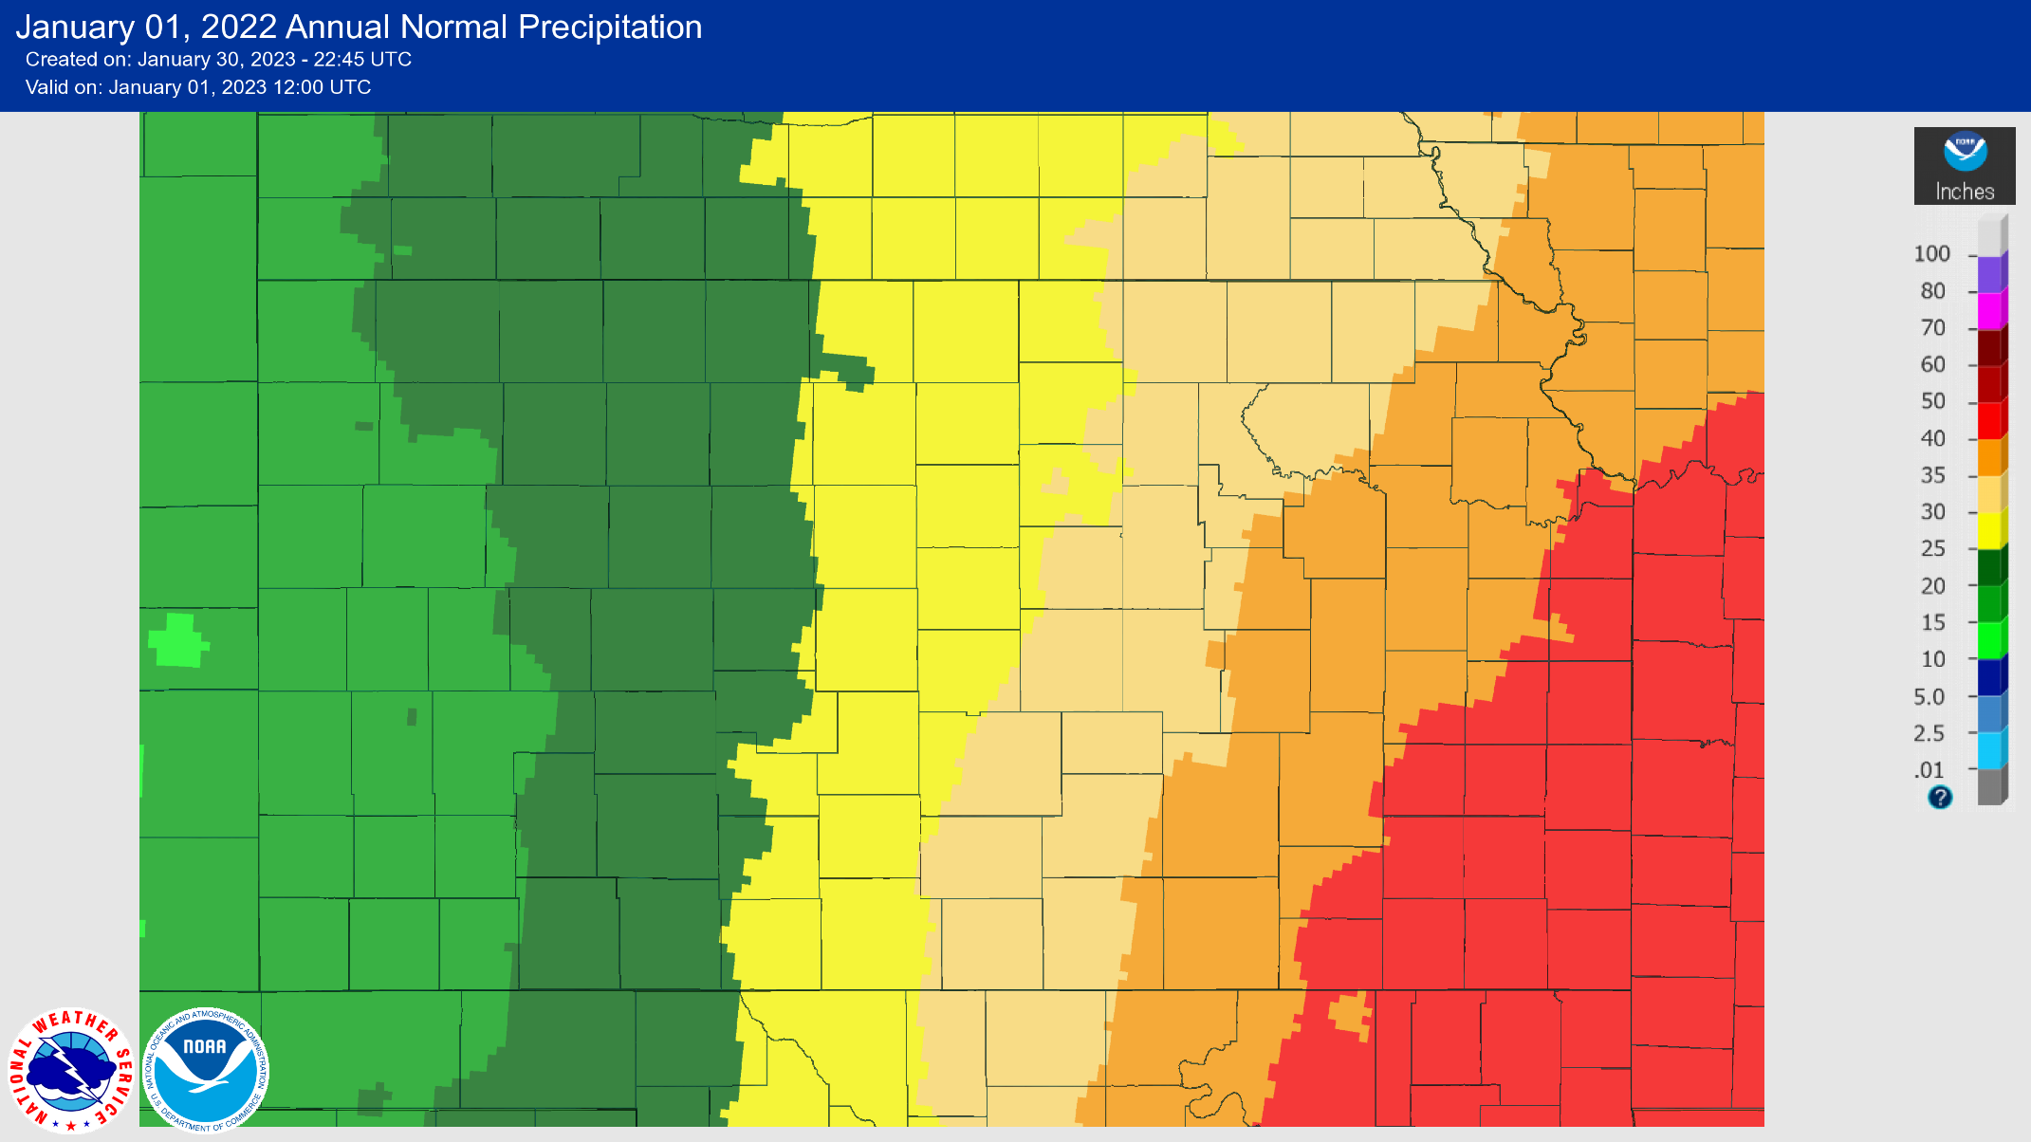
1991 to 2020 Normal Precipitation
Kansas Geological Survey

Slide 3
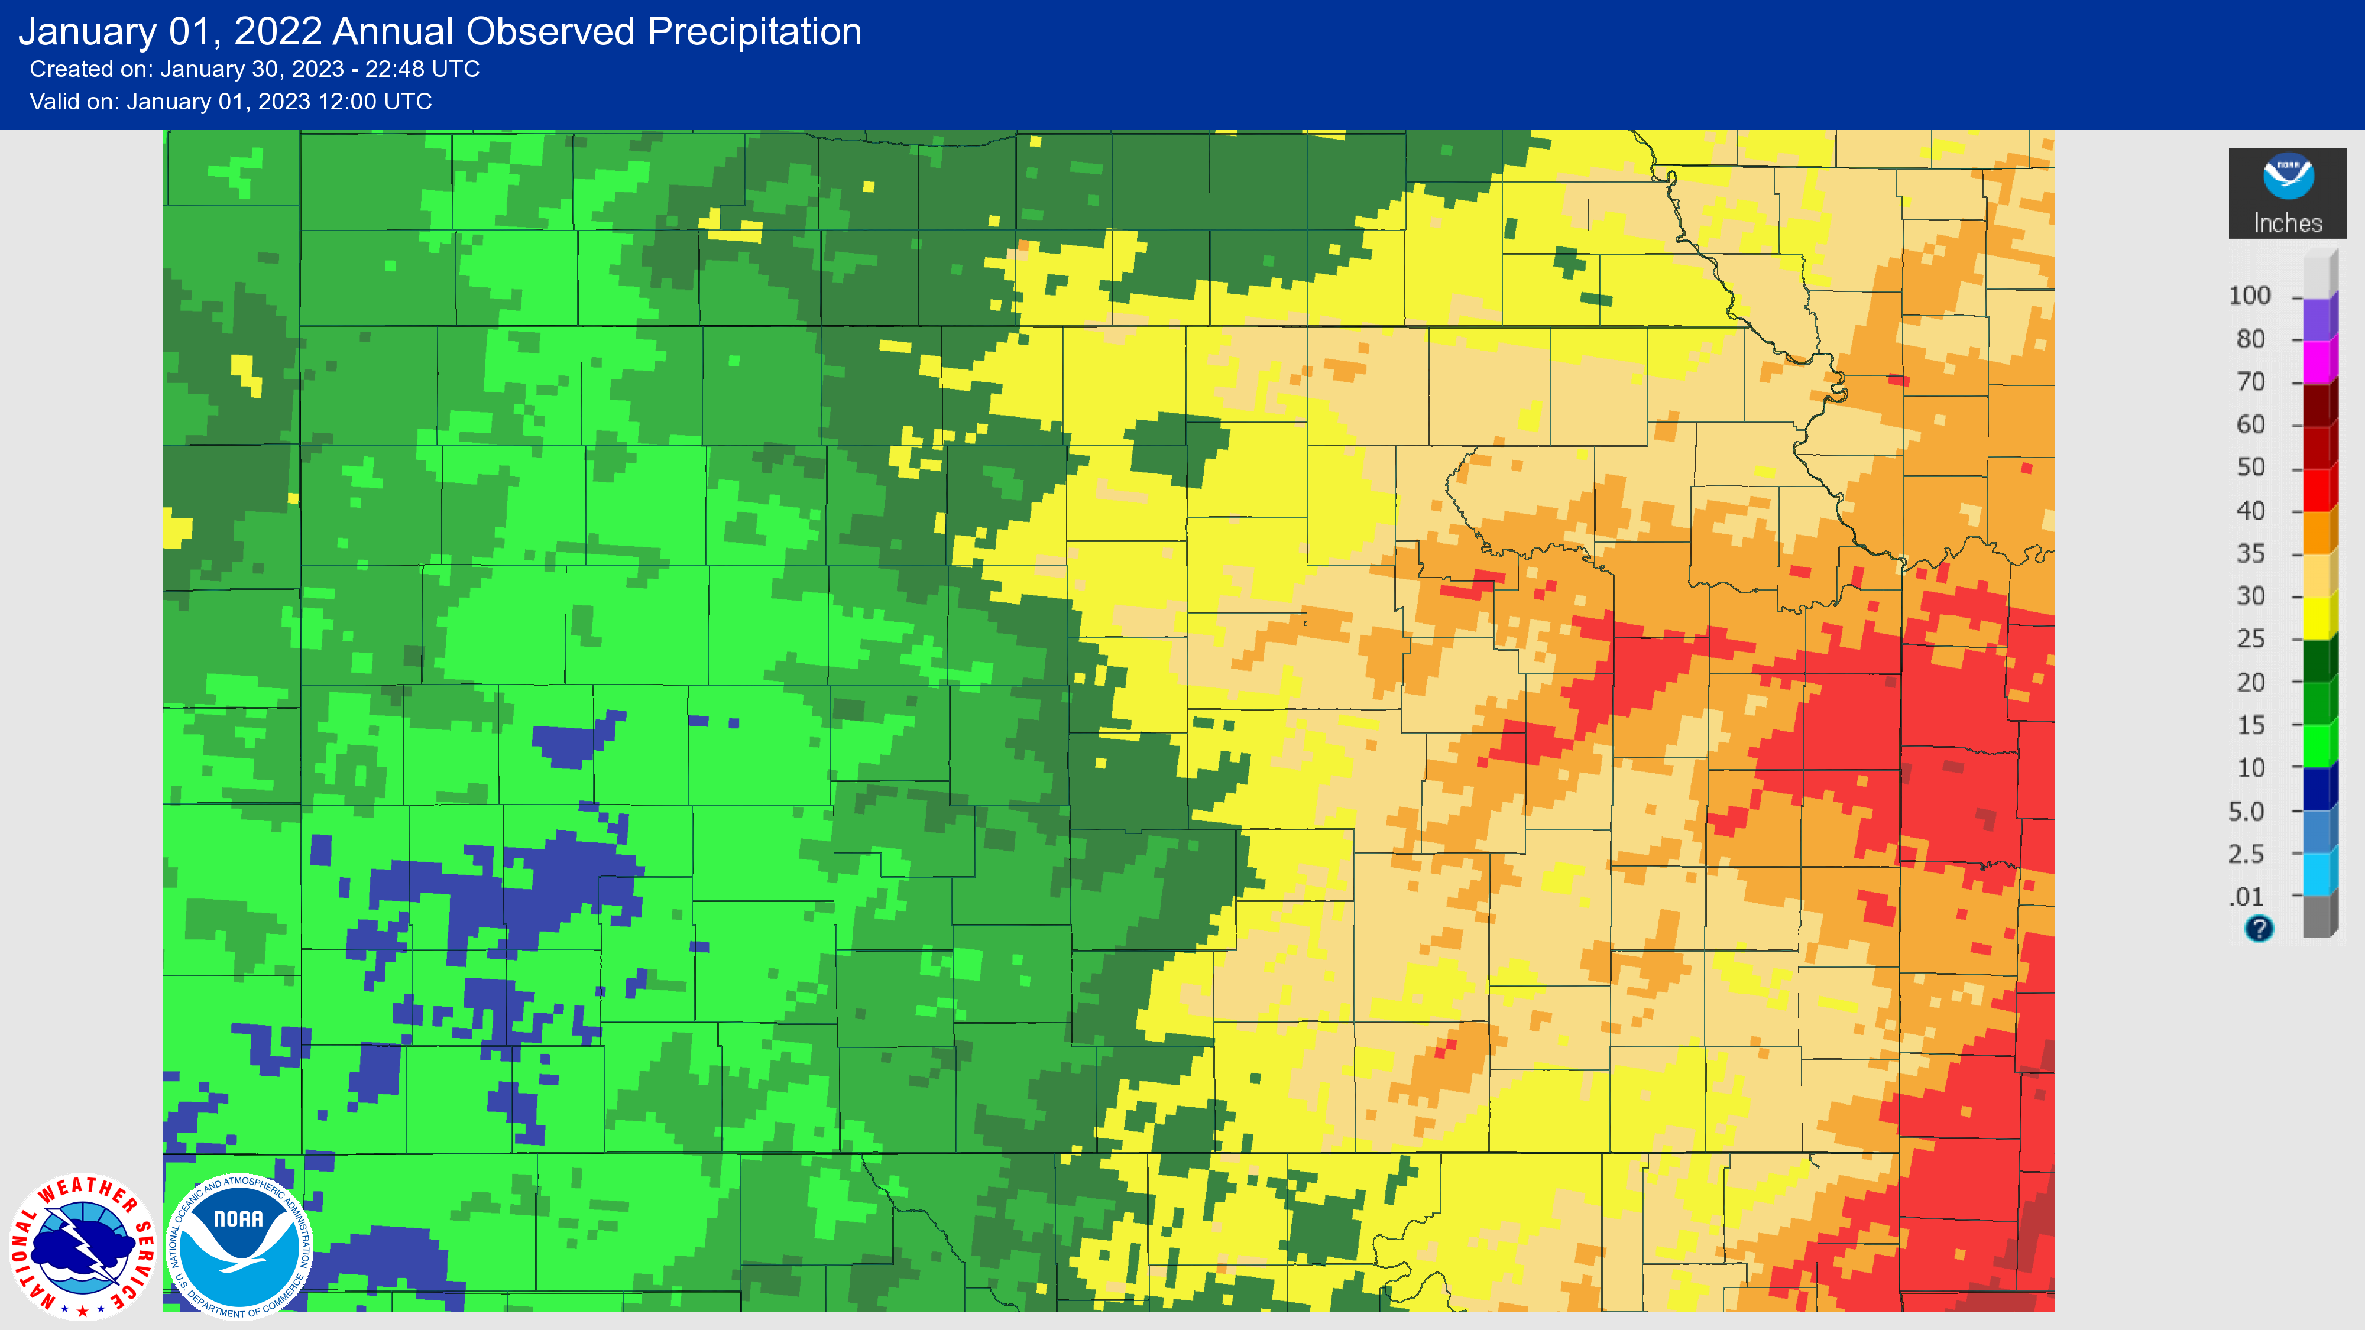
2022 Total Precipitation
Kansas Geological Survey

Slide 4
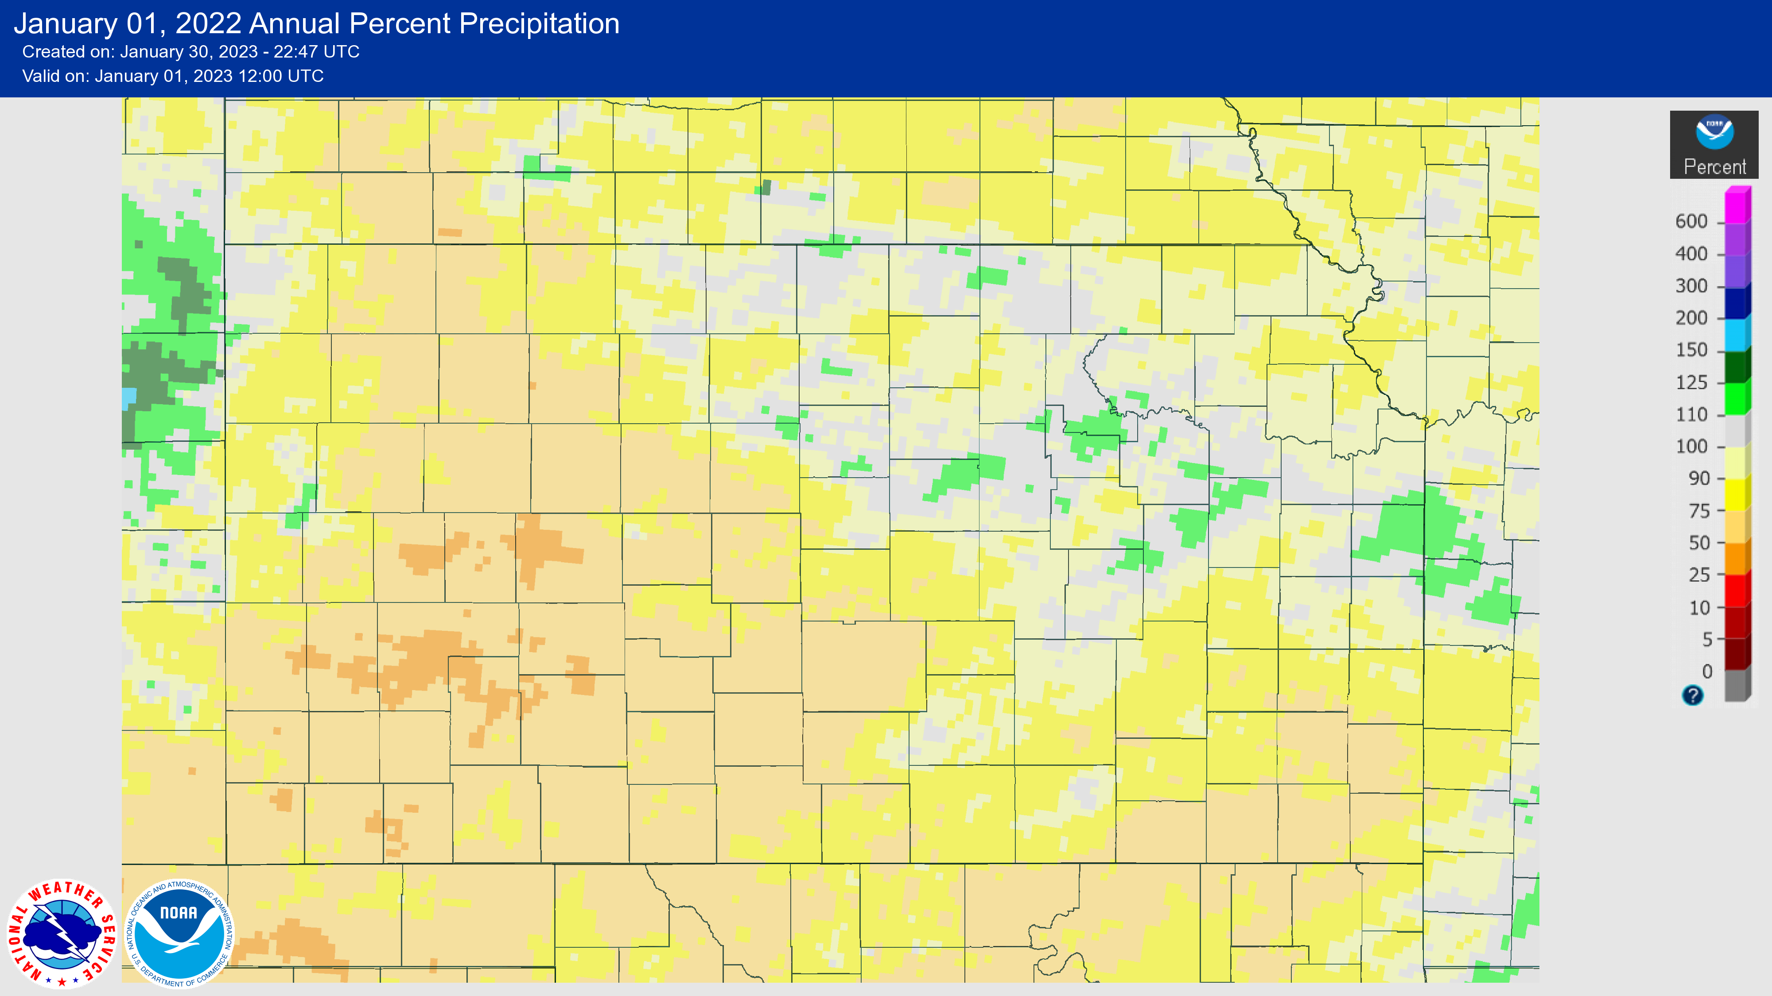
Percent Departure from Normal Precipitation
Kansas Geological Survey

Slide 5
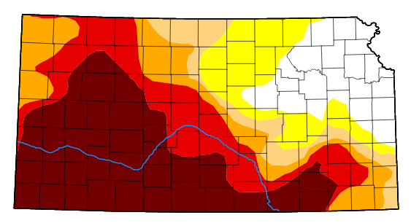
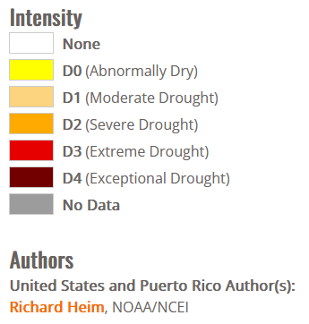
UNL Drought Monitor, 02/28/2023
Kansas Geological Survey

Slide 6
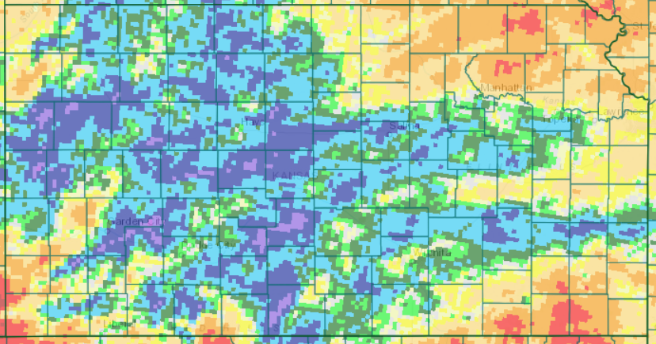
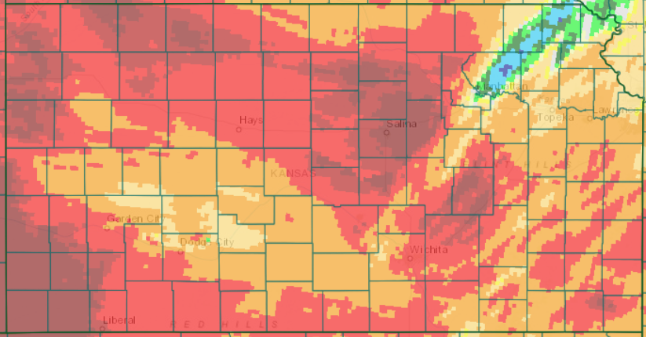
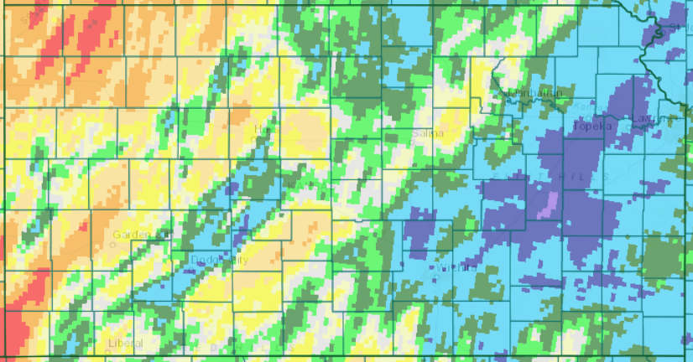
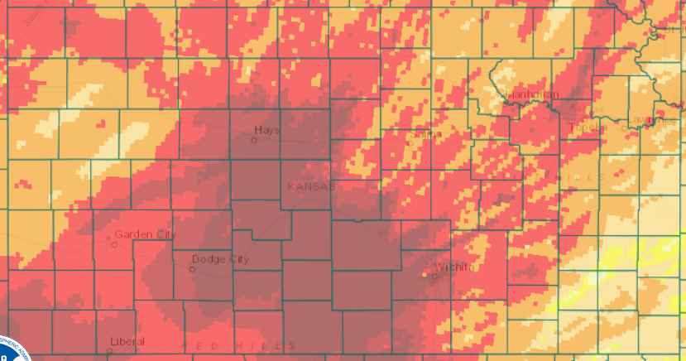
September 2021
November
October
December

Slide 7
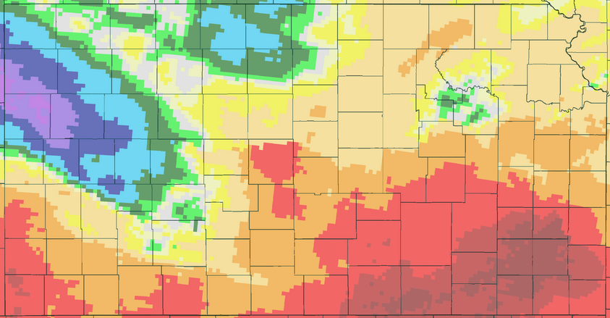
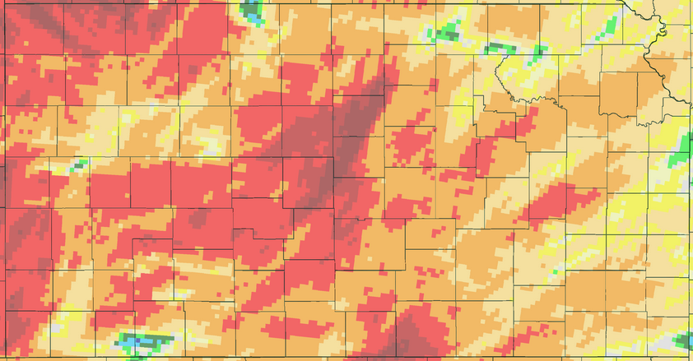
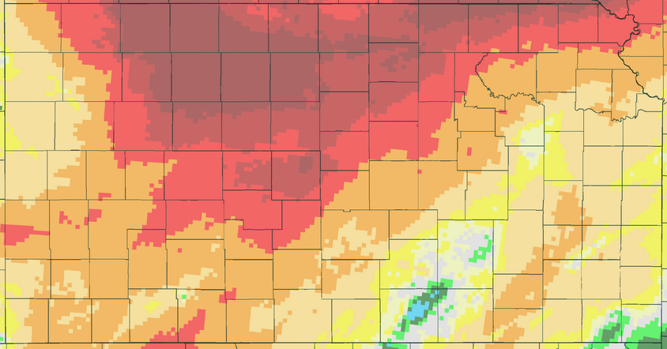
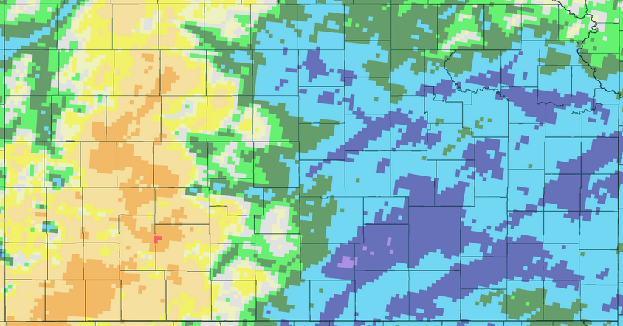
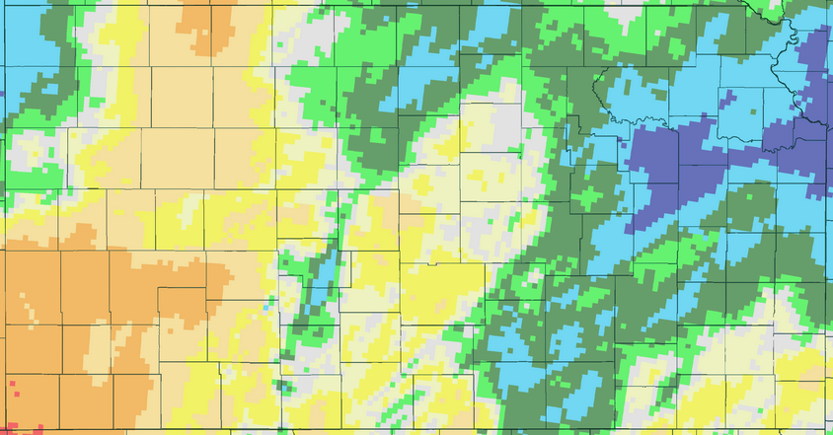
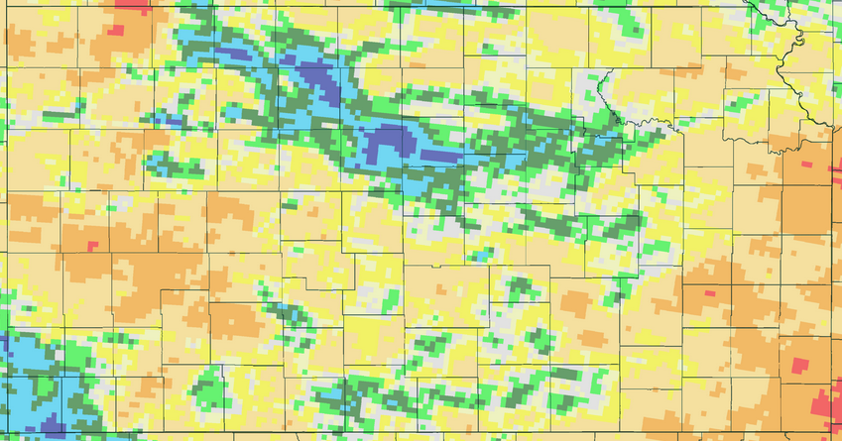
January 2022
April
February
May
March
June

Slide 8
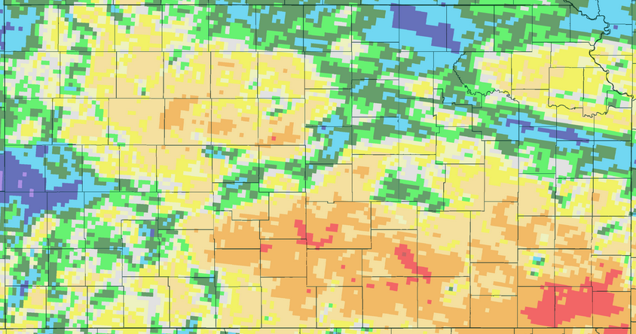
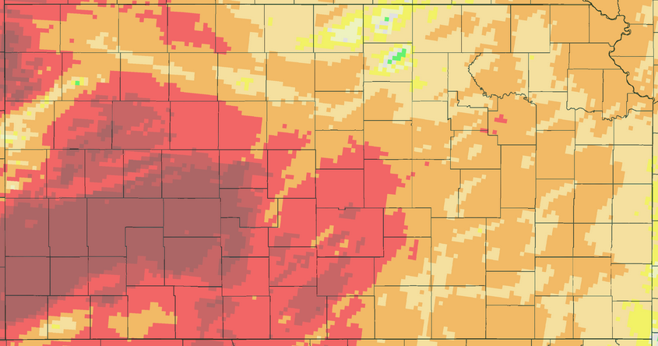
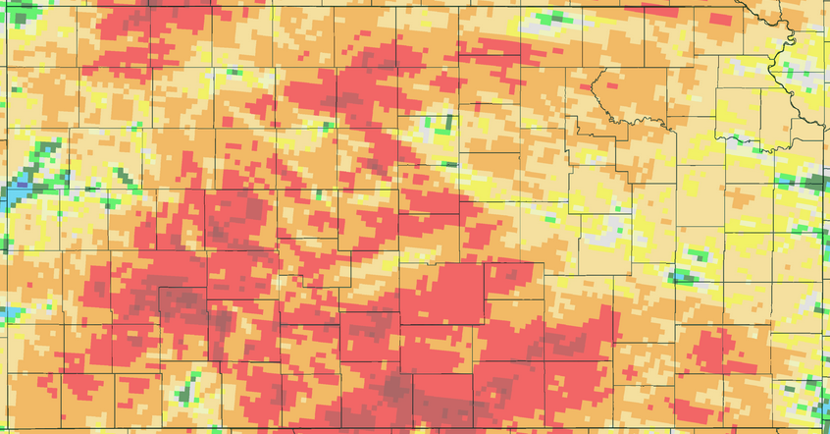
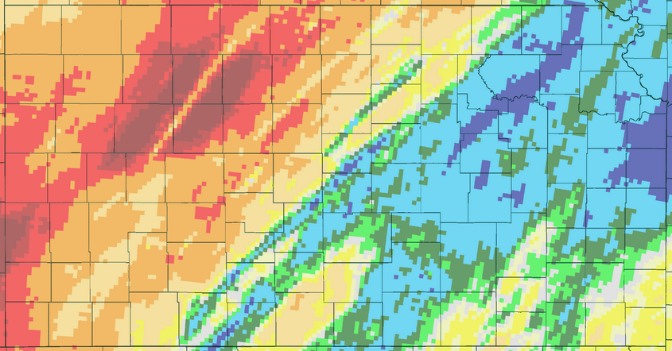
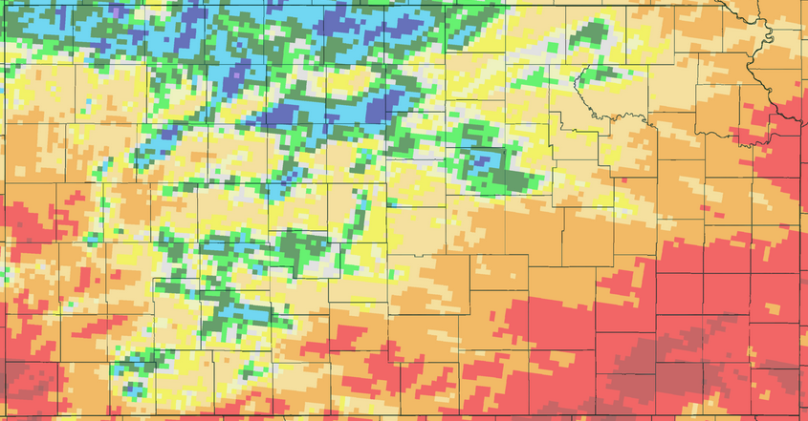
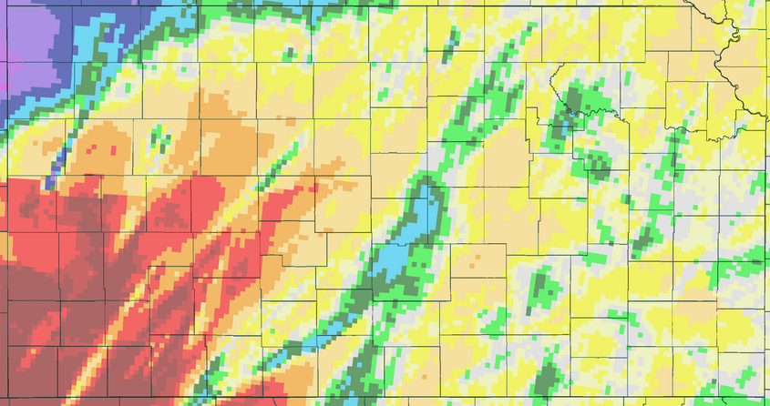
July
October
August
November
September
December

Slide 9
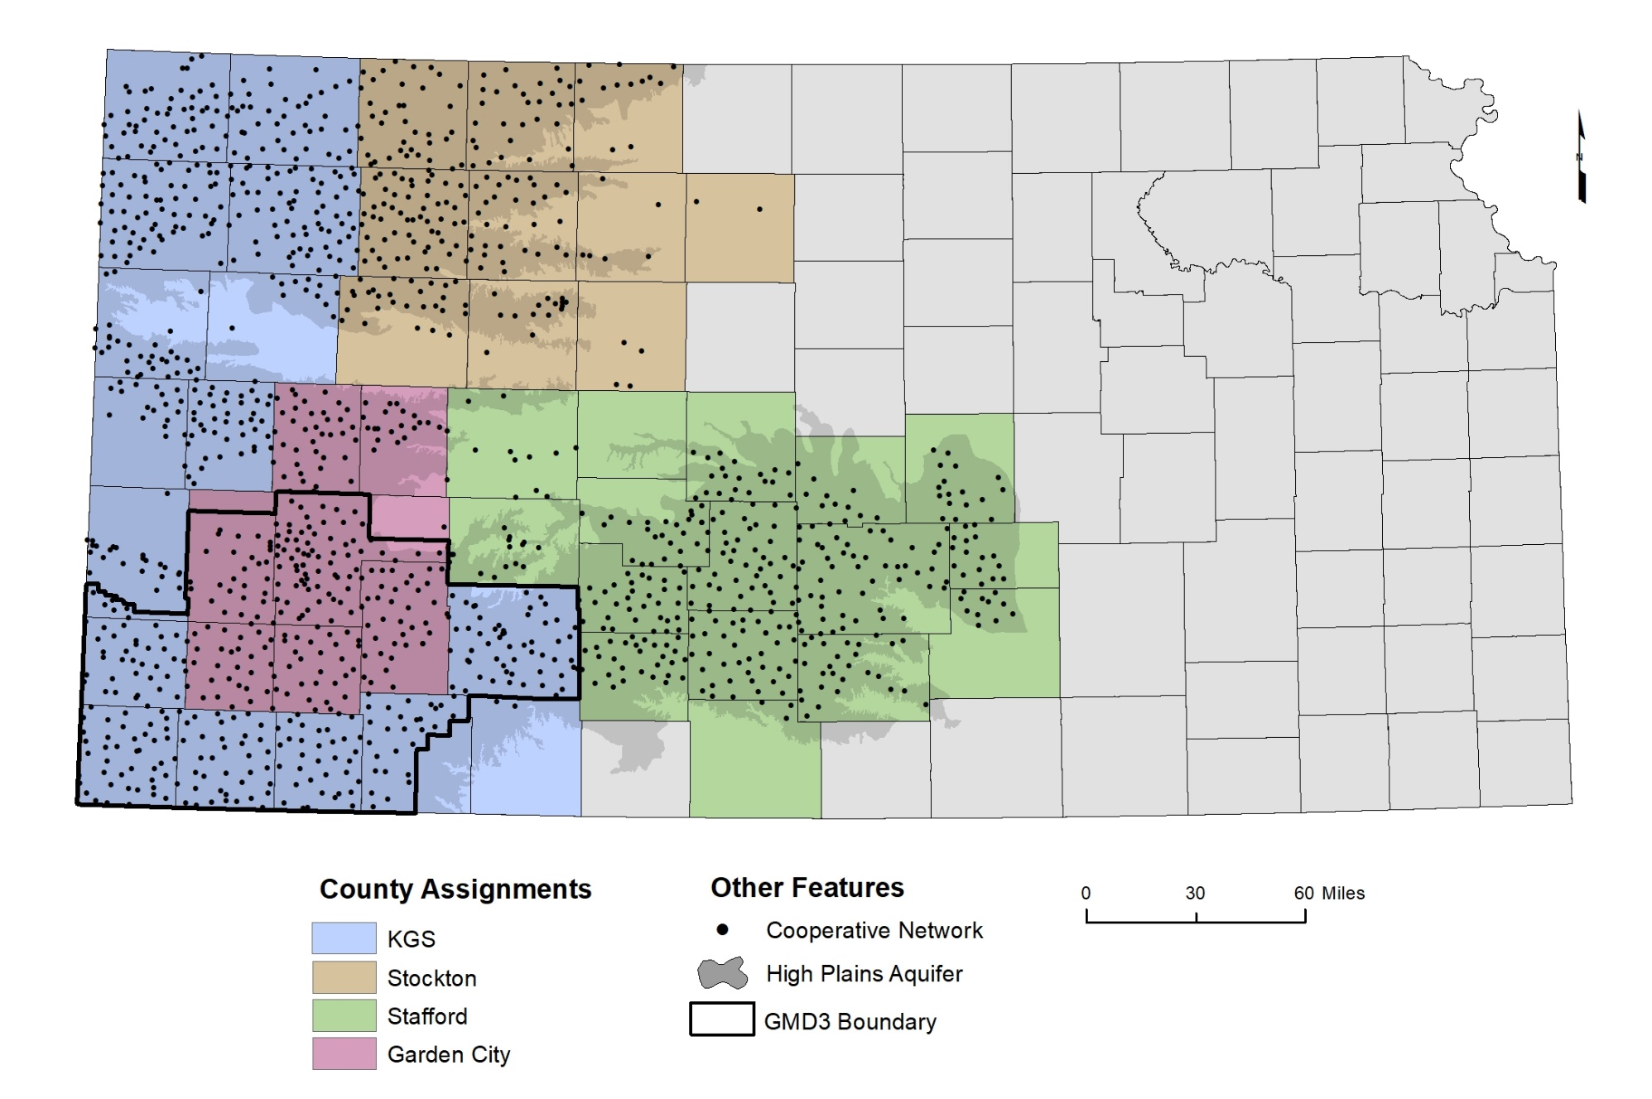
2023 Cooperative Water Level Program
Kansas Geological Survey

Slide 10
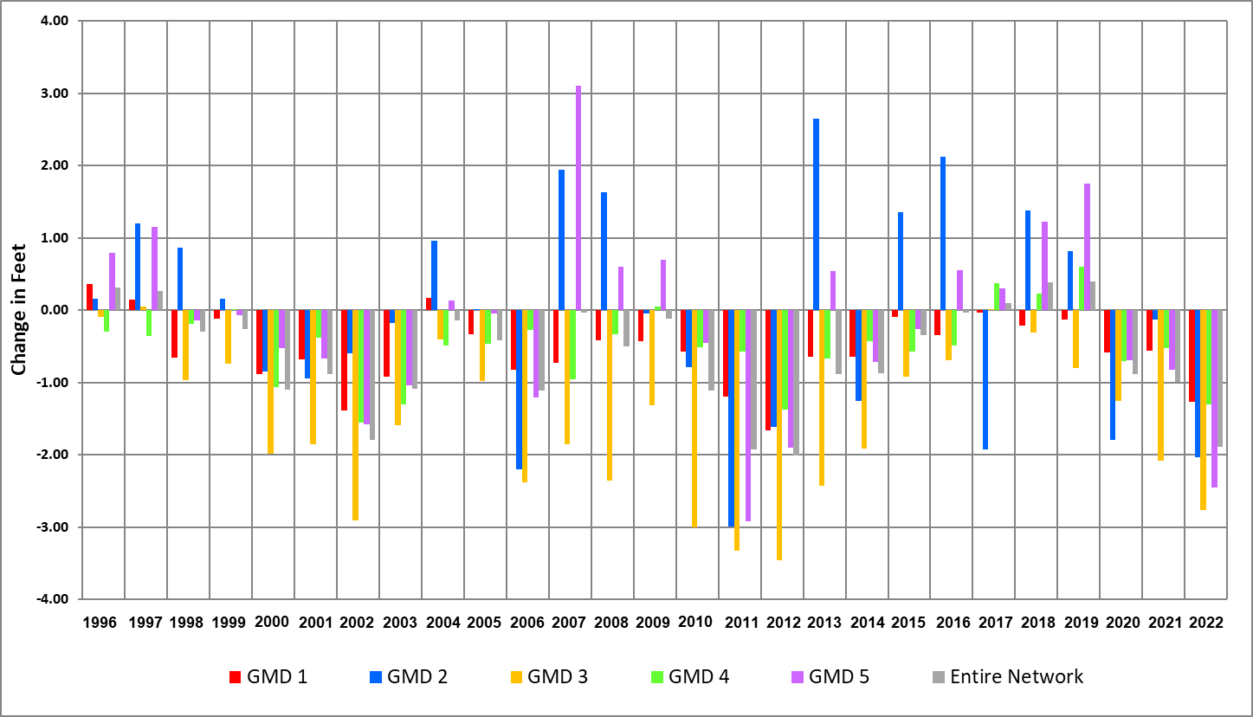
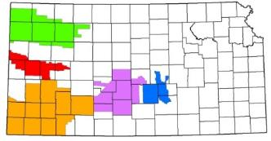
Average Change (by Well)
SW Kansas GMD 3
401 wells measured
Average 2022 to 2023 water-level change = -2.67 ft
*Results are based only on the cooperative network (KGS and KDA-DWR) and do not include sub-regional networks from the KDA-DWR, KGS, or local GMDs. 2023 water levels are provisional.
Kansas Geological Survey

Slide 11
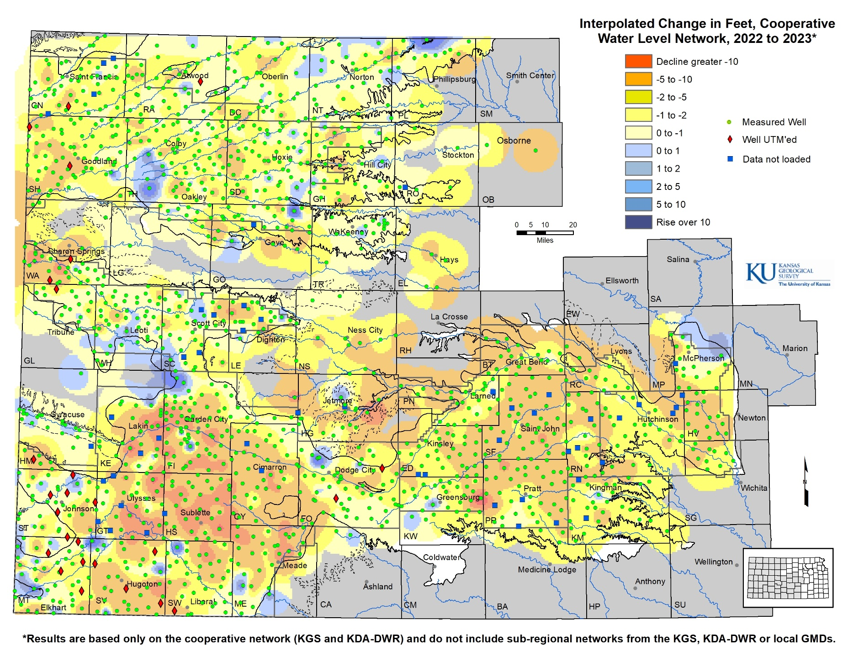
Provisional 2022-2023 Results
Kansas Geological Survey

Slide 12
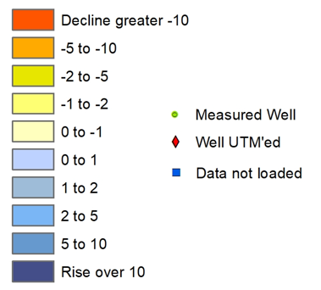
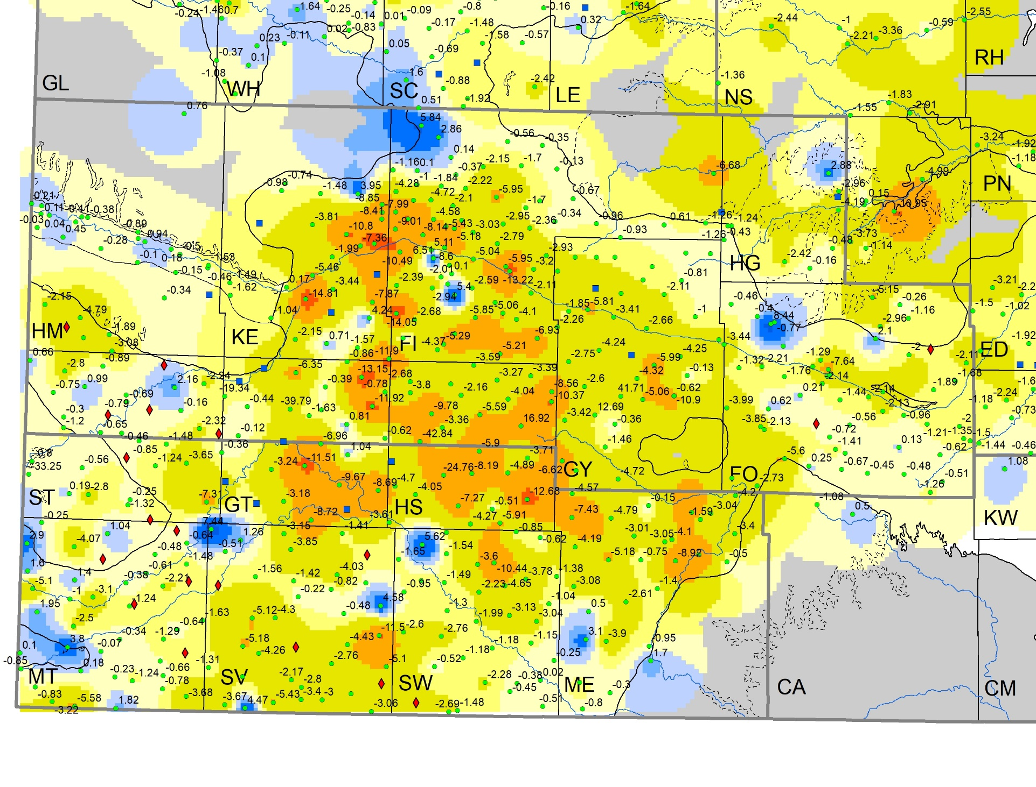
Provisional 2022-2023 Results
Kansas Geological Survey

Slide 13
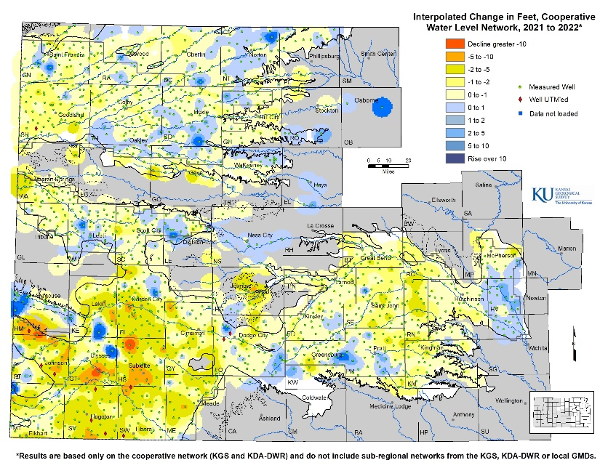
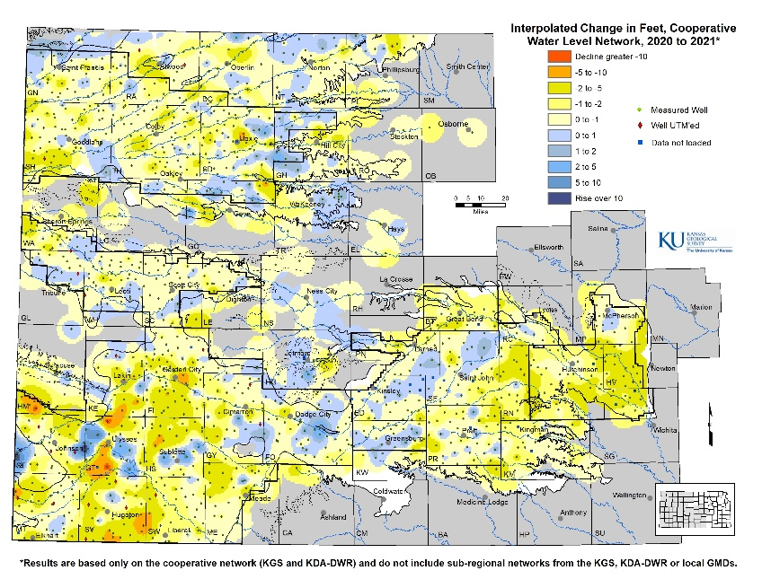
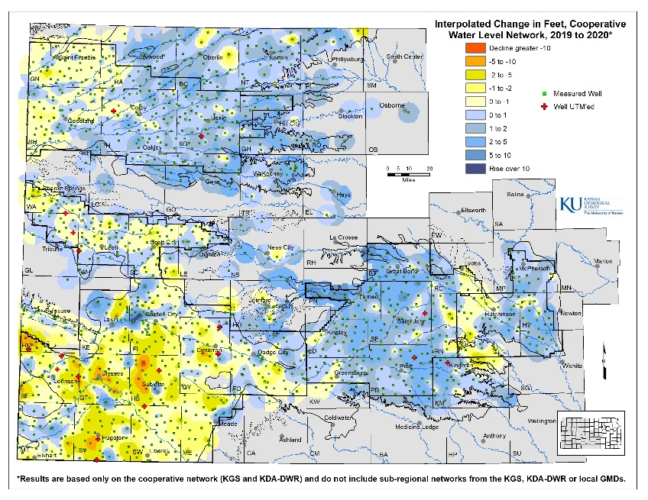
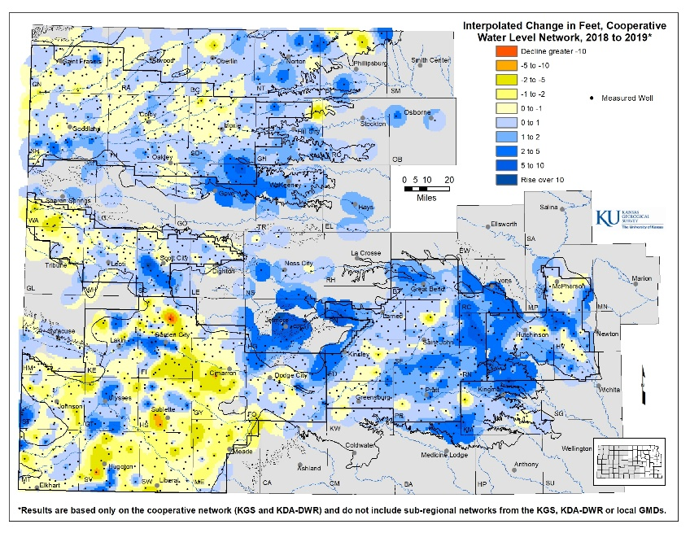
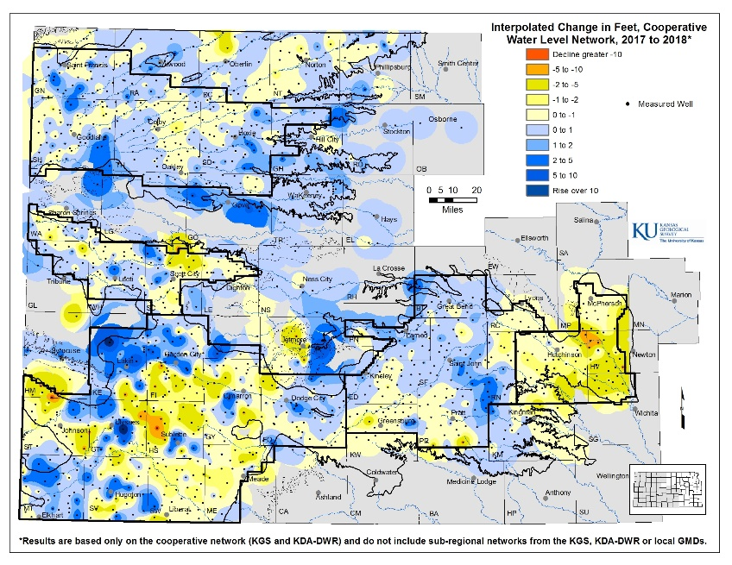
Provisional 2022-2023 Results
2022-2023
2021-2022
2020-2021
2019-2020
2018-2019
2017-2018
Kansas Geological Survey

Slide 14
KGS Water Balance / Q-Stable Analysis

Slide 15
What is it?
A simple approach to assess the relationship between groundwater usage and water-level change
Suited for Ogallala/High Plains aquifer
Seasonally pumped
Water is at depth
Semi-arid region
Data driven with no conceptualizations
Water use
Water-level change
Butler, J. J., Jr., Whittemore, D. O., Wilson, B. B., & Bohling, G. C. (2016). A new approach for assessing the future of aquifers supporting irrigated agriculture. Geophys Researcher Letters, 43 (5), 2004–2010.

Slide 16
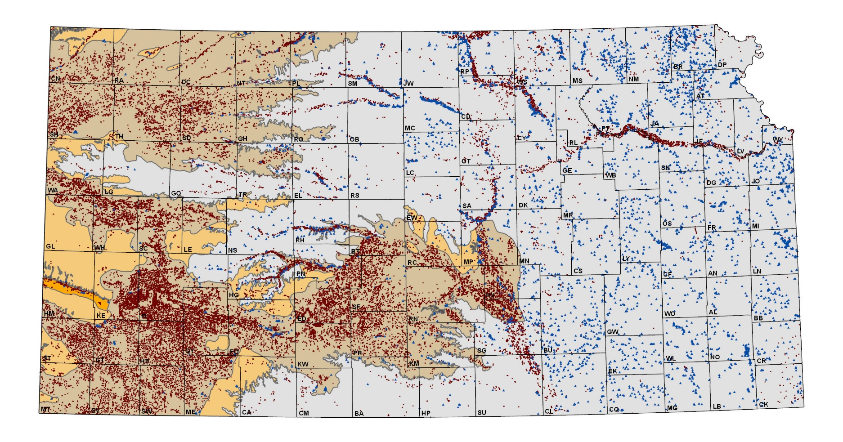
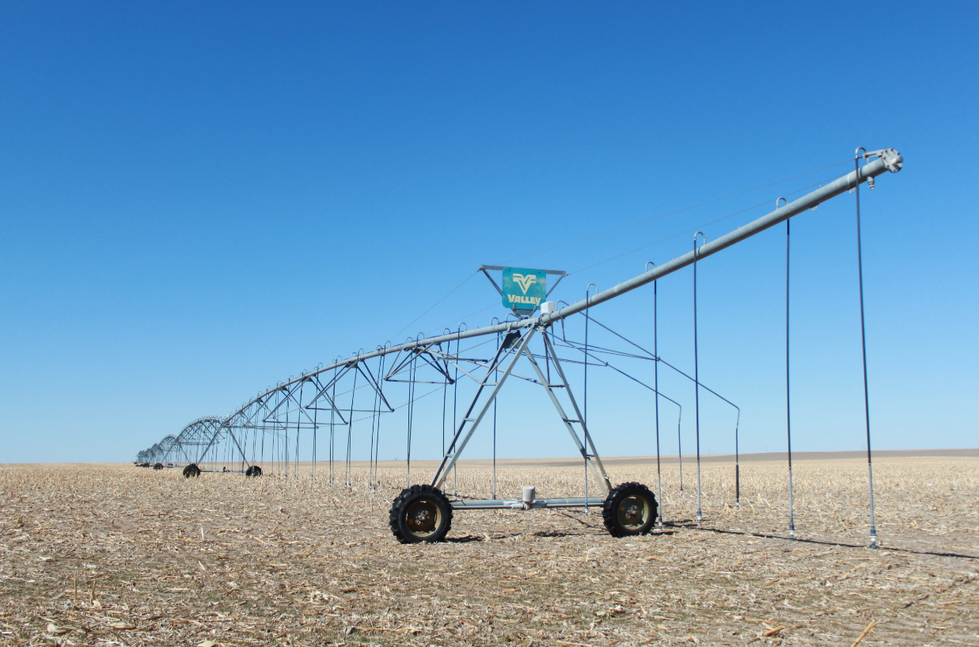
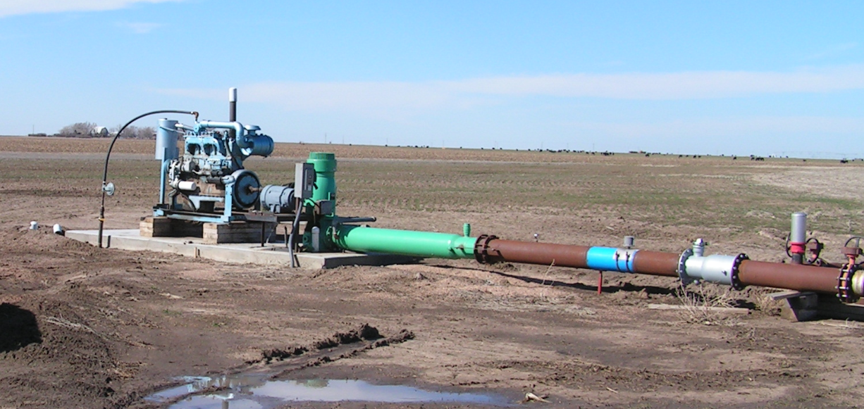
Water Right Data
WRIS / WIMAS
Kansas Department of Agriculture- Division of Water Resources
Annual reported water use
Penalties for falsifying or not reporting
Over 95% of the wells in the Kansas High Plains aquifer have a flow meter
Established meter specification and requirements
Kansas water use program in unique in U.S. and the world
Kansas Geological Survey

Slide 17
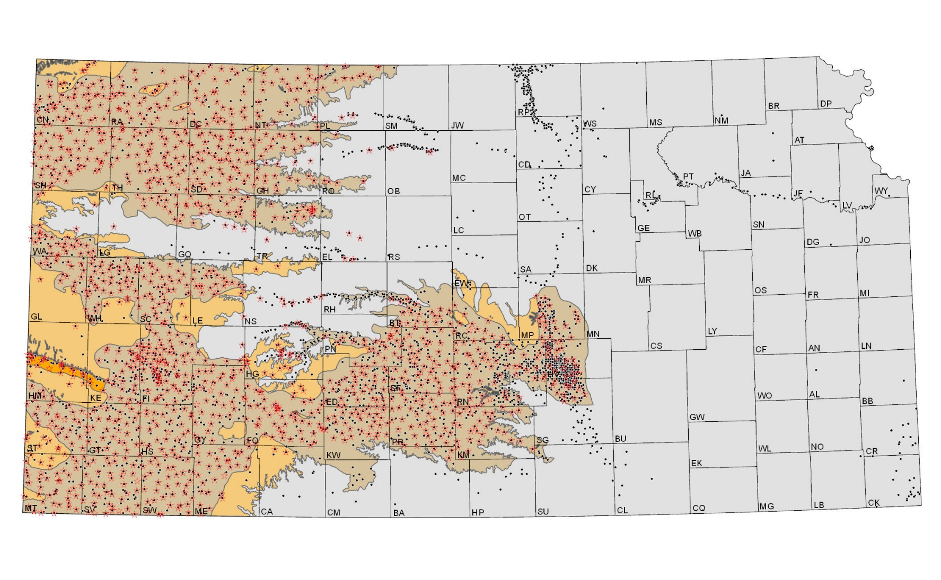
Measuring Wells in Kansas
WIZARD
Kansas Geological Survey
Depth-to-water measurements
Wells measured by GMDs 2 and 5, KDA-DWR, USGS, and the KGS
Cooperative Water Level Network
~1,400 wells
Focused on High Plains aquifer
Annual measurements by the KGS and KDA-DWR
Regional aquifer characterizations
Kansas Geological Survey
Notes:
Measured depth to groundwater can be obtained online from the KGS WIZARD database at http://www.kgs.ku.edu/Magellan/WaterLevels/index.html. WIZARD contains data collected from a local, state, and federal agency with the black dots indicating wells measured at some point over the last 20 year. The red stars represent wells included in the Kansas Cooperative Water-Level Measurement Network where each winter, the KGS and KDA-DWR measure roughly 1400 wells to assess regional trends and conditions in the High Plains aquifer region.

Slide 18
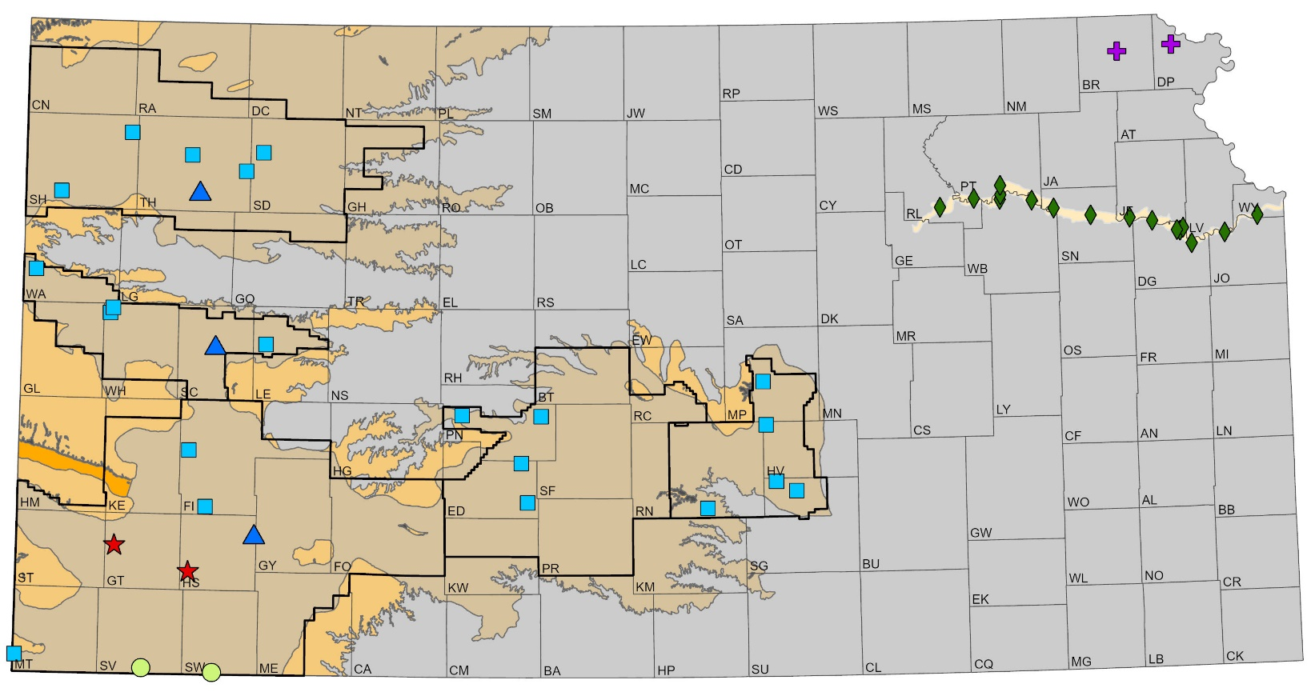
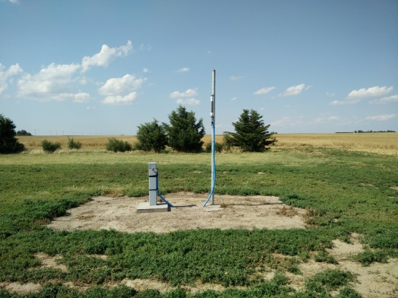
Kansas Index Well Program
First installed in 2007 through the Kansas Water Plan Fund
Continuous, real-time water-level recordings
Characterizations at the local scale
New Ogallala/Dakota nest sites
Kansas Geological Survey
Notes:
To help answer that question, the Kansas Index Well Program has provided great insight into how the aquifer behaves throughout the year. Initiated in 2007, Index Wells are continuous, real-time monitored wells shown with various point symbols on the map. Water-level responses for the majority of index wells to date indicate consistent aquifer behaviors regardless of past climatic or pumping conditions.

Slide 19
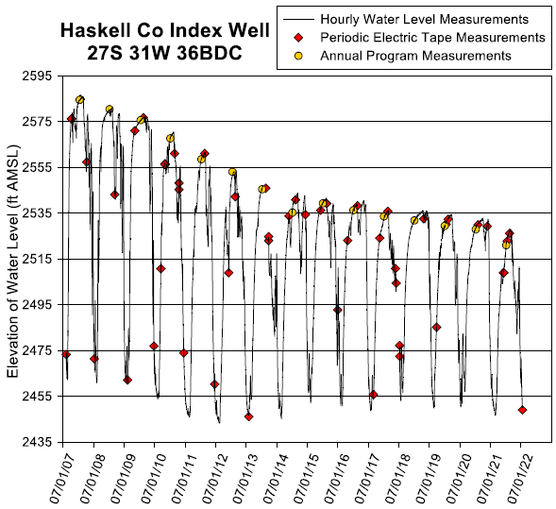
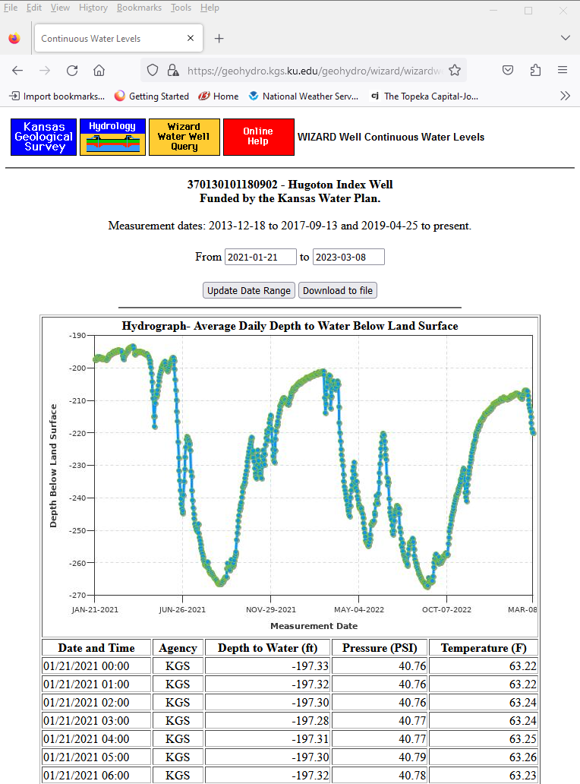
Kansas Index Well Program
Kansas Geological Survey
Notes:
To help answer that question, the Kansas Index Well Program has provided great insight into how the aquifer behaves throughout the year. Initiated in 2007, Index Wells are continuous, real-time monitored wells shown with various point symbols on the map. Water-level responses for the majority of index wells to date indicate consistent aquifer behaviors regardless of past climatic or pumping conditions.

Slide 20
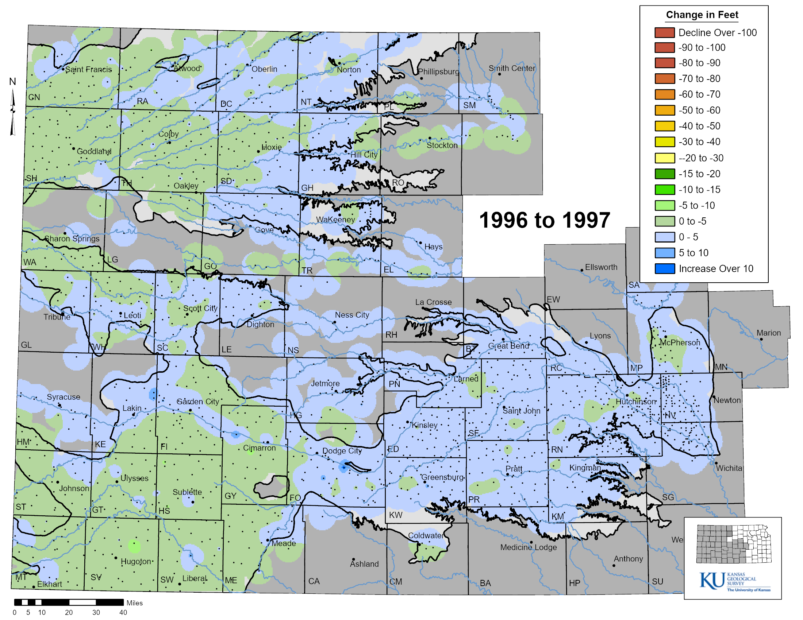
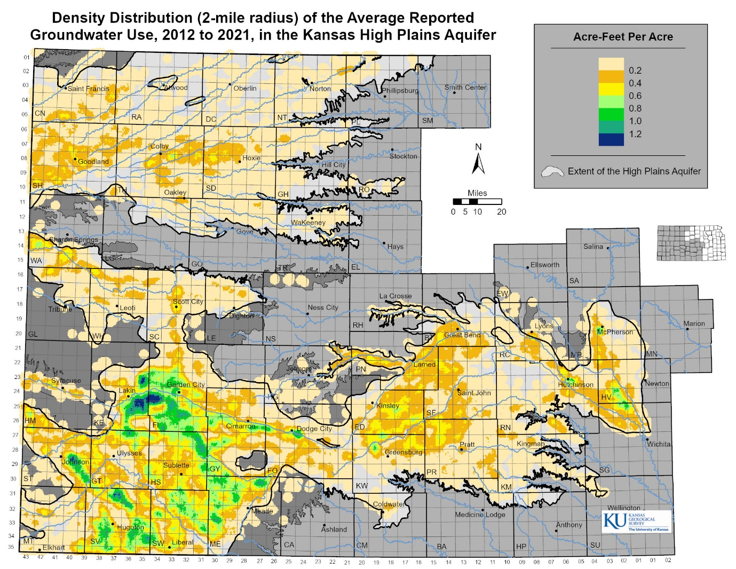
Water-Level Change vs Reported Water Use
Water-Level Change
Groundwater Use
How far out of whack are we?
Kansas Geological Survey
Notes:
The map on the left is an animation of water level changes across the HPA region. Groundwater declines are more prevalent in Ogallala portion of the HPA where annual pumping typically exceeds natural recharge rates. Rainfall, especially over the growing season from April to September, greatly effects groundwater pumping, which in turn, has the greatest influence on decline rates in the Ogallala. The map on the right shows the density of average reported groundwater usage over the HPA. Areas of high water use often correspond to areas of greater groundwater declines. The question is- how far out of proportion is water use versus water declines (e.g., “whack”)?

Slide 21
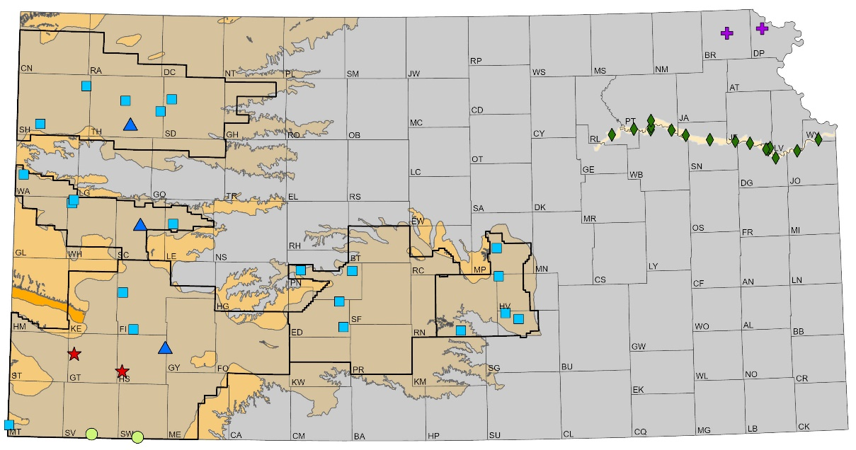
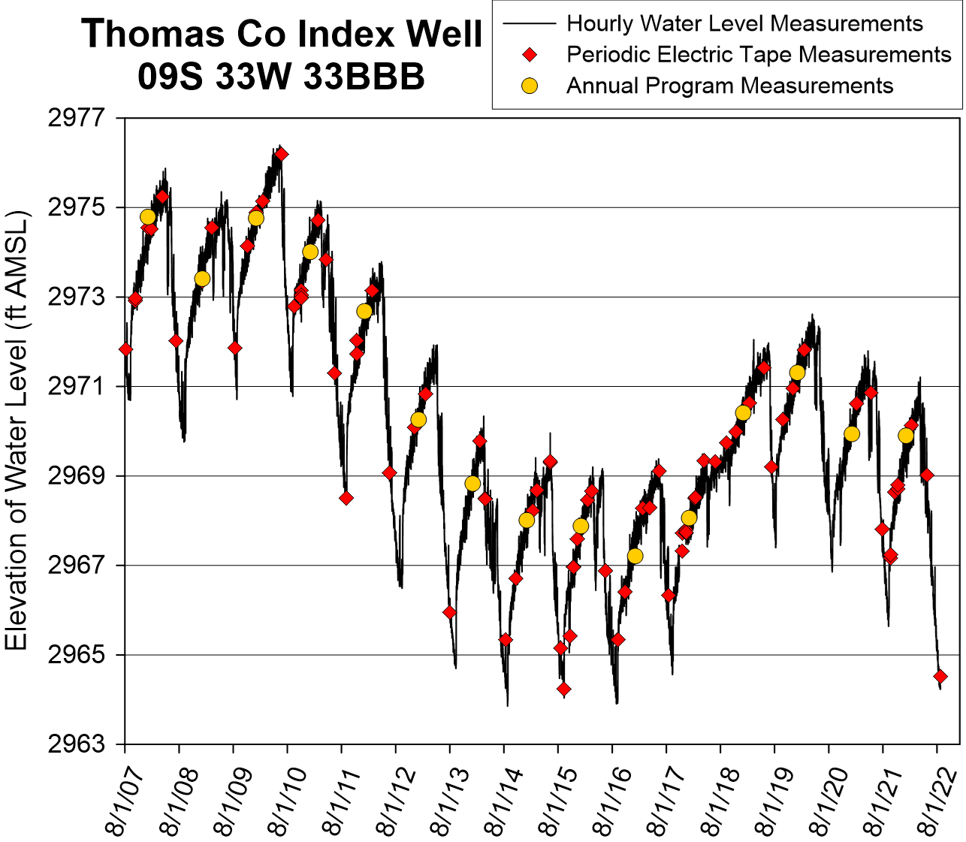
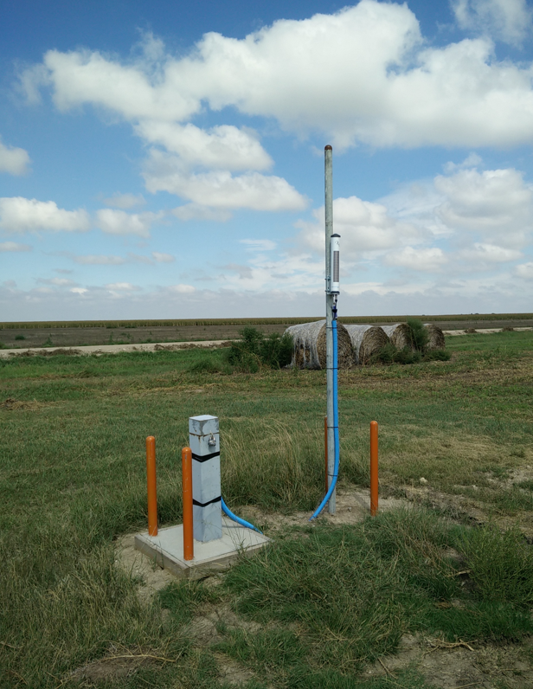
Kansas Index Well- Recovery Curves
Over the last decade, end-of-season recovery is similar regardless of past pumping or climatic conditions
Kansas Geological Survey

Slide 22
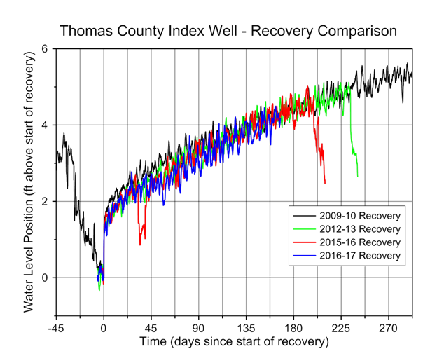
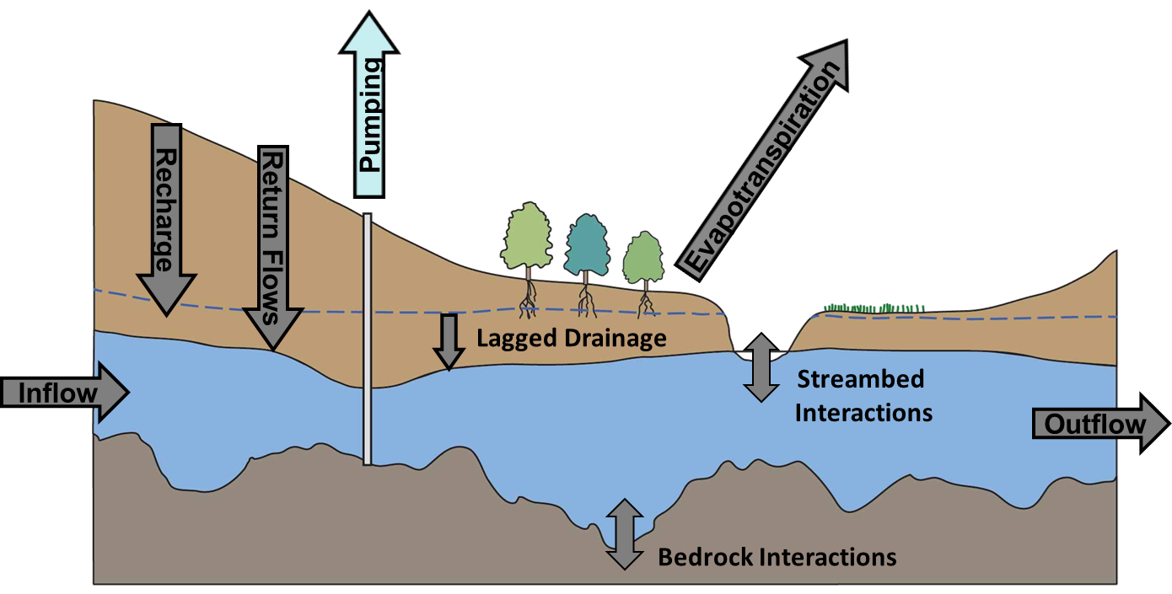
Index Wells Recovery Curves, Thomas County
Water level change starting at the end-of-season pumping (September to April~June)
Recovery is similar each year
“Net Inflow”
Everything flowing in and out of the aquifer except pumping
Kansas Geological Survey

Slide 23
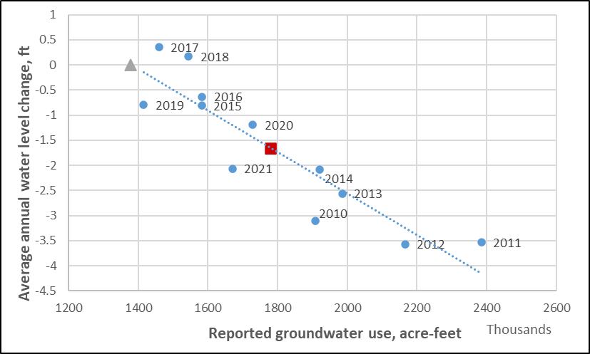
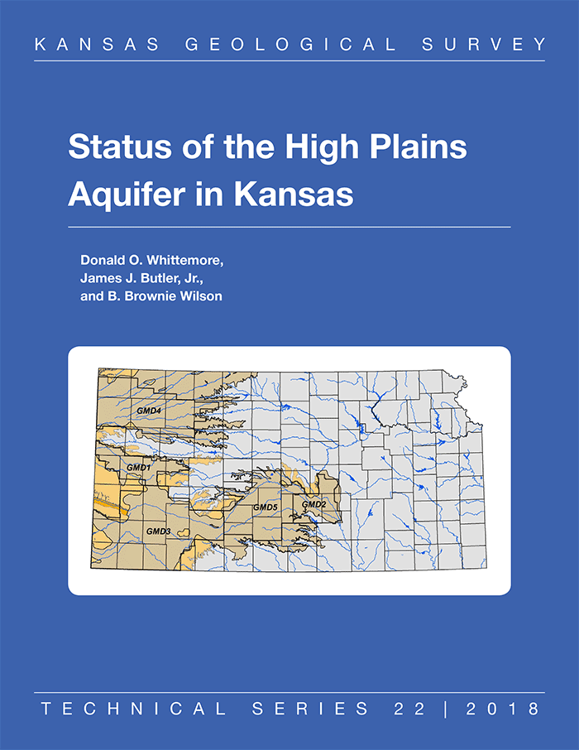
Status of the High Plains Aquifer in Kansas
KGS Technical Series 22- http://www.kgs.ku.edu/Publications/Bulletins/TS22/index.html
Western Kansas GMD3, 2010 to 2021
R-squared = 0.81
Average water level change = -1.65 ft
Average reported use = 1,779,092 AF
Percent reduction for stable water levels:
Average conditions = 23%
Drought (2011) = 42%
Average Conditions
Specific Yield
Net Inflow
Kansas Geological Survey

Slide 24
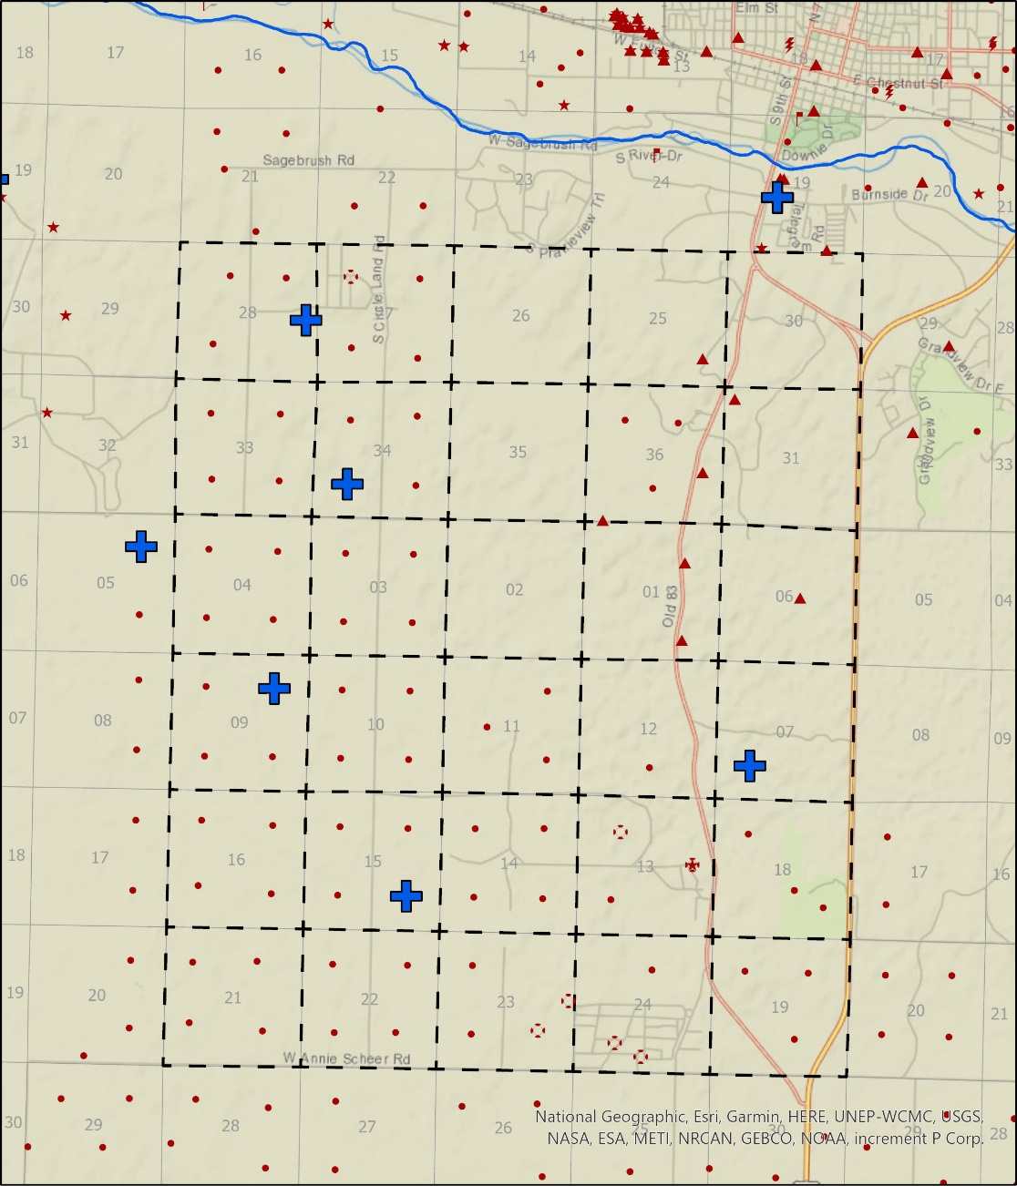
Circle Land and Cattle
Reported water use and measured water levels, 2011 to 2021
R-squared = 0.74, P = 0.0007
Average water level change = -3.35 ft
Average total reported use = 18,941 AF
Percent reduction for stable water levels:
Average conditions = 17%
Drought (2012) = 30%
Benefits from its position relative to the Ark River
Kansas Geological Survey

Slide 25
Hy-Plains Feedyard LLC
Reported water use and measured water levels, 2010 to 2021
R-squared = 0.87, P = 0.00001
Average water level change (10 mile radius) = -2.18 ft
Average total reported use (5 mile radius) = 19,294 AF
Percent reduction for stable water levels:
Average conditions = 29%
Drought (2011) = 53%
Kansas Geological Survey

Slide 26
GMD3 model Northern Scott, Finney, Gray Counties
Reported water use and measured water levels, 2005 to 2021
R-squared = 0.05, P = 0.38
Average water level change = -0.98 ft
Average total reported use = 98,959 AF
Percent reduction for stable water levels:
Average conditions = 74%
Drought (2012) = 81%
Data squirrels in 2010 and 2011
Kansas Geological Survey

Slide 27
GMD3 model Northern Scott, Finney, Gray Counties- Adjusted
Reported water use and measured water levels, 2005 to 2021
R-squared = 0.54, P = 0.0008
Average water level change = -1.05 ft
Average total reported use = 98,959 AF
Percent reduction for stable water levels:
Average conditions = 33%
Drought (2012) = 52%
Data squirrels in 2010 and 2011 removed
Kansas Geological Survey

Slide 28
Conclusions and Observations
Reductions in pumping to stabilized water levels vary greatly
Modest reductions in pumping, 10 to 15%, will reduce decline rates.
Benefits to water conservation efforts stay local.
Conditions will likely hold for the next decade or two but will need to be revisited, especially with prolonged wet or dry conditions.
Even with reductions on the short-term, long-term sustainability in the Ogallala will still be challenging

Slide 29
GMD3 iCare Project
https://www.gmd3.org/icare
Kansas Geological Survey

Slide 30
Arbitrary ranking of aquifer thickness, water use density, and water level change
 | Ranking
 | 1 | 2 | 3 | 4
Aquifer Thickness | < 50 | 50-100 | 100-200 | >200
Water Density | >0.75 | 0.50-0.75 | 0.25-0.5 | <0.25
Water-level Change | Declines over -20 | -15 to -20 | -5 to -15 | everything else

Slide 31
Initial Scoring
Classified average ranking score based on natural breaks
Areas provide a starting place for further refinement based on local knowledge
Kansas Geological Survey

Slide 32
iCare Regions, Version 1
Manually delineated
Large enough to get meaningful Q-stable results….hopefully
Can be further subdivided but will look to the sub-regions (aka neighborhoods to take care of this).
Kansas Geological Survey

Slide 33
Kansas Geological Survey

Slide 34
iCare Regions
Kansas Geological Survey

Slide 35
Aquifer thickness
Use Density
Water-level change
Geology/Ditch/IGUCA
iCare Regions
HPA / Dakota Extents
Kansas Geological Survey

Slide 36
Aquifer thickness
GMD3 Rate Data
Water-level change
Geology/Ditch/IGUCA
iCare Regions
HPA / Dakota Extents
Kansas Geological Survey

Slide 37
Aquifer thickness
Points of Diversions
Water-level change
Geology/Ditch/IGUCA
iCare Regions
HPA / Dakota Extents
Kansas Geological Survey

Slide 38
Kansas Geological Survey

Slide 39
Questions????
Kansas Geological Survey
1930 Constant Ave
Lawrence, KS 66047
785-864-2118
Visit our site at http://www.kgs.ku.edu
Notes:
Thank You!

Slide 40
Reductions in Reported Water Use, by GMD, Needed to Stabilized Water Levels
Based on average conditions from 2011 to 2021 and drought year (2012).
Averages over large areas
Approach can be scaled down but is depending on data availability, specifically water-levels
15%
(40%)
29%
(51%)
2%
(23%)
3%
(19%)
22%
(36%)
Kansas Geological Survey

