Slide 1
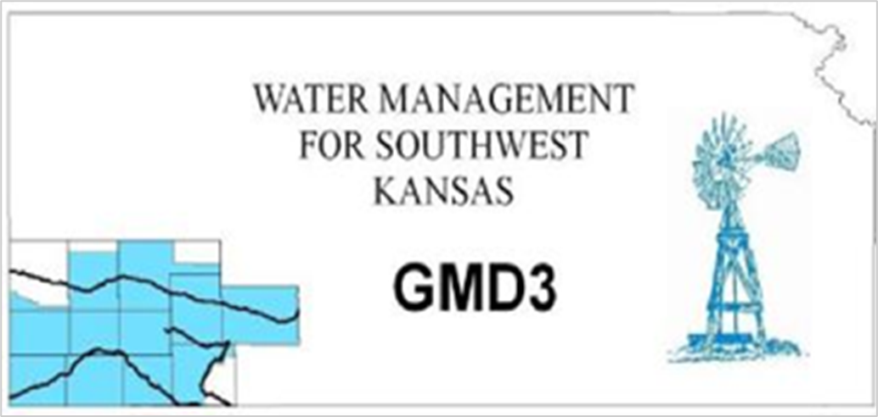
Report of Activities
2023 GMD3 Annual Meeting
SW Kansas Groundwater Management District
Mark Rude, Executive Director

Slide 2

Report of Activities
Your District Water Policy Leaders
Key activities
Current events
Funding of the Management Program

Slide 3

Your Local Water Policy Leaders

Slide 4
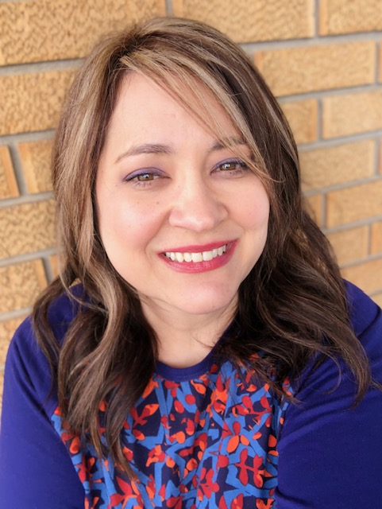
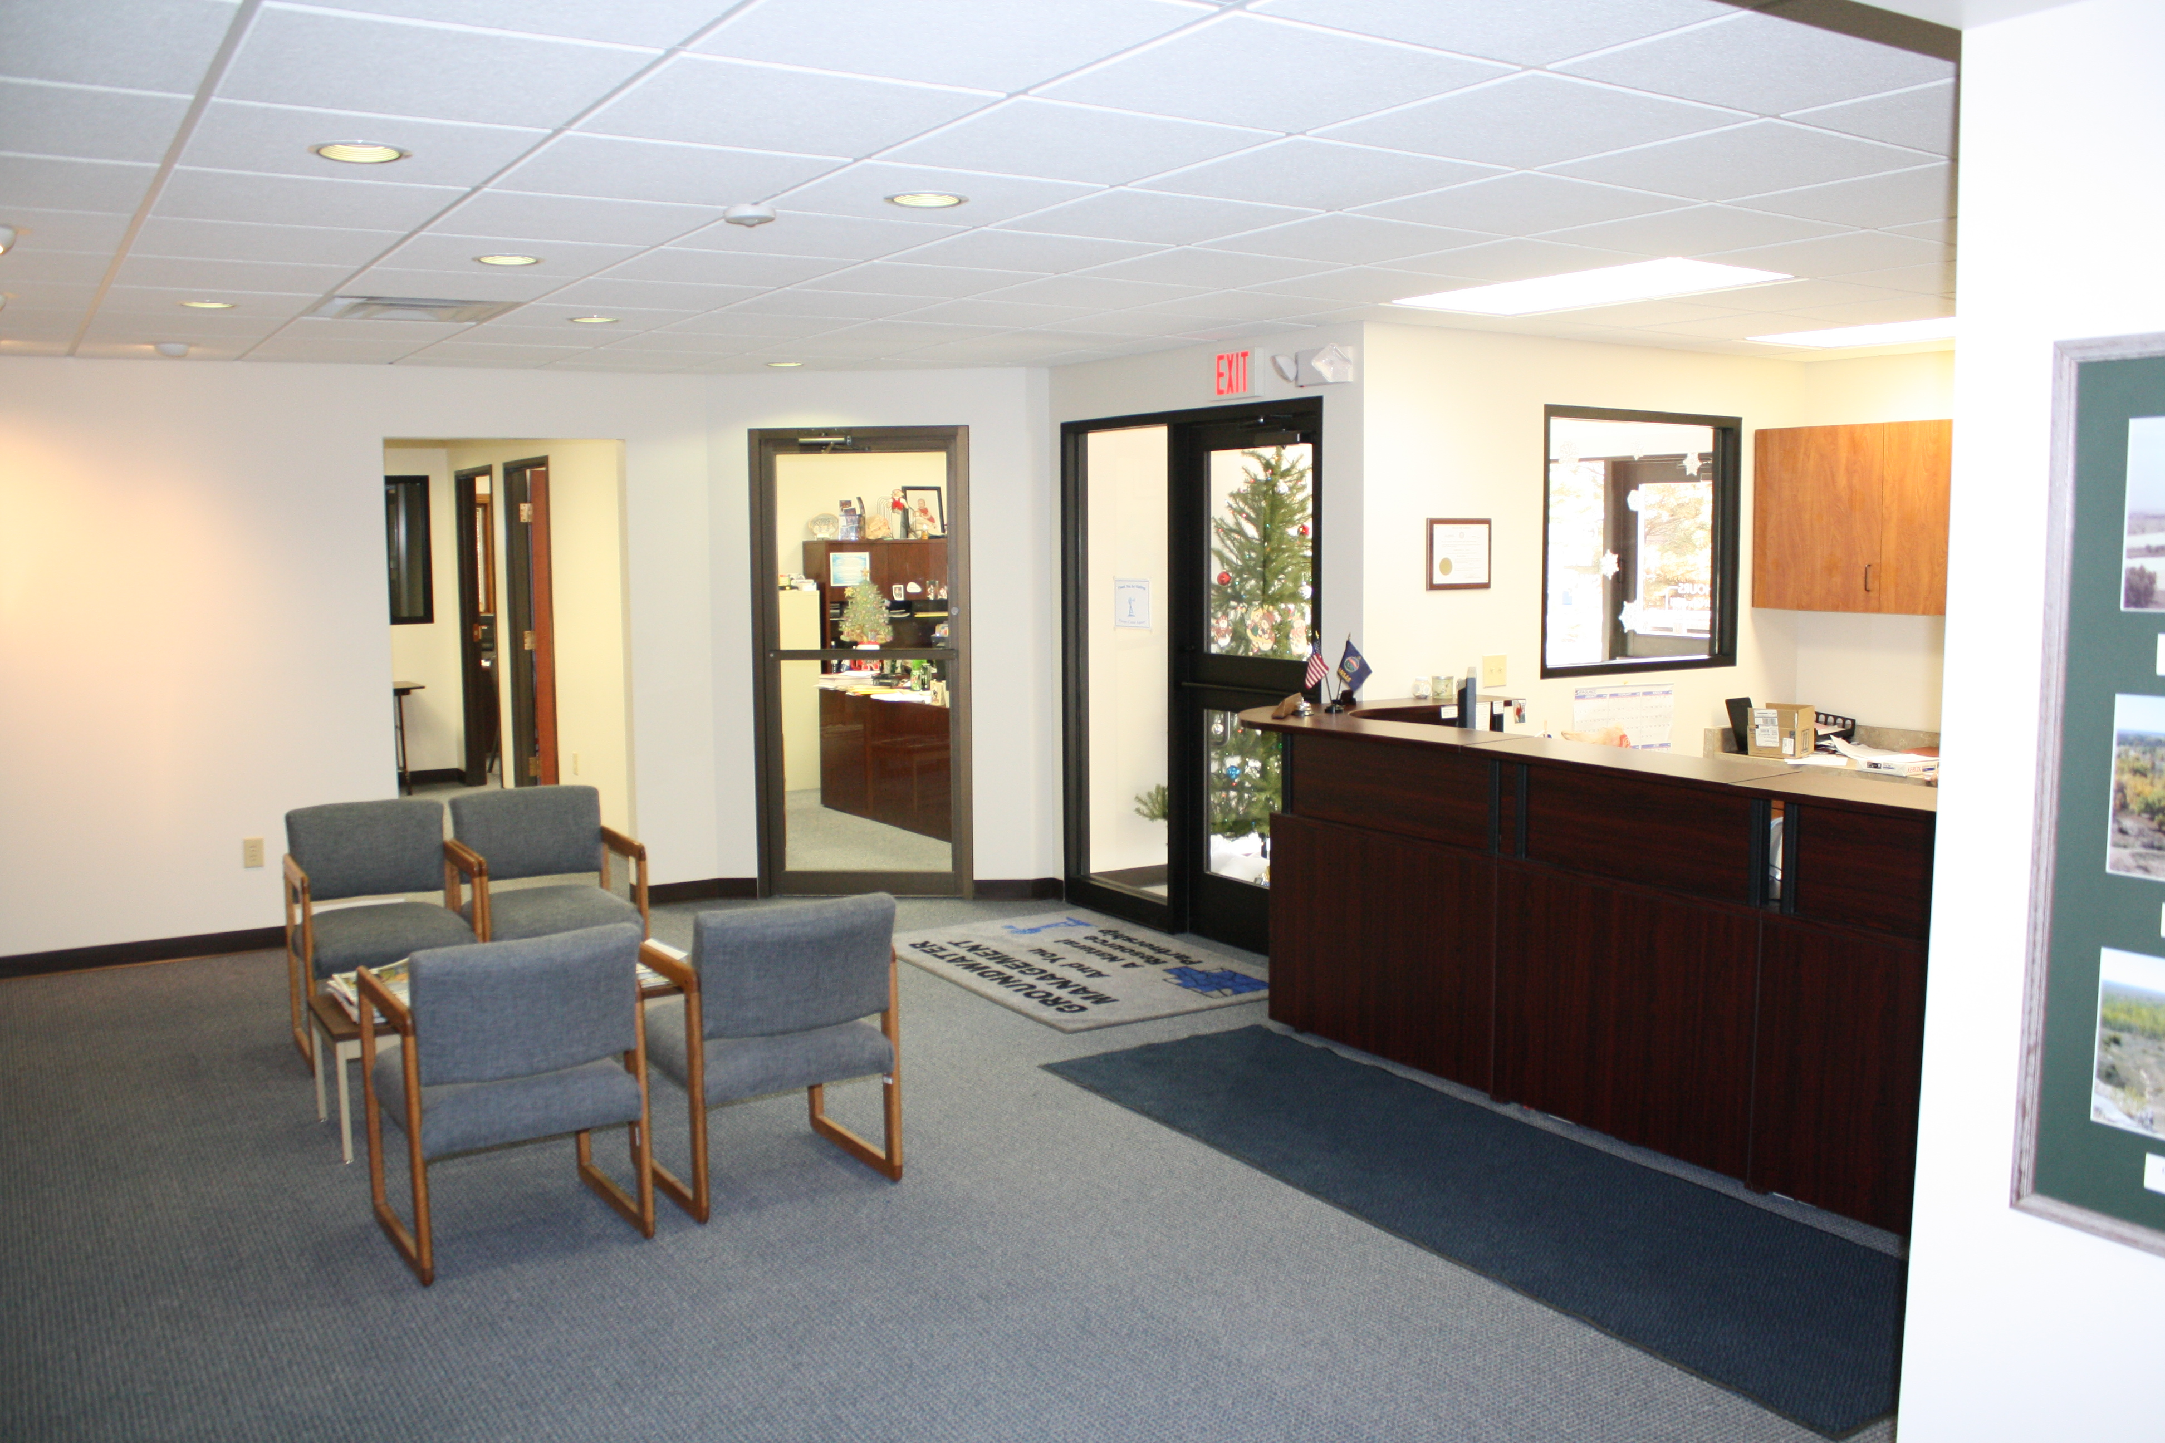
GMD3 Staff
11 years
Brandi Sneath, 9 years
Office Administration
  Receives your call
  Office and member support
  Ledger and records
  Communications
  Web master
  Perfect Audit Co-Manager

Slide 5
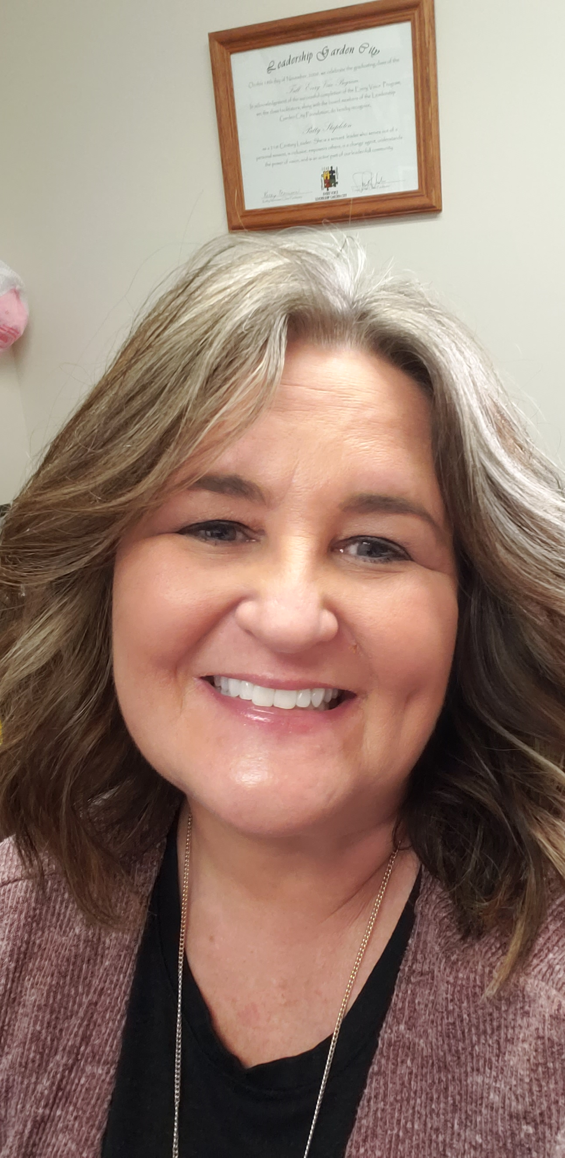
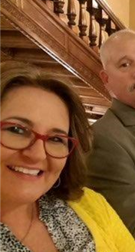
GMD3 Staff
Patty Stapleton, 16 yrs.
Office & Event manager
  Office operations
  Board and advisory groups
  Assessments
  Banking and Insurance
  Communications
  Perfect Audit Co-Manager

Slide 6
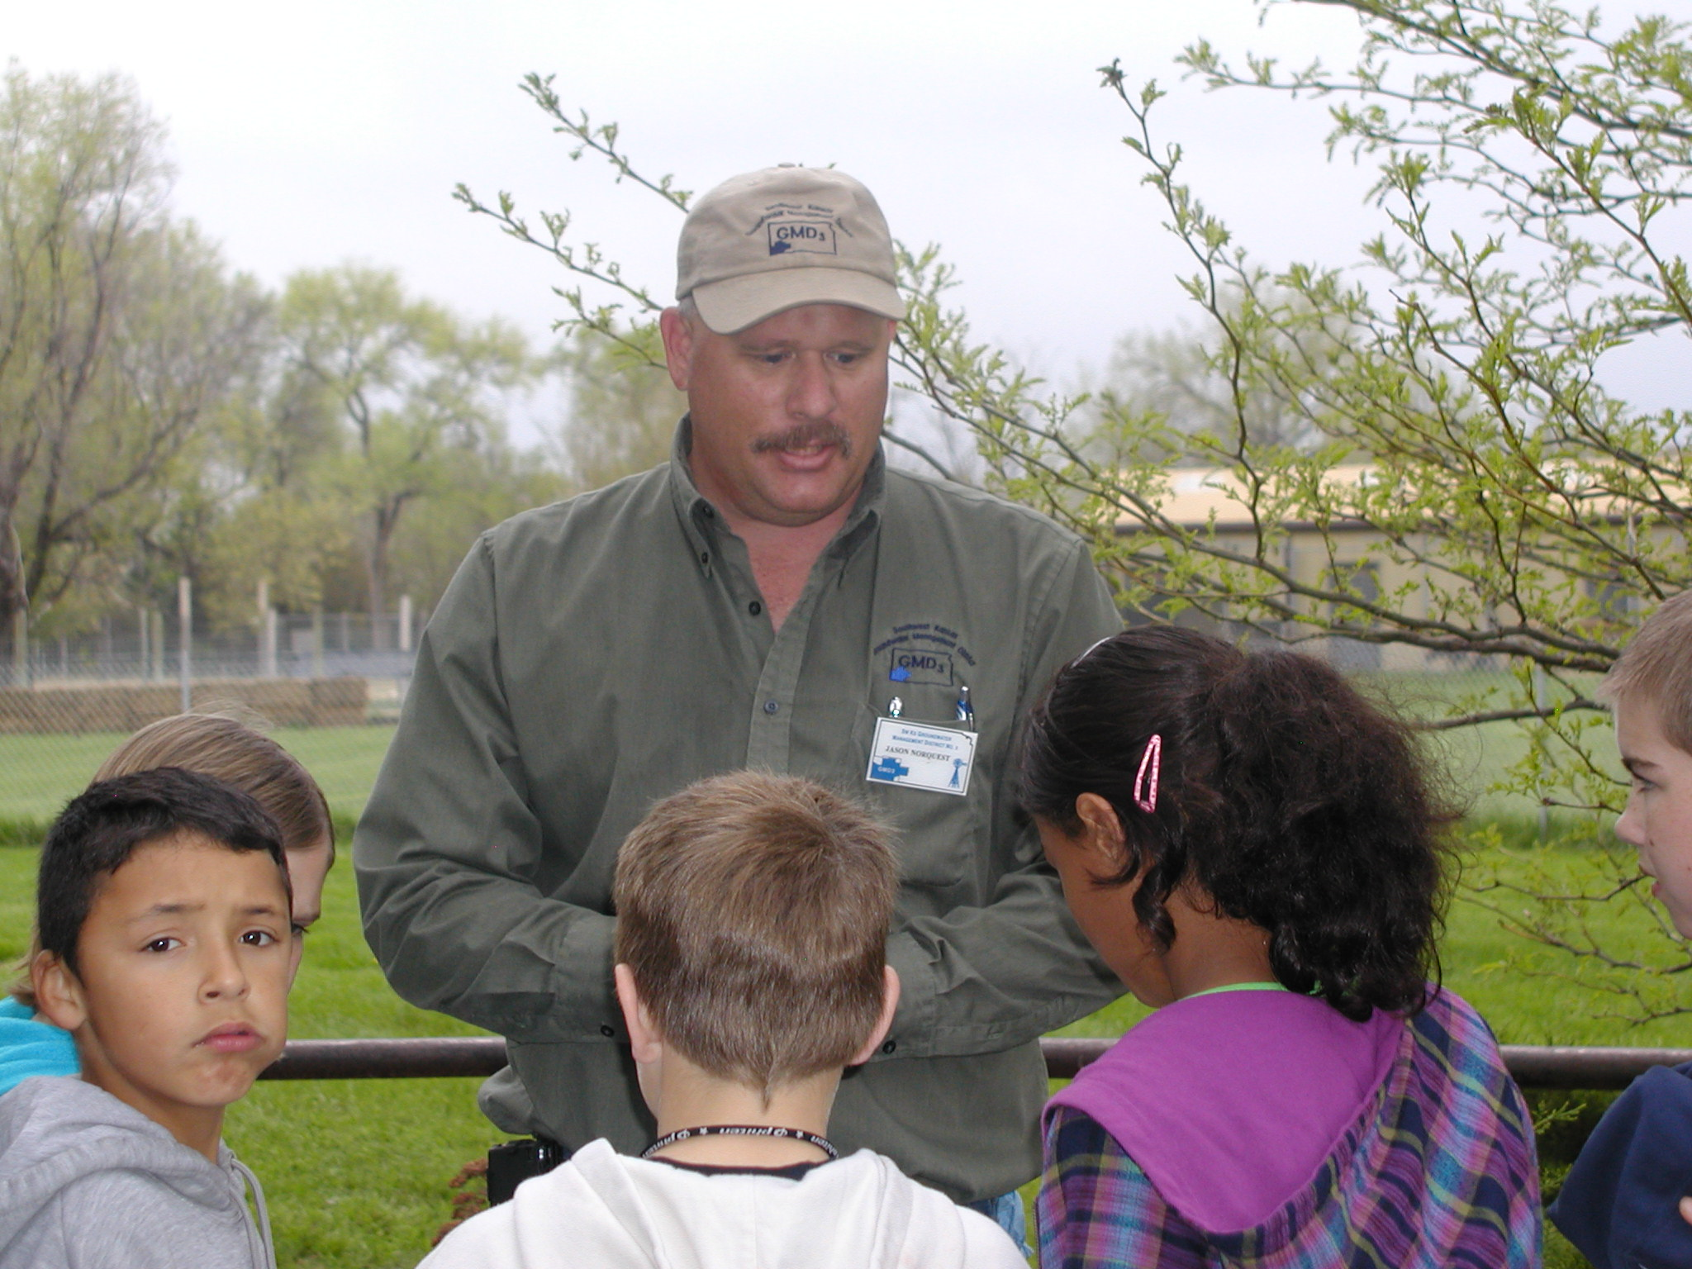
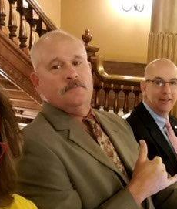
GMD3 Staff
Jason Norquest, 25 yrs.
Assistant manager
  Ag Business
  Water rights
  State applications and reports
  Policy development
  Classroom instruction
  Techno-geek

Slide 7

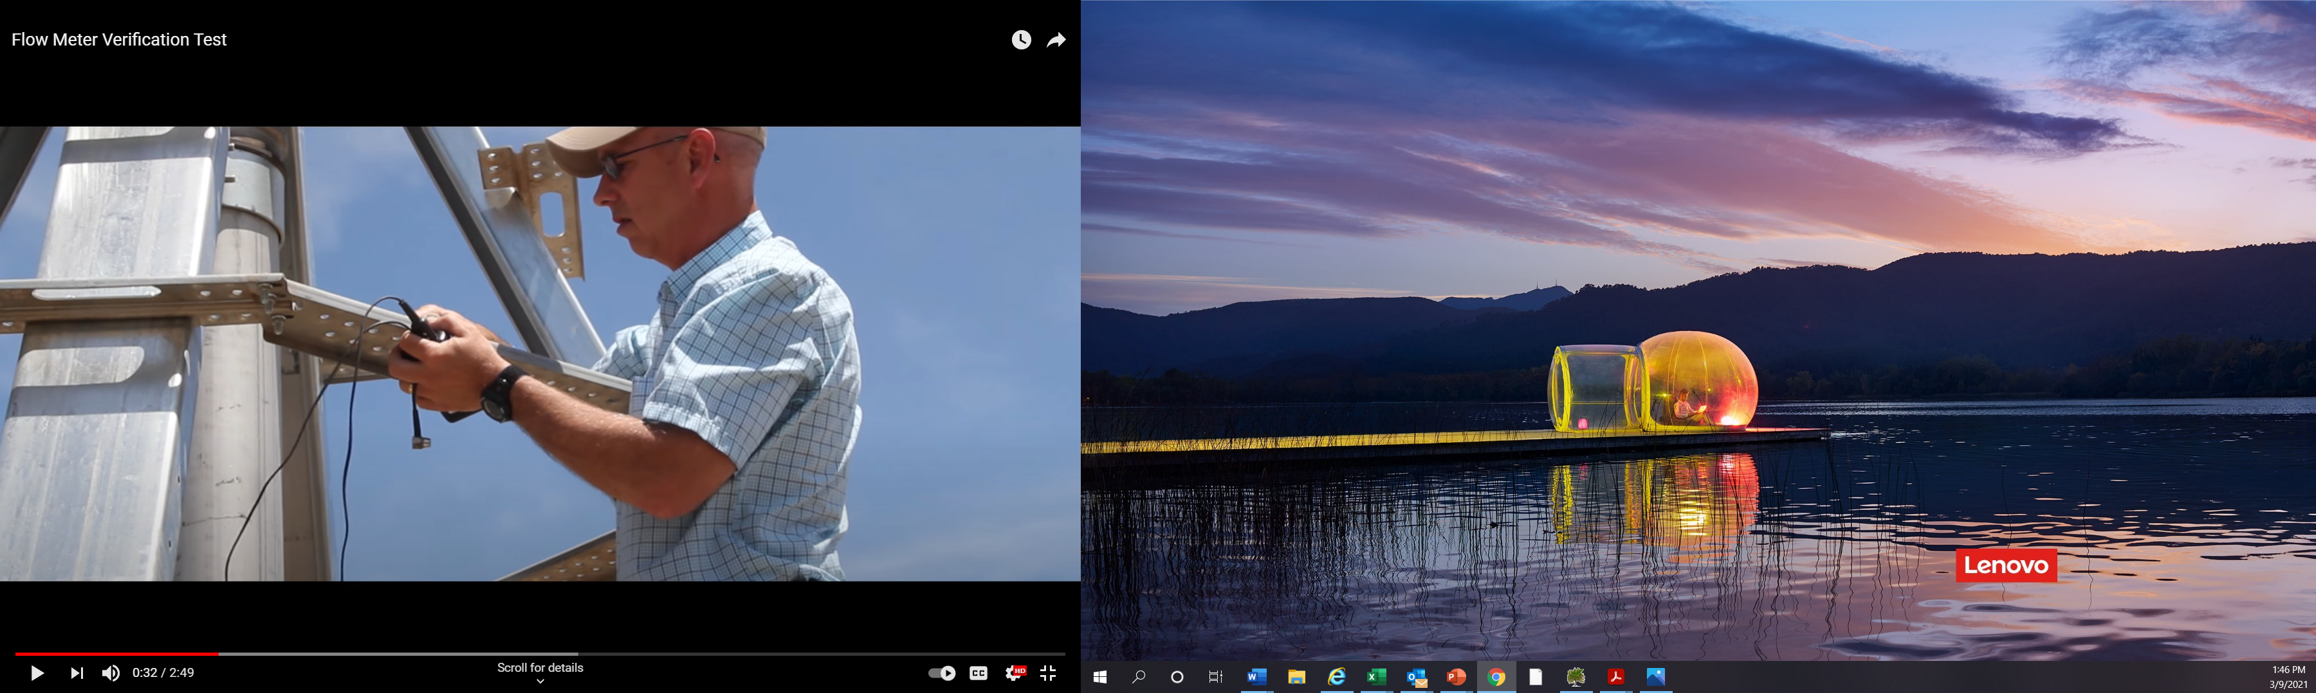
GMD3 Staff
Chris Law, 16 years
Director, Field Services
  Animal Science & Industry
  Local government
  Flowmeters and verification tests
  Water rights assistance
  Conservation field compliance
  Manage summer staff inspections

Slide 8
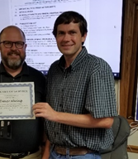
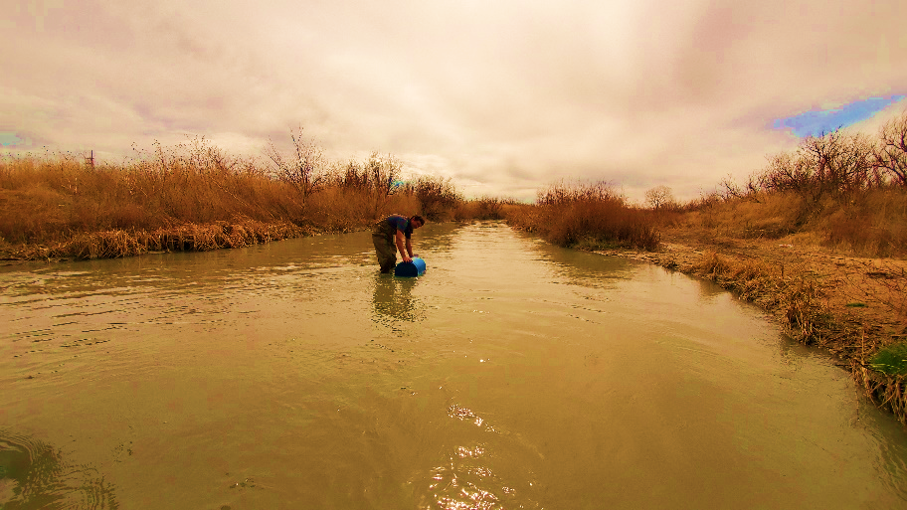
GMD3 Staff
Trevor Ahring, PE, 14 yrs.
Special Projects
  Water Conservation
  Grant writing and reports
  Well & aquifer calculations
  Water rights assistance
  Water structures review
  Water quality sampling

Slide 9
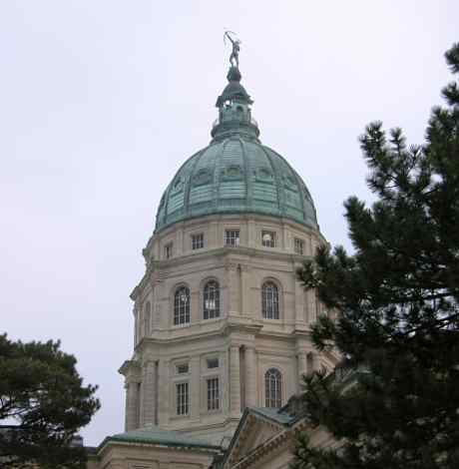
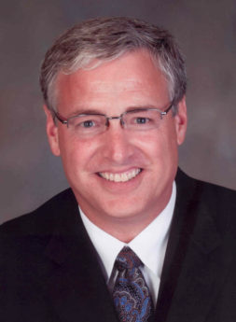
GMD3 Staff
Mark Rude, LG 18 yrs.
Executive Director
  Board engagement
  Management Program
  Member engagement
  Water policy development
  Programs and Partnerships
  Outreach and advocacy
  Staff growth

Slide 10

Goal #1 – Completed update of the Management Program
Notes:
This official Management Program document discusses relationships and interdependent roles of the Groundwater Management District No. 3 (GMD3) with its water management partners to conserve and develop the water resources of the state and achieve the mission of the governing body.

Slide 11






Management Program Activities
Water Rights Advise and Assistance
Water Conservation
Water Quality Protection
Models and Research
Ark River Management
Outreach and Advocacy
Notes:
For GMD3, there are 6 Management Program activity areas that will be reviewed at our annual meeting in March.

Slide 13
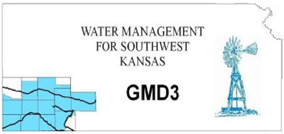
Problem: Depleting groundwater supply.
Thinking:
  Respect water rights
  Lower rate of consumption
  Promote efficient use and reuse
  Seek other sources of supply

Slide 14
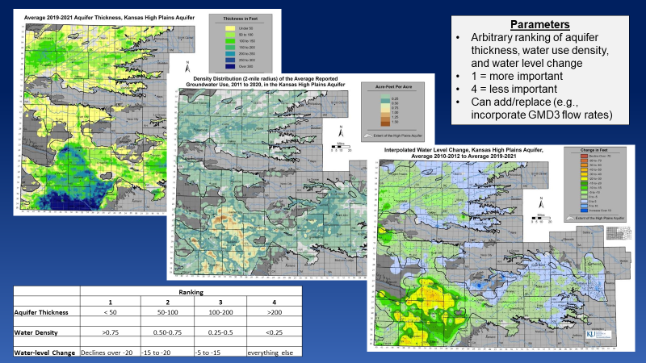
Kansas is data strong
The best information for the best decisions.
The High Plains Aquifer – which includes the Ogallala – supplies between 70-80% of the water used by Kansans each day.
Notes:
Commonly adopted data sources and models elevate public water awareness in support of wise water management decisions.

Slide 15

Water Conservation, pgs. 7-8
Two types :
Type (1) Use efficiency
  - the amount of valued output per unit of water consumed.
  Type (2) Maintaining aquifer storage
  - demand management
  - replenish storage.
  Should be no penalty for water conservation.
Wise use. Conservation is not so much defeating consumption as using water wisely.

Slide 16

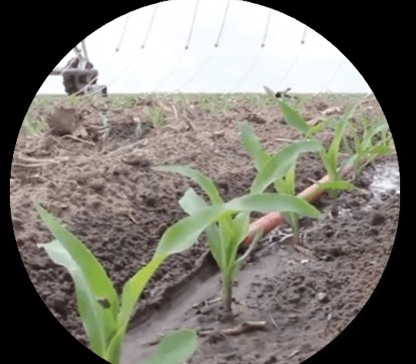

Conservation activities include:
Water Flowmeter assistance.
MOUs and user agreements.
Approve state required Conservation Plans.
Advise member water groups – RAC’s, NRCS Work groups, companies, etc.
Inform and develop water conservation
  Approve required conservation plans
  Flex account assistance
  WCA plan comments
  I-CARE reports to irrigators
  GIVE program tools
    IRS Code gifted easements
    Farm Bill conservation title reform
      From Rentals to market-based purchase
Voluntary online conservation reporting.
Aquifer recharge improvements.
Soil water loss inhibitor study support.
Master Irrigator advisory committee.

Slide 17
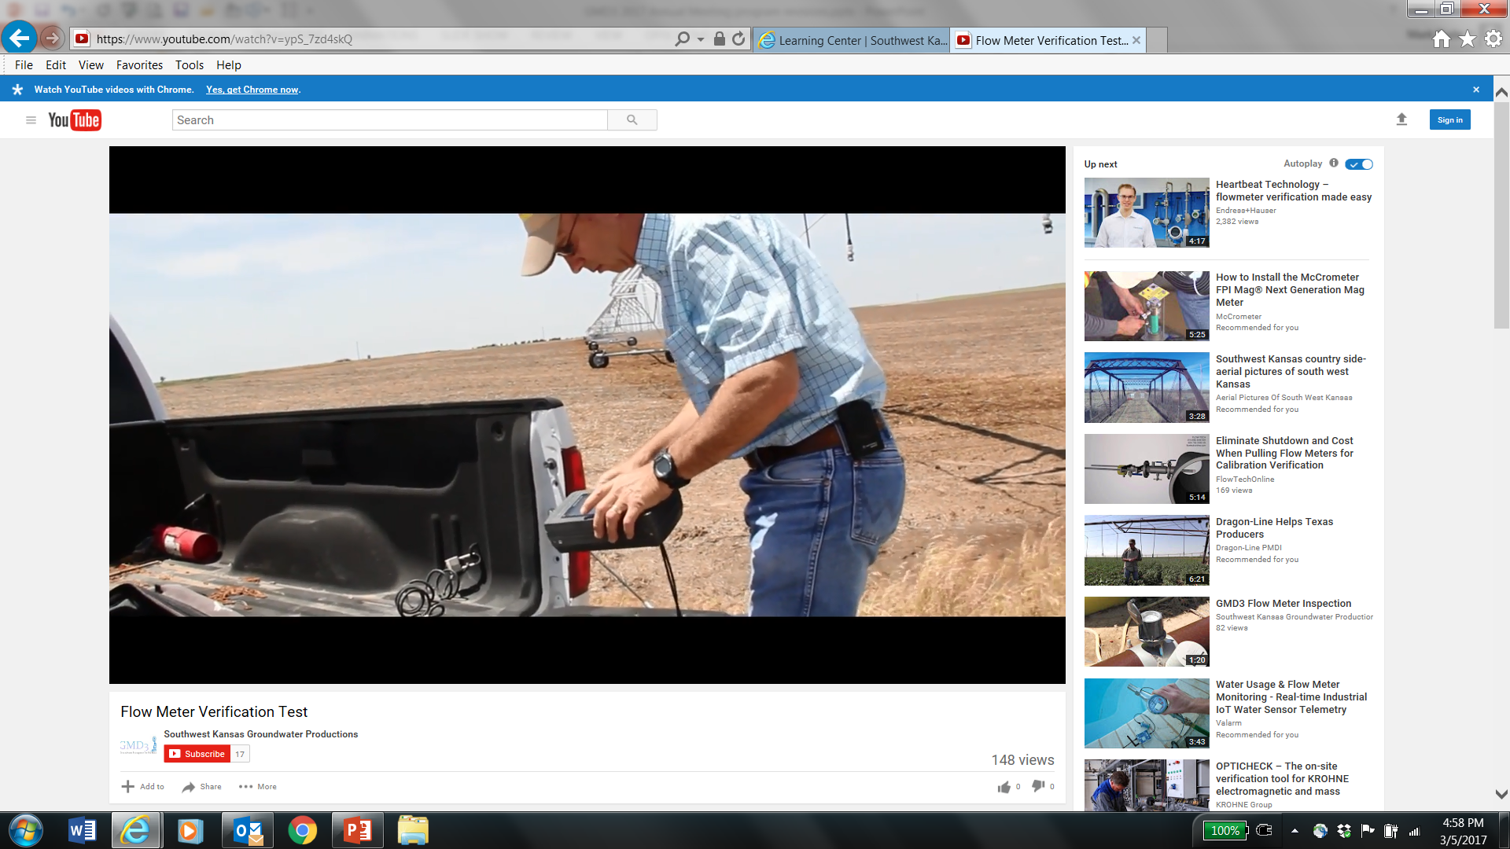
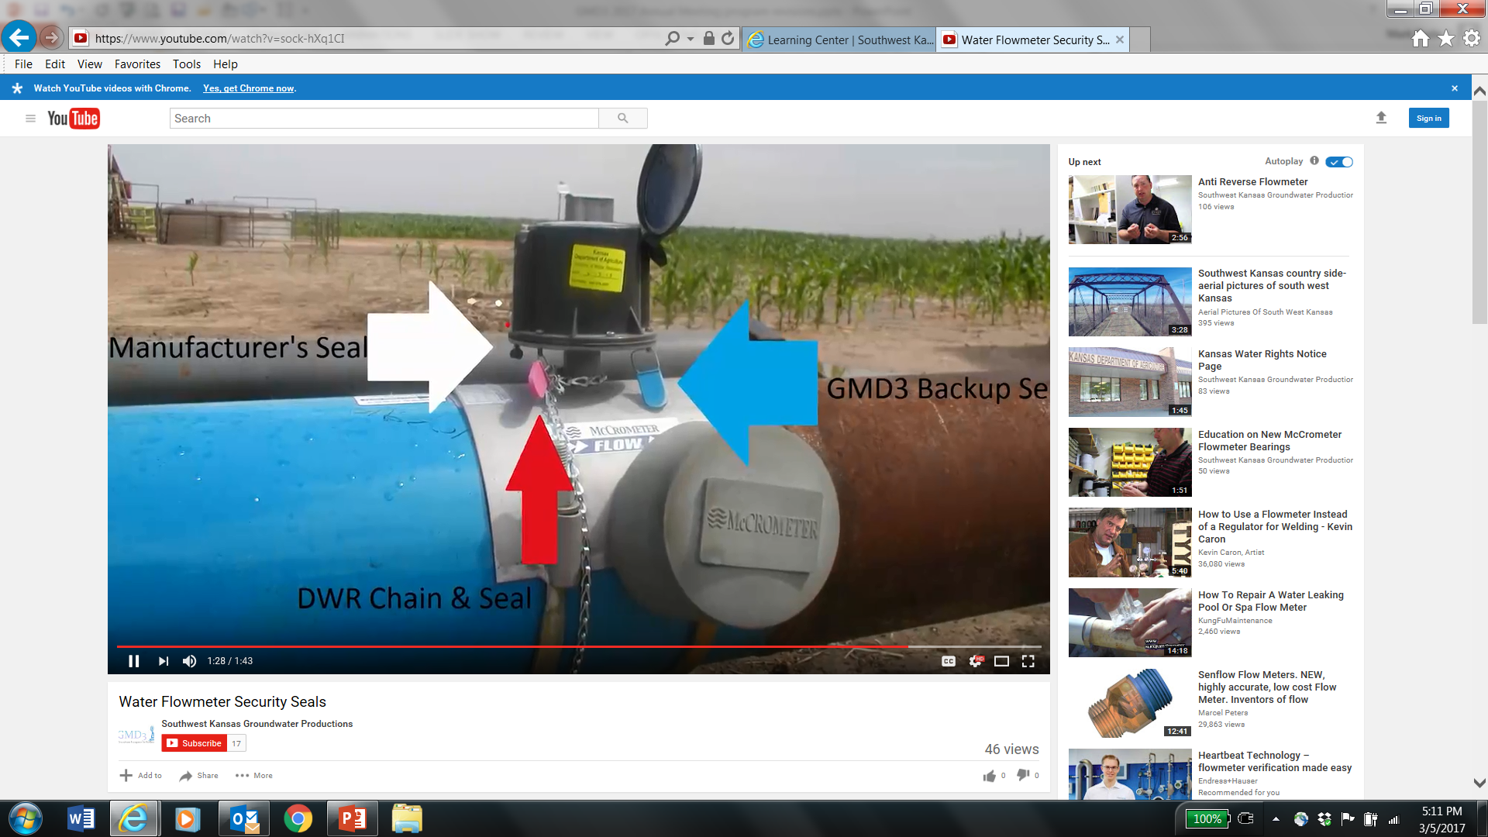
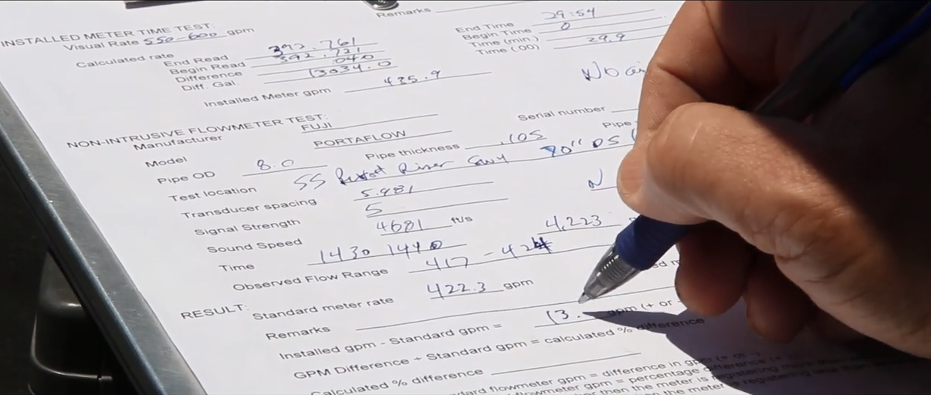
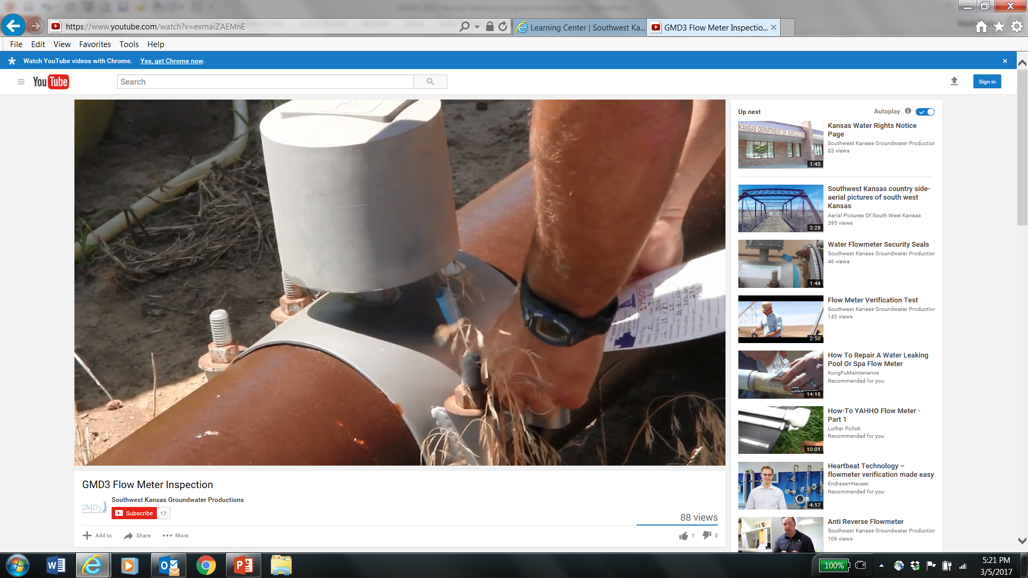
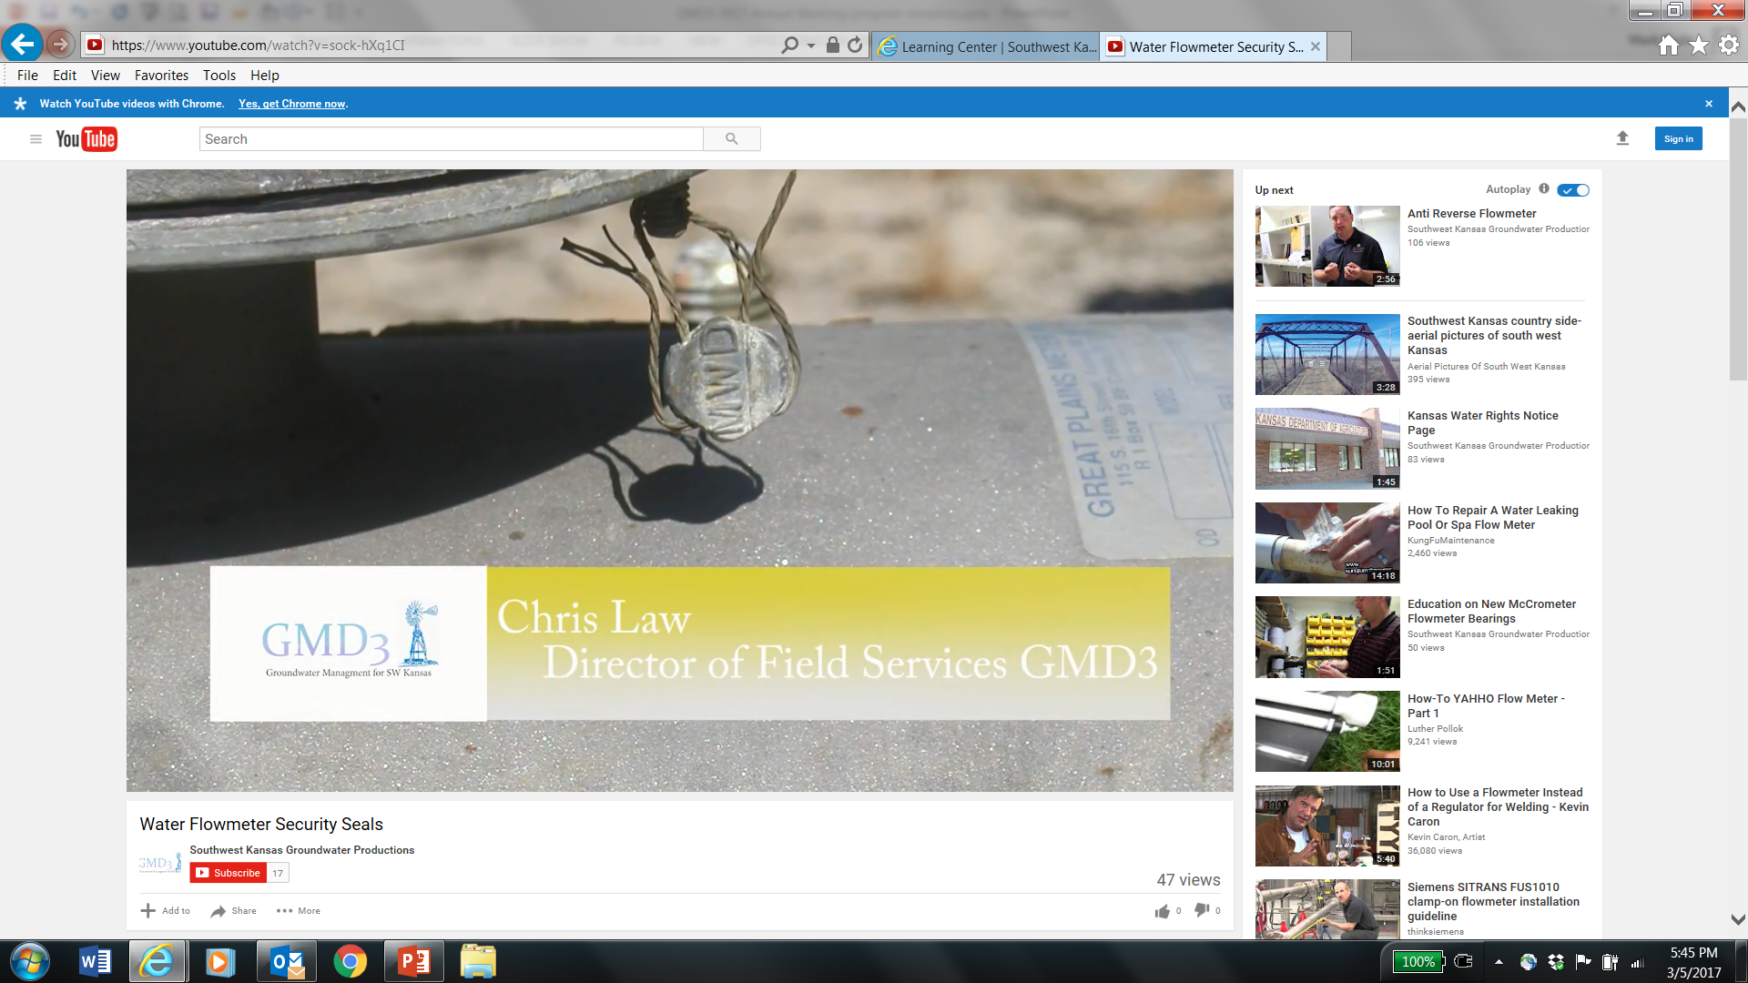
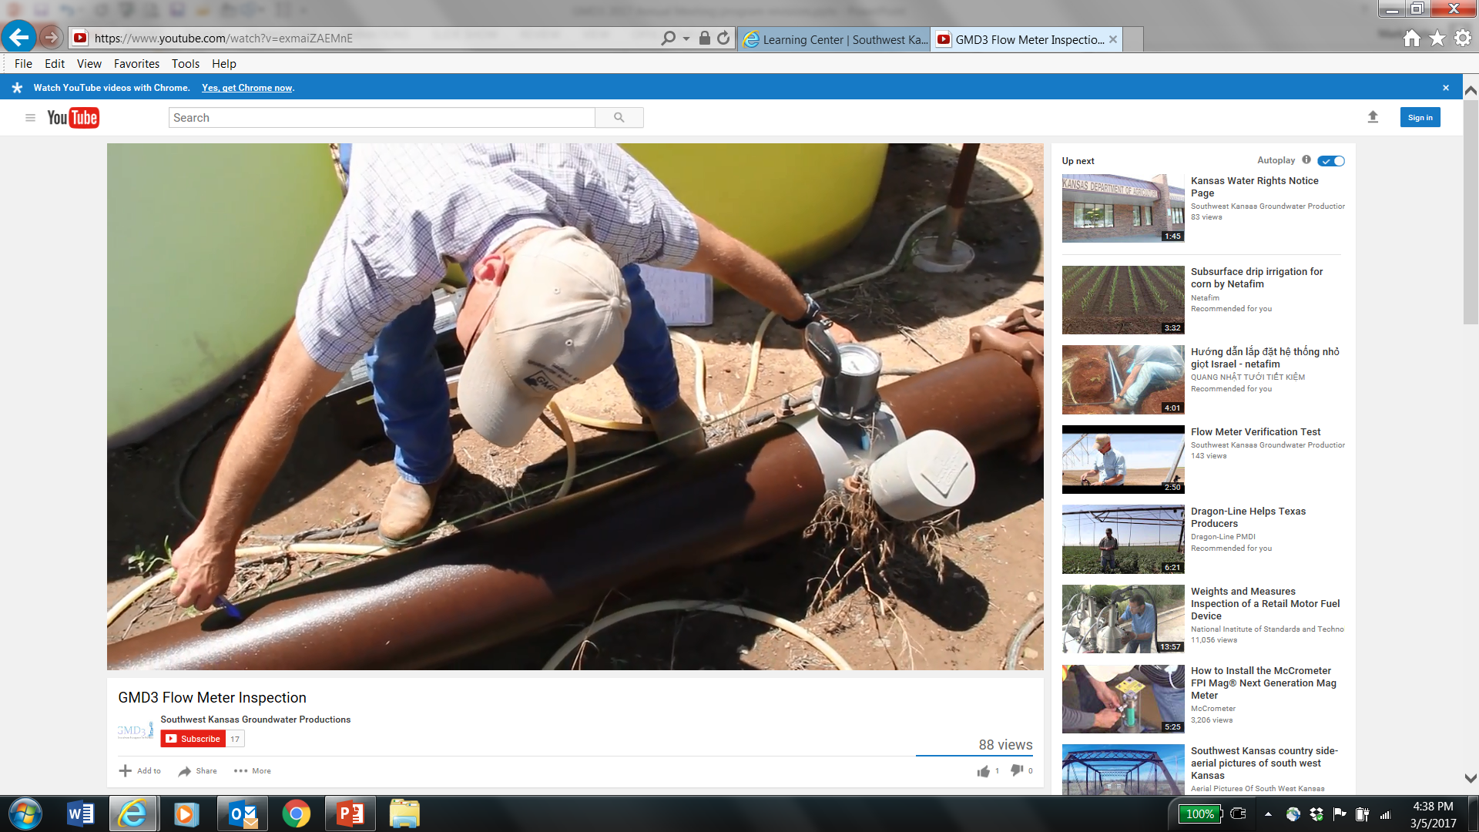

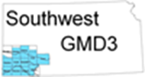
Monitoring Services & Agreements
Flow tests, seals, tags and field data
Check out:
SW Kansas Groundwater Productions

Slide 18
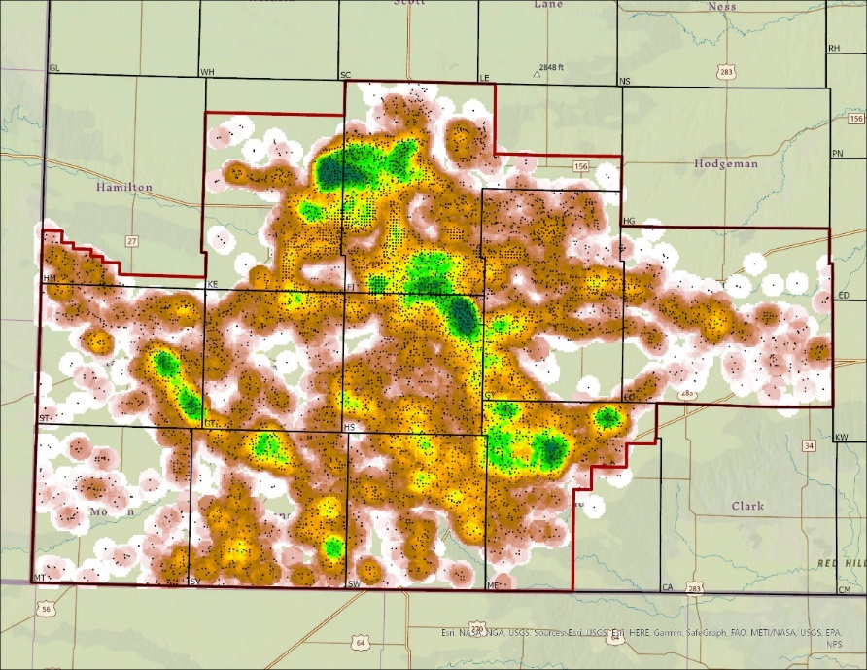
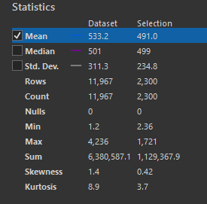
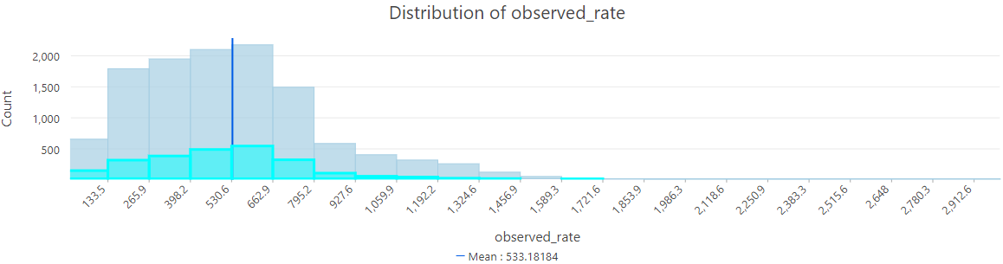

Observed Pumping Rates

Slide 19

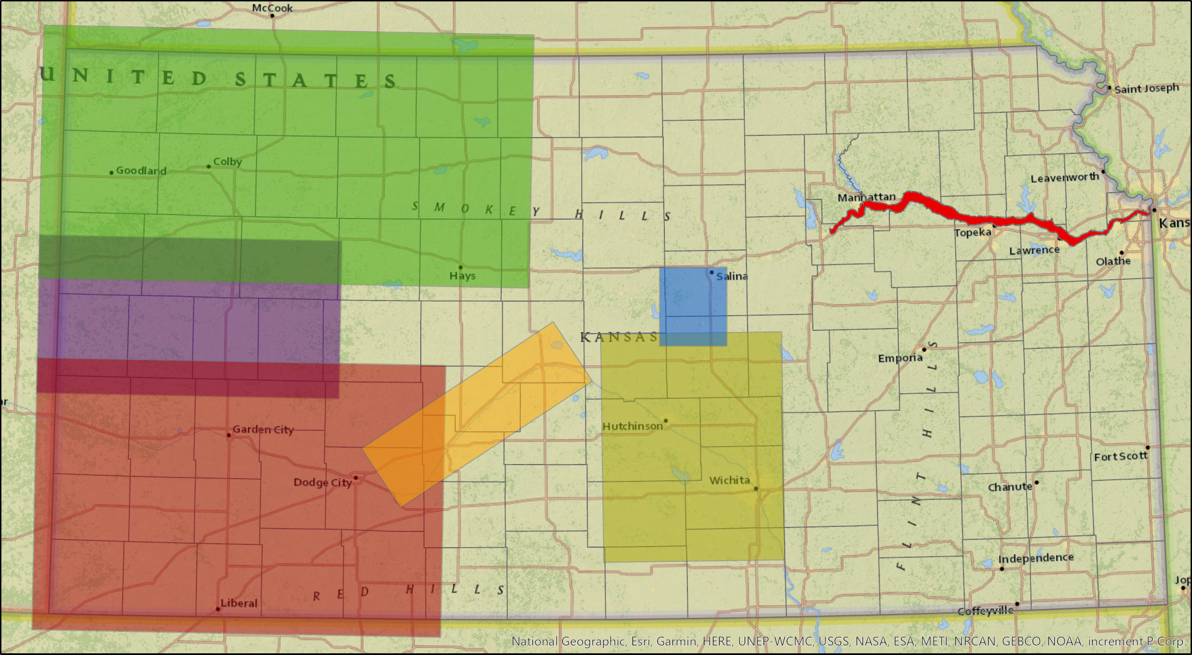

Models, Research & Development
Goal #7 - Update the GMD3 Model with KGS to include a GUI tool.

Slide 20

Targeting water conservation
Corrective controls are Type (2) water conservation that reduce aquifer depletion.
Can be voluntary, compensated or imposed without compensation

Slide 21
Legislature - HB 2279
Amends the GMD Act to require GMDs to submit annual reports to the Legislature, and
Priority areas for conservation and stabilization action plans submitted to Chief Engineer for approval
Or else…

Slide 24
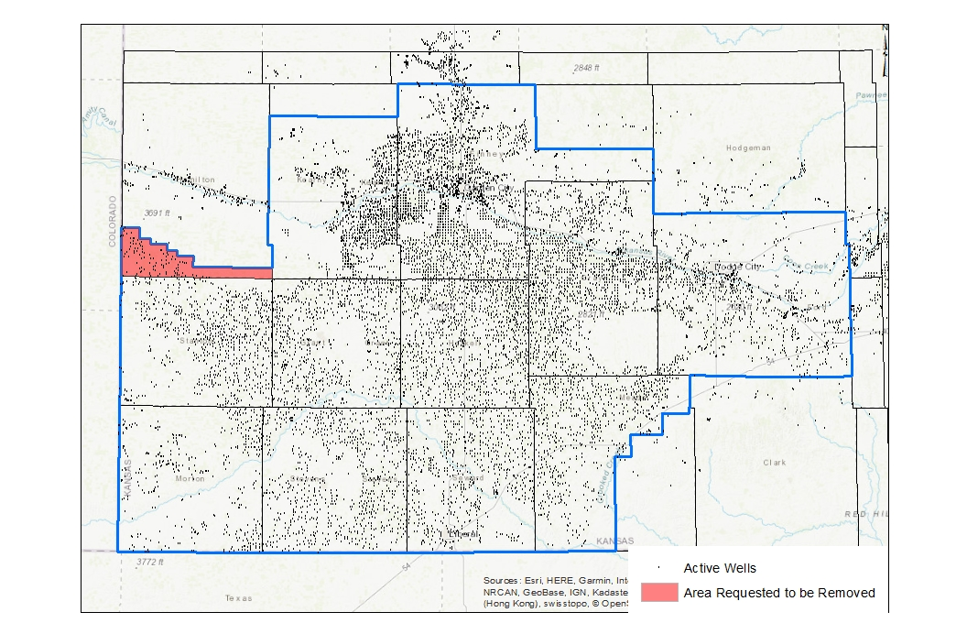

Slide 26
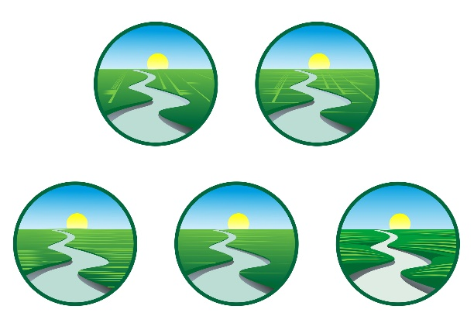
Arkansas River Management, pg. 9
Thinking
Western Water Conservation Projects Fund Activity
Water quality sampling and mitigation
Better distribute surface supply
Form a Watershed Group for project funding

Slide 27
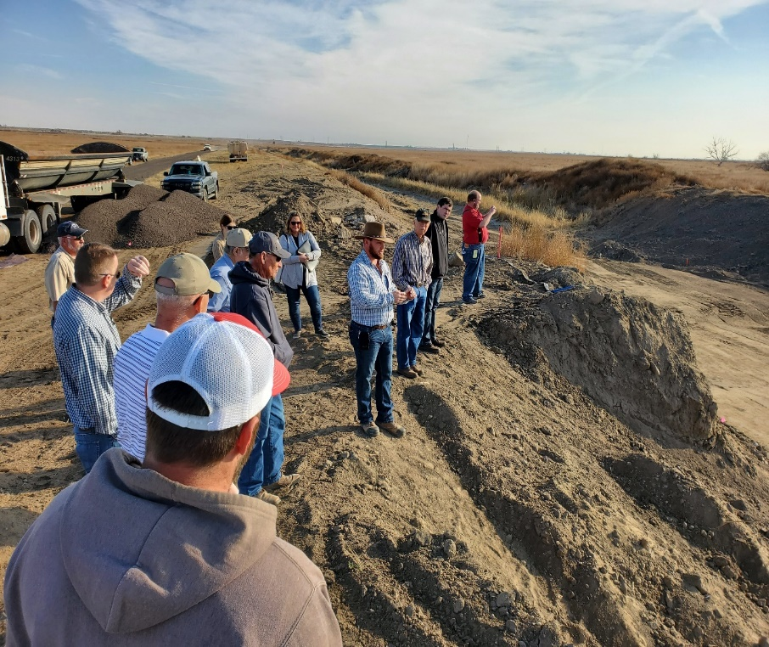

Slide 30



Federal affairs and conferencing with Districts in other states
GMDA - a NWRA National Groundwater Caucus
Kansas Water Congress is the Kansas member of NWRA

Slide 31
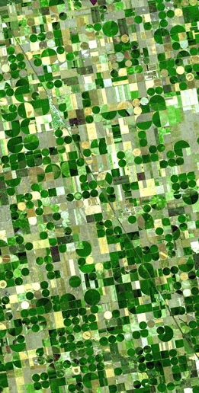
Land Parcels in the District
GMD3 Funding
Over 40 acres = 29,347
Owners live in Kansas = 23,416
In District = 19,590
Out of District = 3,826
Live outside Kansas = 5,931
Member Landowners – $0.05/ac.
Total parcels (including under 40ac) = 79,559
Notes:
20% of parcels have out of state ownership.

Slide 32
GMD3 Funding
Notes:
Water users have invested and developed groundwater rights to use nearly 3.7 million acre-feet annually that is subject to a $0.14 per acre foot user fee, and there are a little over 5 million acres of land that is subject to a nickel per acre land reassessment to fund the District. The Land assessment is proposed to be raised by 2 cents, or a total of 16 cents per acre-foot for next year.

Slide 33
Comparison - Land and Water Charges
GMD NAME |  | LAND |  | WATER
 |  | ASSESSMENT |  | ASSESSMENT
 |  | CHARGE |  | CHARGE
Western KS GMD1 |  | $0.05 |  | $0.60
Equus Beds GMD2 |  | $0.05 |  | $1.50
Southwest KS GMD3 |  | $0.05 |  | $0.16
Northwest KS GMD4 |  | $0.05 |  | $0.349
Big Bend GMD 5 |  | $0.05 |  | $2.00
USER FEE
Per AF
GMD3 - User Fee Proposed to stay at $0.16 per acre foot for 2024 budget

Slide 34
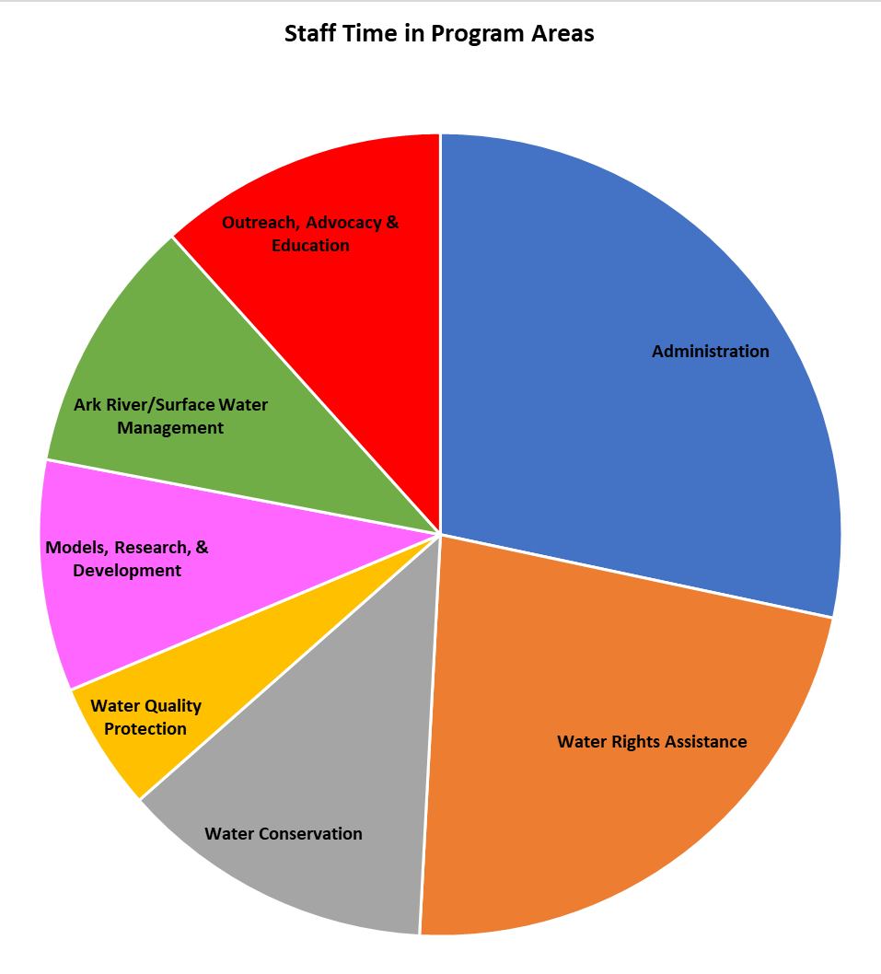


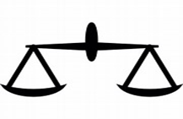

2022 GMD3 Program Activities
Expenditure by Source –
General Fund
6 Full-time Staff in Program Areas
Notes:
A. Administration
General Income/ books/ records/ files/ facilities/ Bills/ Supplies /Board meetings
1. Water Rights Assistance
Calls/ Walk-ins/ Field meetings/ MOUs/ Policy/ Advice
2. Water Conservation
Field work/ Projects/ WCA Plans/ flowmeters/ tests/ CREP/ tech farms/ Partner programs
3. Water Quality Protection
Samples/ Letters/ Water Quality Activity/ Abandoned Wells/ policy
4. Models, Research & Development
Running models/ projects development/ grant management/ COOP with Partners
5. Ark River/ Surface water management
Ditch Companies/ renewable supplies/ compacts/ POCs/ IGUCA/ WWCP Fund/
6. Outreach, Advocacy & Education
Questions/ Groundwater Policy/ legislature/ Partner meetings/ Presentations conferences

Slide 35
GMD3 Mission Statement
Act on a shared commitment to conserve and develop the water supply of the District to grow the social, economic and natural resources well-being for current and future generations in the public interest.
Next up - 2023 Financial Report and 2024 draft budget

Slide 36
EXPLANATION:
UPDATED AND REVISED BYLAWS YEAR 2023
WHY HAVE BYLAWS?
ANSWER: The GMD Act provides very little guidance about governance, beyond basic rules for identifying qualified voters, requiring a governing board and requiring annual meetings to elect board members. In other words, the GMD Act sets the baseline for what structures are required for governance but does not address how the governance structures are to be established and function.

Slide 37
WHY CHANGE THE EXISTING BYLAWS?
ANSWER: To provide clearer guidance, predictable and consistent rules for:
1. Identifying and nominating potential board members;
2. Clarifying who is qualified to serve on the board to represent each of several diverse classes of members;
3. Identifying individuals who may speak for eligible voters that are not human beings;
4. Identifying board member conflicts of interest;
5. The election and duties of officers;
6. The establishment committees of the board and their function;
7. The employment, duties and responsibilities of an executive director; and,
8. Conducting regular, special and emergency meetings.

