Slide 1
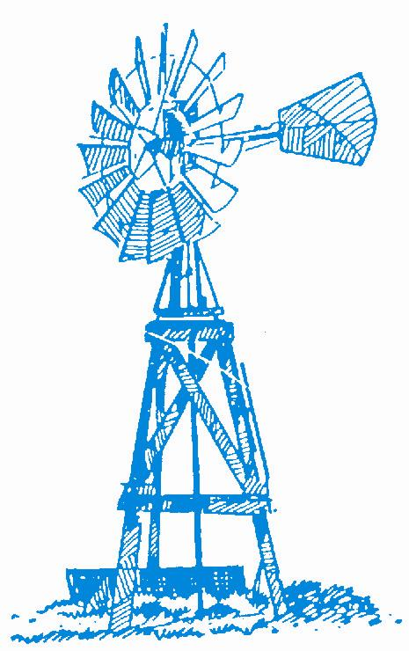

Southwest Kansas Groundwater Management District No.3
GMD3 and You Managing a Limited Resource

Slide 2
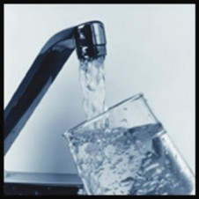
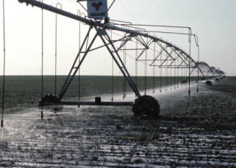

Helping Kansas maintain an adequate water supply for its citizens

Slide 3
Kansas Water Agencies with Water Governance Responsibilities
Kansas Water Office/Water Authority
  - Kansas Water Plan and Surface Water Assurance.
Department of Agriculture : Water Rights & Interstate Compacts
Department of Health and Environment: Clean Water
Groundwater Management Districts (GMDs)
Water Distribution Districts:
  - Rural Water Supply Districts
  - Irrigation Districts
  - Public Wholesale Water Supply Districts (PWWSD)
  A special state agency or public authority (like a PWWSD) is necessary for an Aqueduct project

Slide 5
History of water rights
The Water Appropriation Act passed in 1945 set forth:
“All water within the state of Kansas is hereby dedicated to the use of the people of the state, subject to the control and regulation of the state…”
Kansas is a Prior Appropriation state

Slide 6
Use made of water
Irrigation
Stock water
Municipal
Industrial
Recreation
Domestic
All use must be “beneficial”

Slide 7
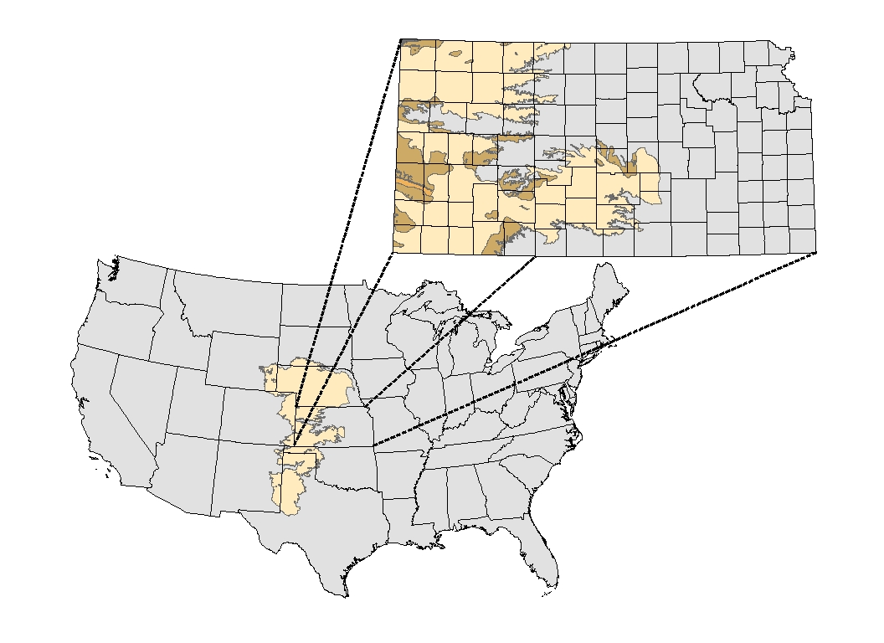
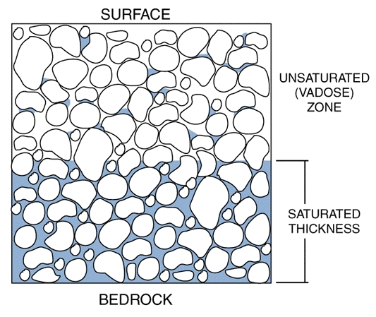
The High Plains Aquifer
Kansas Geological Survey
Notes:
The High Plains Aquifer is one of the largest most accessible ground water system in the entire world. Covers 8 states in the continental United States. The High Plains Aquifer is the single greatest ground-water resource in Kansas.
Often the High Plains Aquifer / Ogallala Aquifer is referenced as an “Underground Reservoir”. This implies a person with the proper scuba equipment and access and go swimming underground. This is hardly the case. Water in an aquifer system is stored in the pore space between geologic layers as shown by the exaggerated illustration.

Slide 8
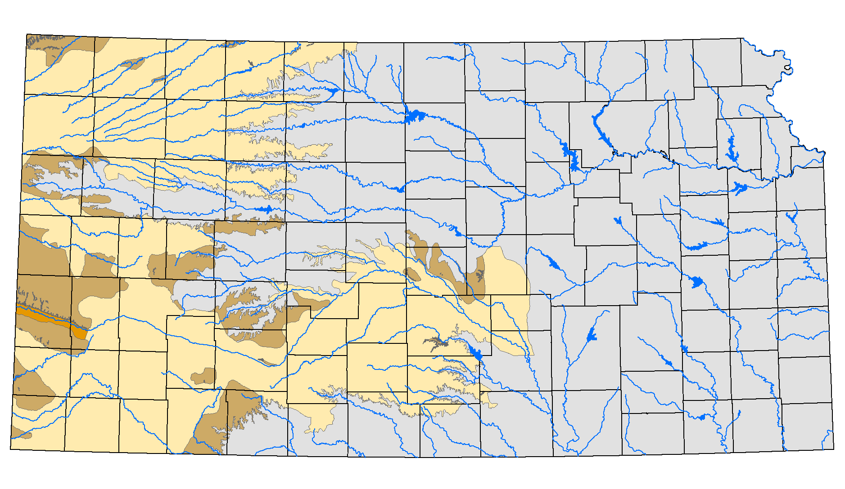
The Kansas High Plains Aquifer
Equus Beds
Ogallala
Great Bend Prairie
Kansas Geological Survey
Notes:
In Kansas, The High Plains Aquifer is made up of several smaller sub-regional aquifer- the Ogallala, Great Bend Prairie and Equus Beds. On a national scale, many people and publications will refer to the HP aquifer as the Ogallala. In Kansas, we make a distinction.
The Great Bend Prairie and Equus Beds aquifers are generally closer to the land surface (not as deep) and are more responsive to recharge. They are managed as sustainable systems. The Ogallala is generally deeper and with less annual precipitation, has little natural recharge. Recharge estimates are in the 0.5 to 1 inch range annually.

Slide 9
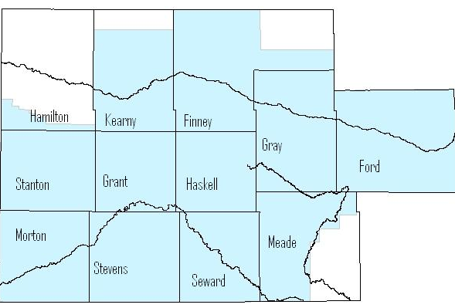
GMD3 Facts…….
District Area………..5,392,000 acres ……………..8425 square miles
Irrigated Acres………….1.5 million………..1/2 of actual Kansas irrigated acres
Non-Domestic Wells……………………approximately 10,600
District Annual Water Use…………………..2,133,000 acre feet
Membership……over 12,900 Eligible Voters

Slide 10
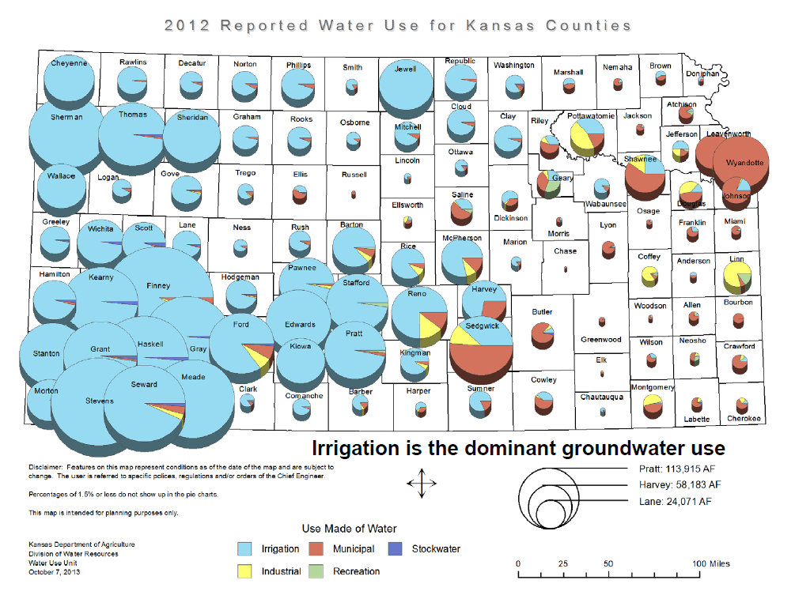
Kansas Water Use
Notes:
Try to get an updated one

Slide 11
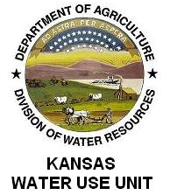
2011 Reported Water Use
 | 2011 Kansas
 | Total Water Diverted
 | by Groundwater Management District
 | and outside GMD
 | All uses; all quantities in acre-feet
 | 2011 Water Use by
 | Groundwater Management District
 | GMD 1 | 216,456 | 4.38%
 | GMD 2 | 246,978 | 5.00%
 | GMD 3 | 2,376,591 | 48.13%
 | GMD 4 | 434,545 | 8.80%
 | GMD 5 | 687,511 | 13.92%
 | OUTSIDE GMD | 975,902 | 19.76%
 | Total | 4,937,983 | 100.00%
Notes:
Maybe get a new one

Slide 12
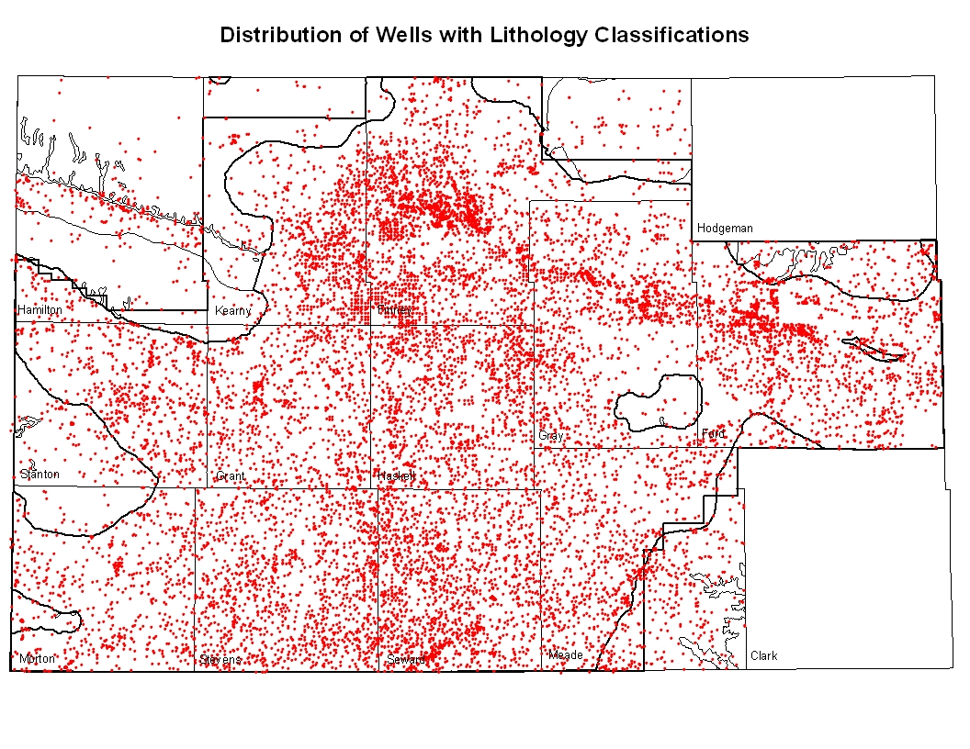

Slide 13
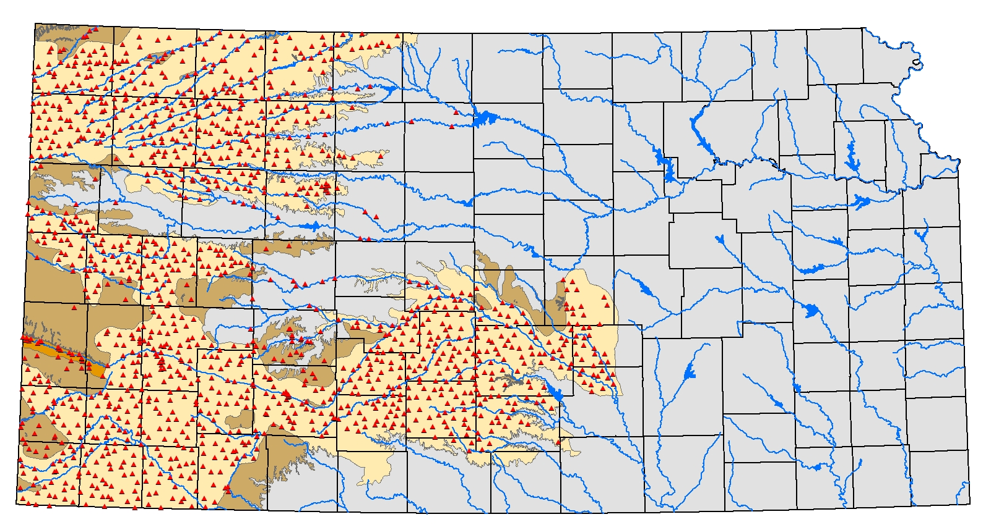
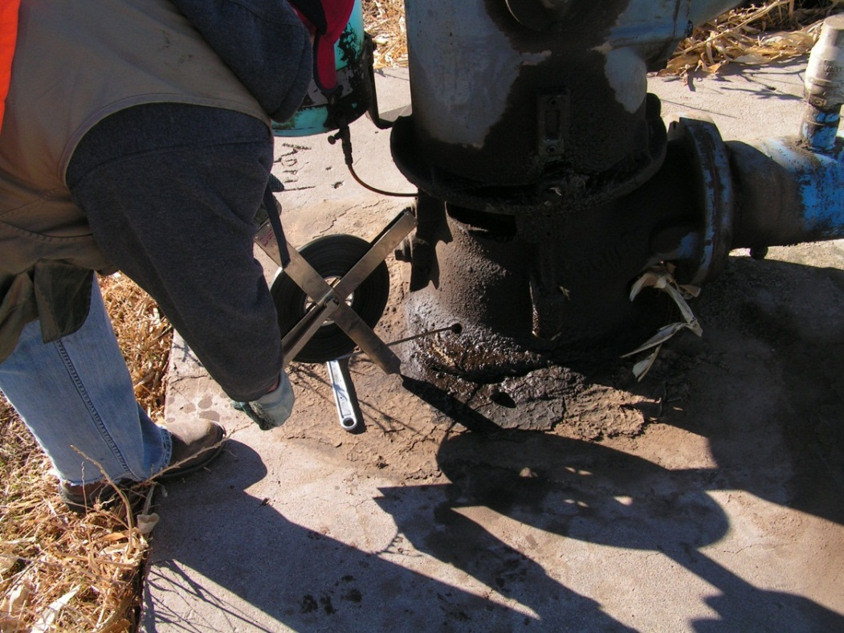
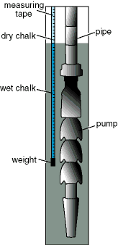
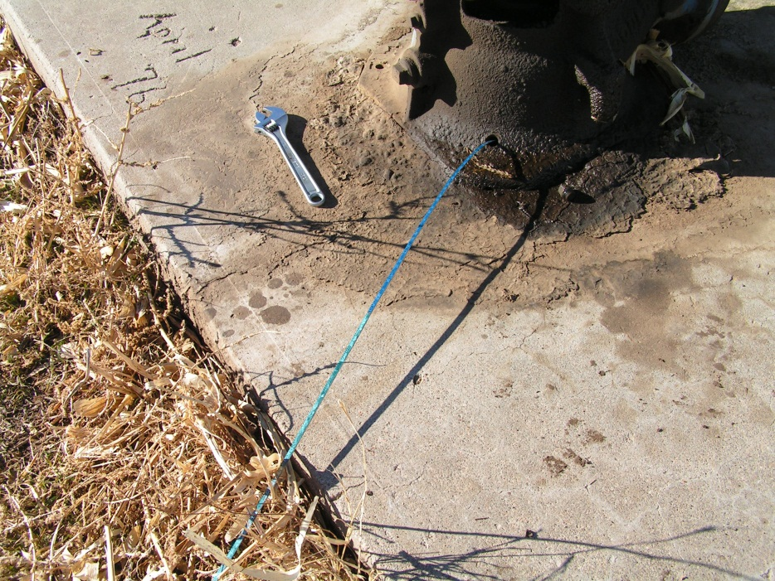
Measuring a well
Kansas Geological Survey
Notes:
The depth-to-water is measured using a steel tape that is incremented to the hundredth of a foot. The bottom of the tape is covered with blue chalk. When the tape is lowered in the well, it crosses the water table and makes a very clear and distinct mark on the chalk covered tape which is called the “cut”. The depth to water can then be calculated based on the distance from the top of the well to the cut.

Slide 14
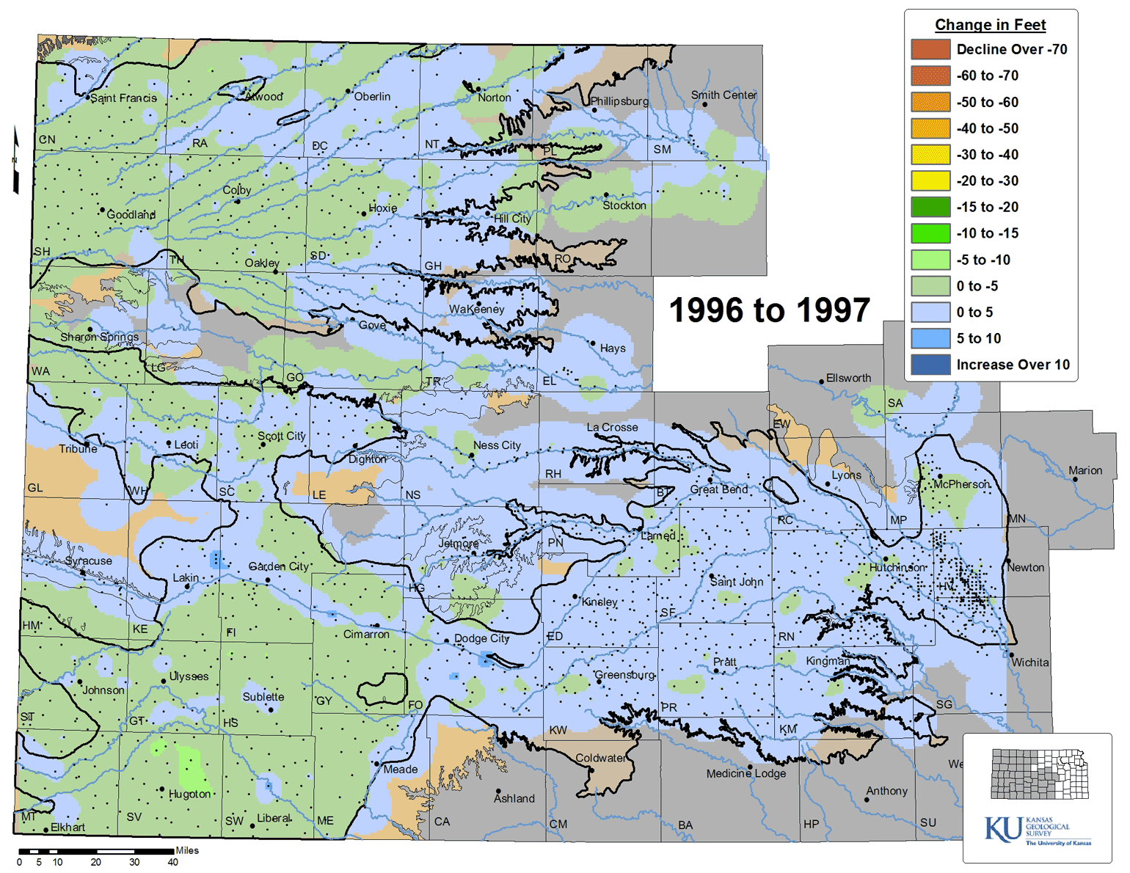
Accumulated Water Level Change, 1996 to 2012
Kansas Geological Survey
Notes:
Animated map showing the accumulated change in the water table. For the Ogallala aquifer, notable decline areas are south of Garden City, south of Ulysses, south west Wallace County, west of Goodland and east of Colby. These also correspond to areas of reported ground water use. Keep in mind this map is showing changes at all monitoring wells, regardless of what aquifer they are screened in. There are some Dakota wells and other older sediments that are separate from the High Plains Aquifer.

Slide 15
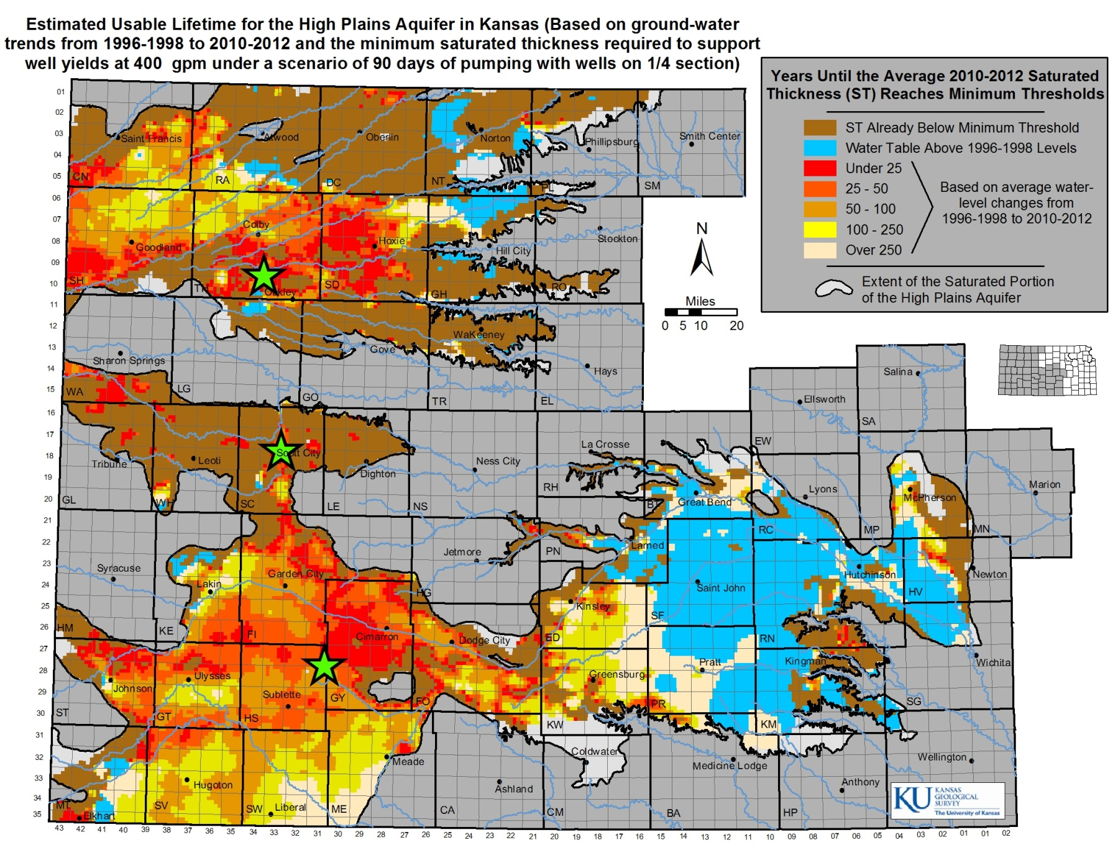
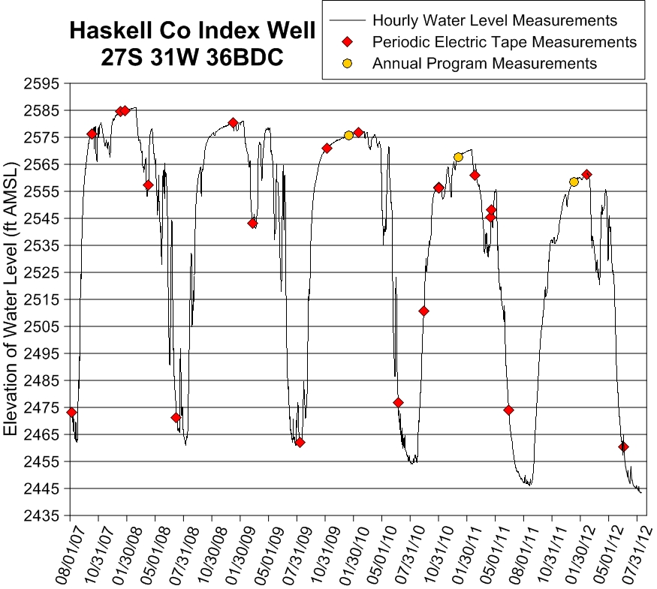
Static Versus Pumping Water Levels- Haskell Co Index Well
Kansas Geological Survey
Notes:
The Haskell County Index Well shows a dramatic difference in the static water level and the pumping water level. When wide-spread pumping occurs, the water level in this observation well drops over 100 feet changing the winter/static saturated thickness of ~160 ft to the pumping saturated thickness less than 40 ft..

Slide 16

Estimated Usable Lifetime- 400 gpm Well Yields Threshold
Kansas Geological Survey
Notes:
This map is an estimated projection (NOT A PREDICTION) of how many years until the HP aquifer reaches a point where wells requiring 400 gpm extraction yields will begin to be impaired if ground-water level trends from 1999 to 2009 repeat continuously and unchanged into the future. This methodology is only suitable to the Ogallala portion of the HP aquifer because of its very small annual recharge levels. South-central Kansas does have local issues of ground-water declines but given higher precipitation and recharge levels, this area of the state has a much greater potential to recover.

Slide 17
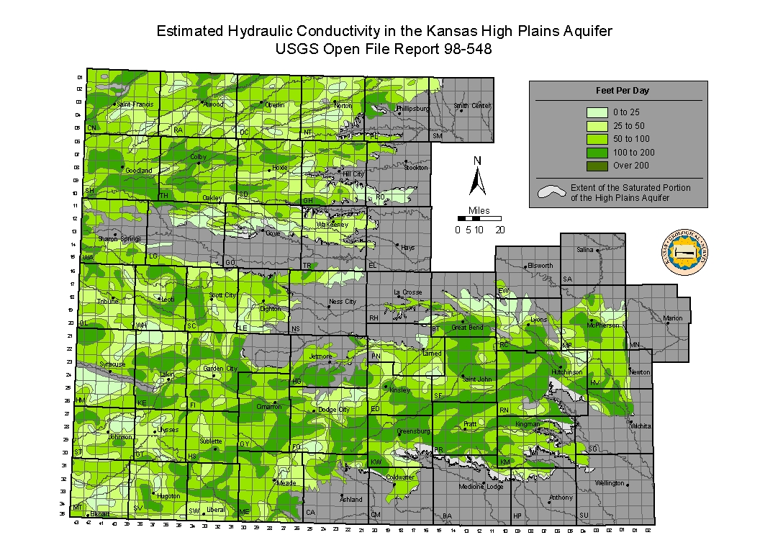
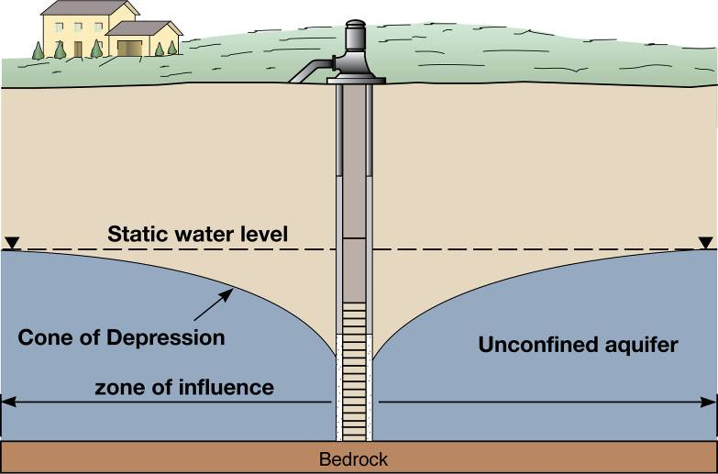
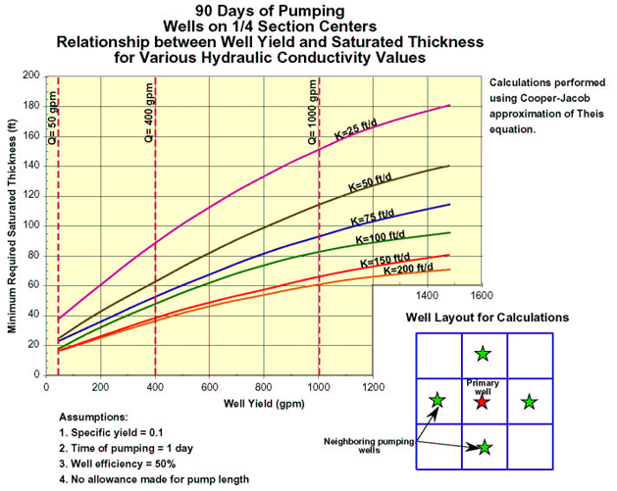
Refining the Saturated Thickness Threshold
Kansas Geological Survey
Notes:
When a ground water well begins to pump water, the water table forms what is called a “Cone of Depression” where the water table will drop dramatically around the wells and to lesser depths are you move away from the well. Eventually the cone becomes stable. The exact shape of the cone is dependent upon many things, one of which is the hydraulic conductivity of the aquifer. The hydraulic conductivity, or K value, is measured in terms of volume (cubic feet per day) and is an indicator of how readily water flows through the aquifer. In generally, the higher the K value, the lesser the depth of the cone of depression and vise versa.
The depth of the cone of depression and its relationship to hydraulic conductivity provides a saturated thickness threshold for the estimated usable lifetime. Using standard ground water equations and modeling, the KGS developed a graph showing the minimum saturated thickness needed to support various well yields given the hydraulic conductivity in an area. The 400 gpm yield was used since this is roughly the minimum yield needed to operate a center pivot irrigation system. Based the graph, the minimum saturated thickness per hydraulic conductivity indicate the original 30 foot saturated thickness threshold may be conservative.

Slide 18
Practical Saturated Thickness (PST)
Definition: The saturated highly permeable portion of a heterogeneous aquifer that yields water to pumping wells at significant rates.
Practical
Saturated
Thickness
Well
Land Surface
Saturated
Thickness
Water Table
Bedrock
Silt/clay

Slide 19
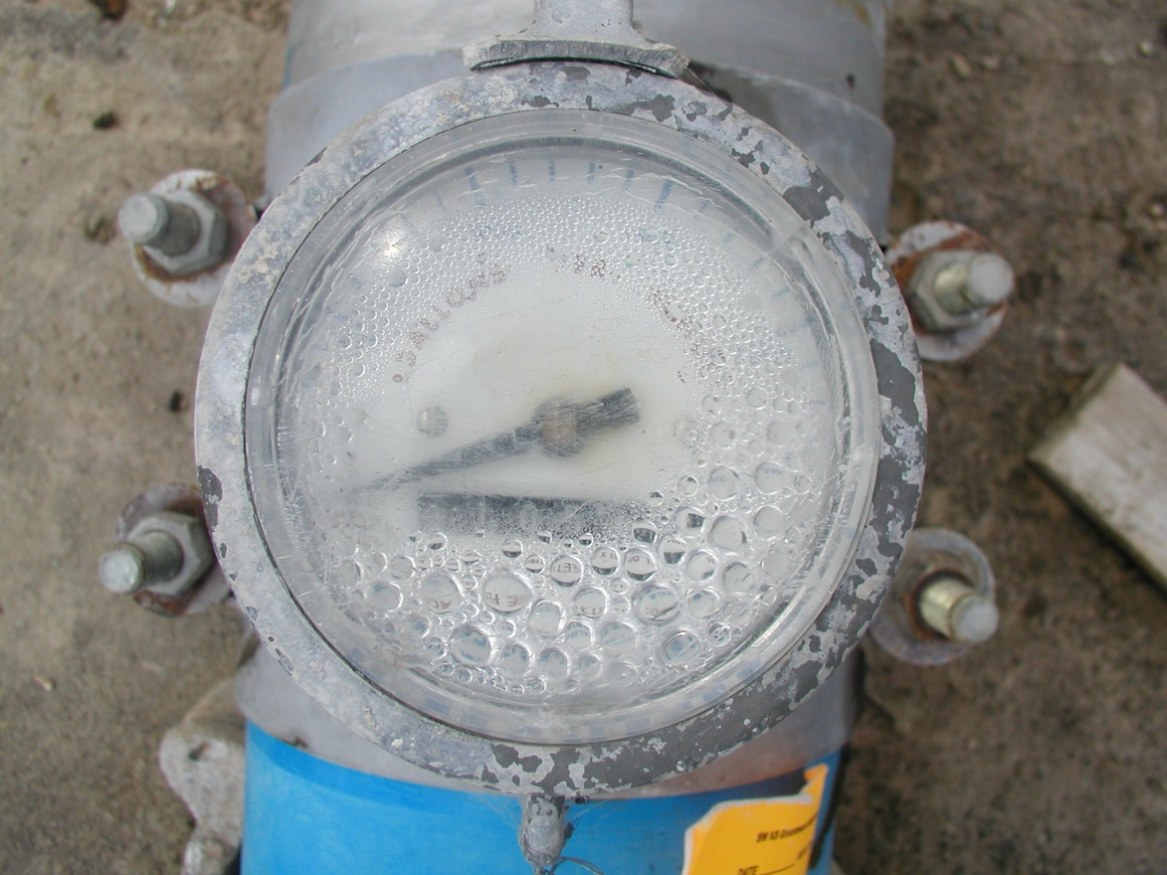
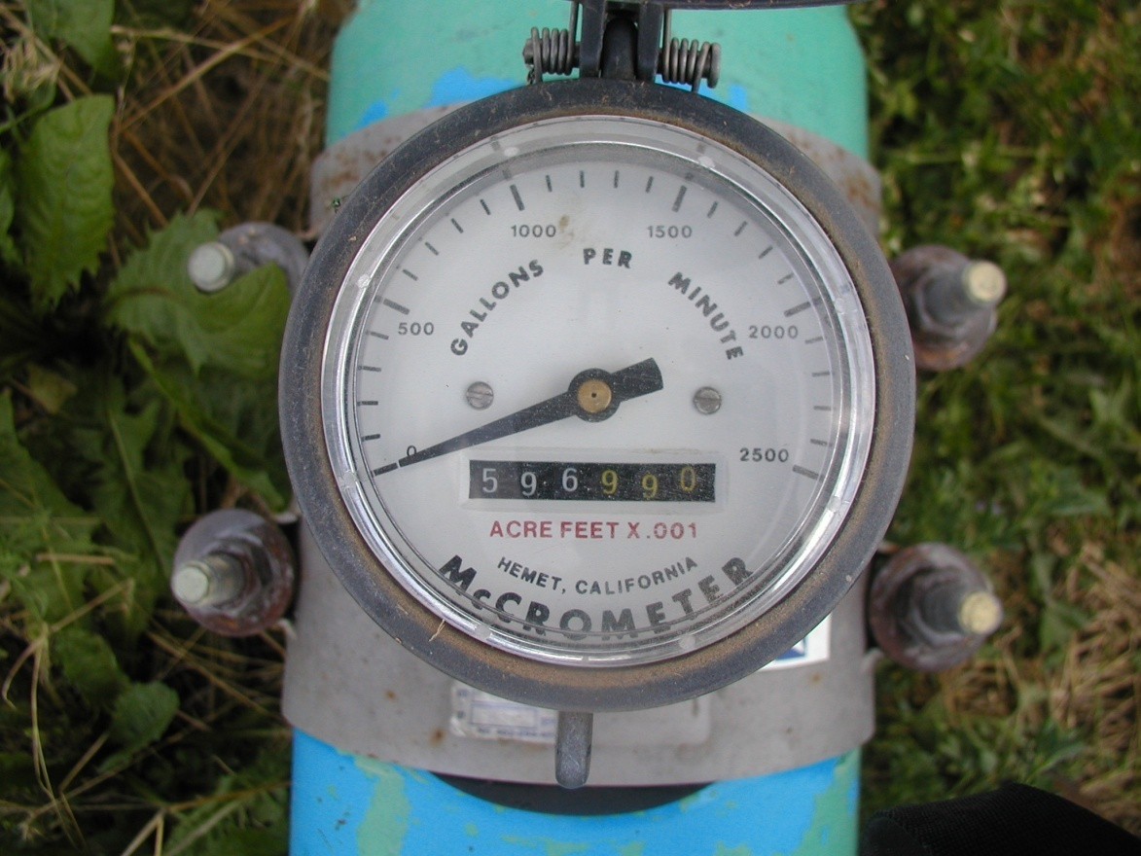
Moisture on
Flowmeter lens
Needs maintenance
immediately
A Well Maintained
Flowmeter

Slide 20
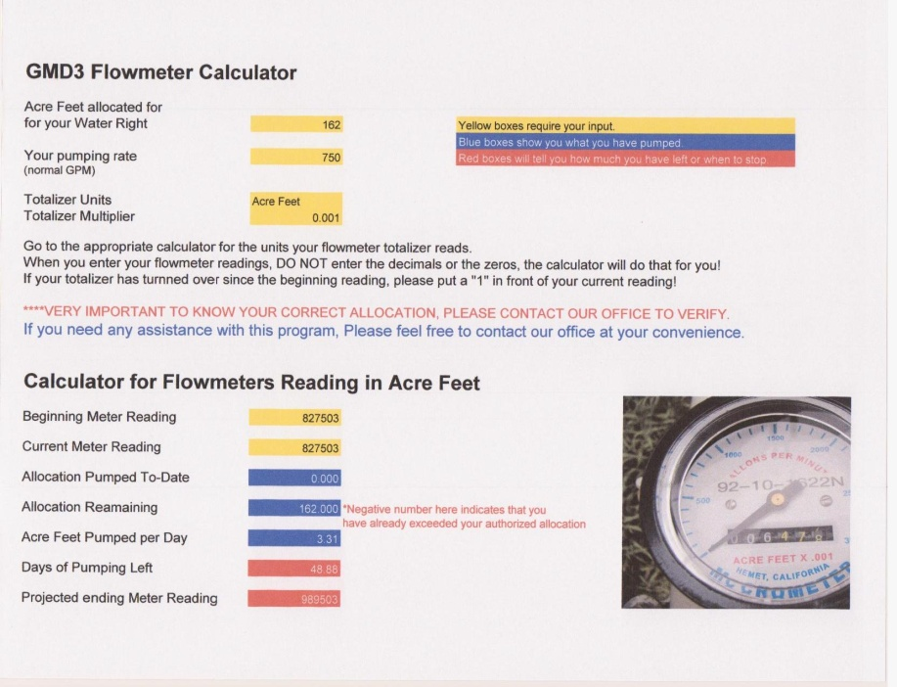
Water Monitoring Assistance
We have also developed a flowmeter calculator that will assist the water user in determining when their limit is reached

Slide 21
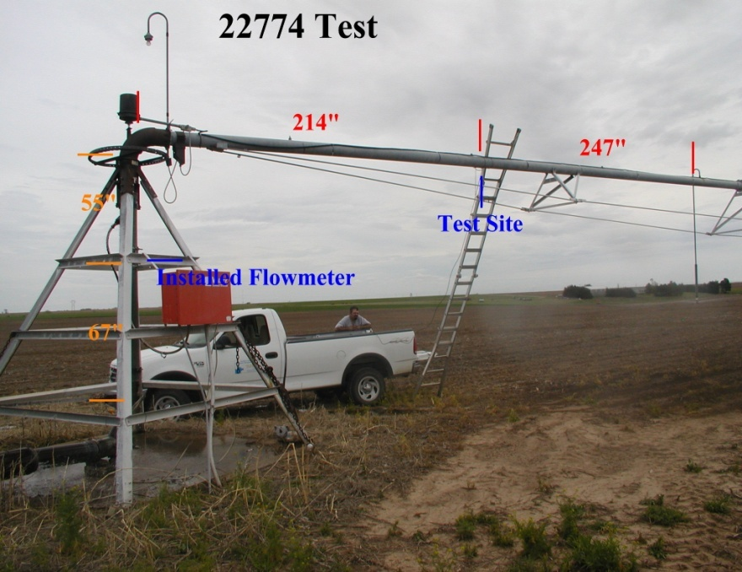
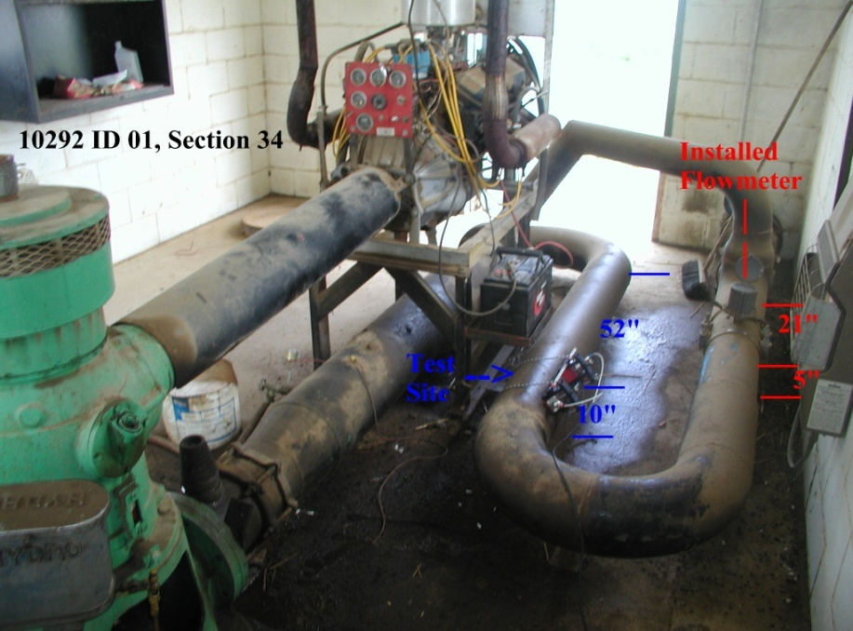
Contract Meter Inspections Summary
Goal = over 2,000 wells/year
In Compliance = 95 %
Out of Compliance = 5 %

Slide 22
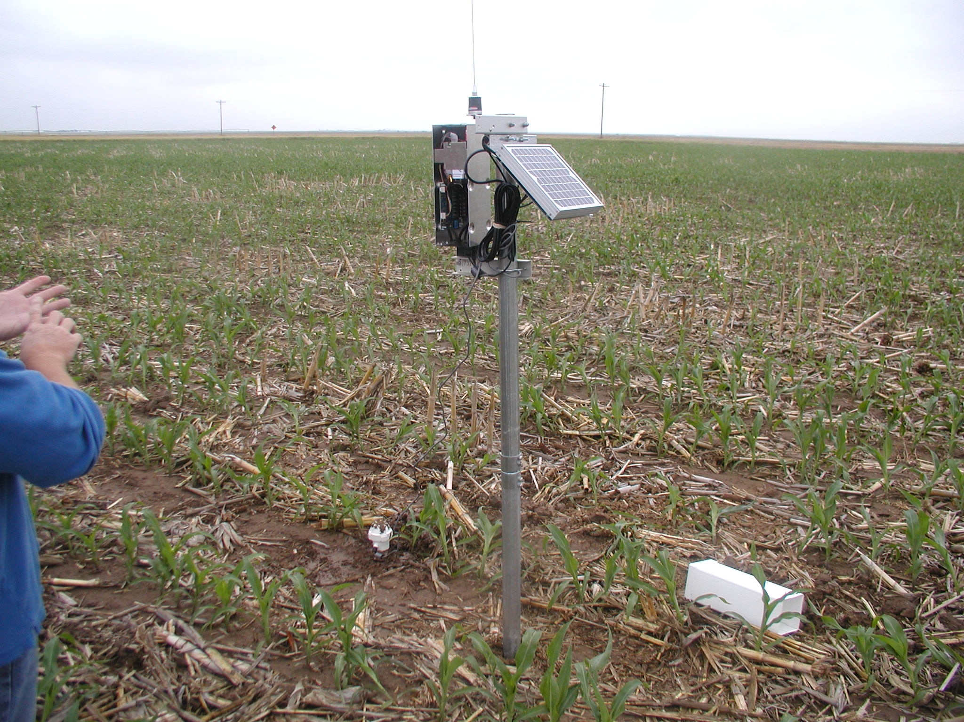
Soil Moisture Probes

Slide 23
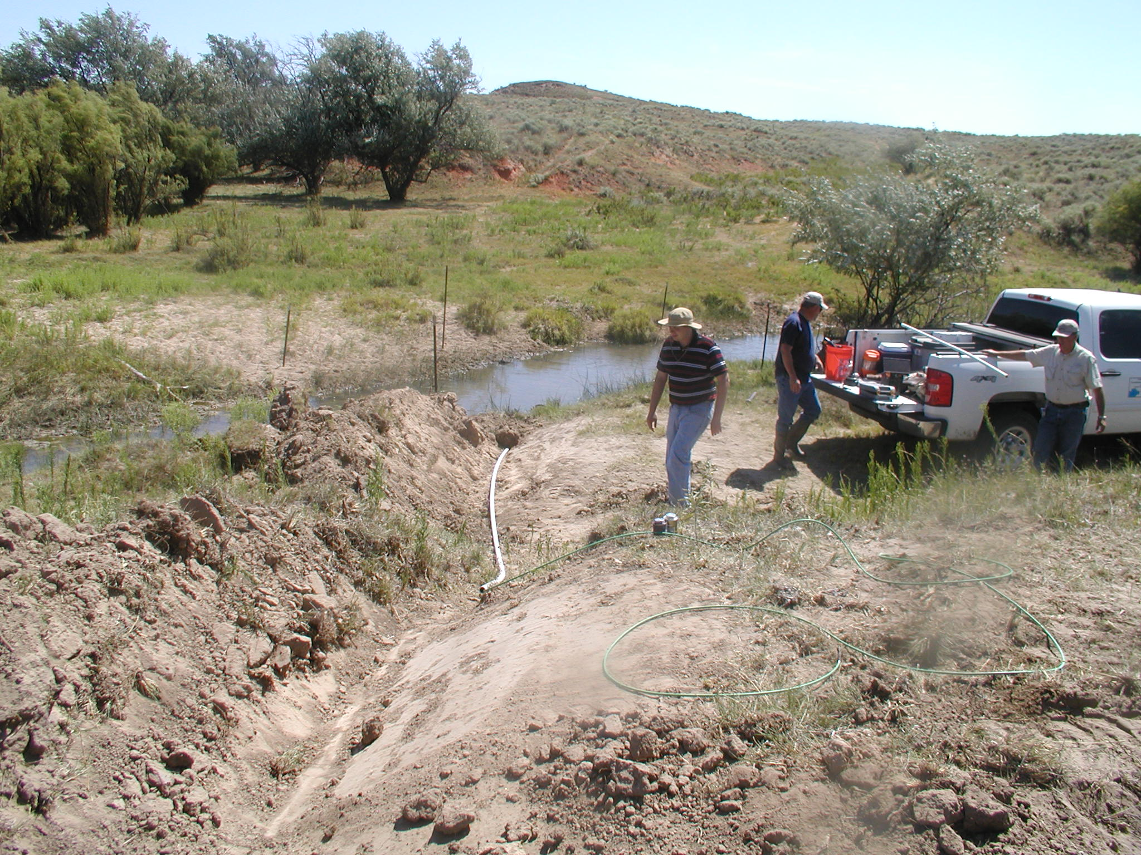
Pressure Transducers
Meade Co.

Slide 24
Collaborative Activity
Models for Water Management
A Hydrologic Model to predict budget and use affects on future supply.
An Economic Model linked to hydrologic model to evaluate the economic changes.
Opportunities for sub-unit management incentive: EQIP, Water TAP, CREP

Slide 25

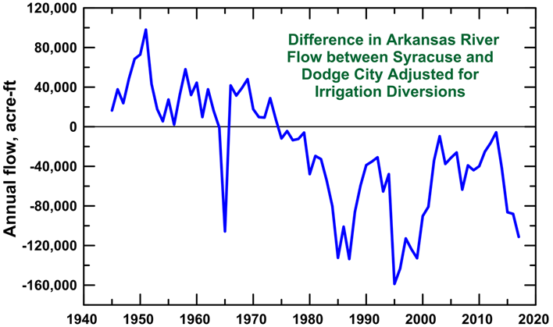
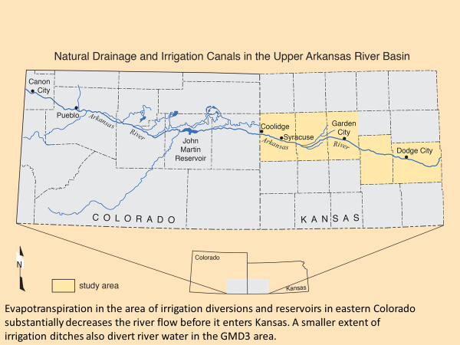
GMD3 Ark River Management Program
Years
Ark River basin is shared with Colorado
Flows enter but don’t leave GMD3
2019 - HR 6018 & SR 1729

Slide 26
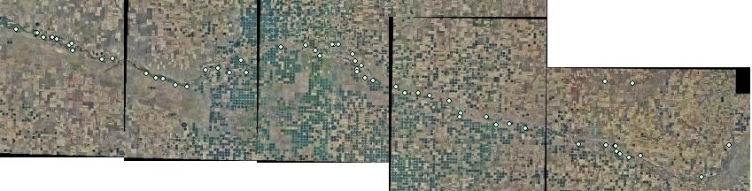
Target Groundwater Quality Sample Sites for KGS analysis

Slide 27
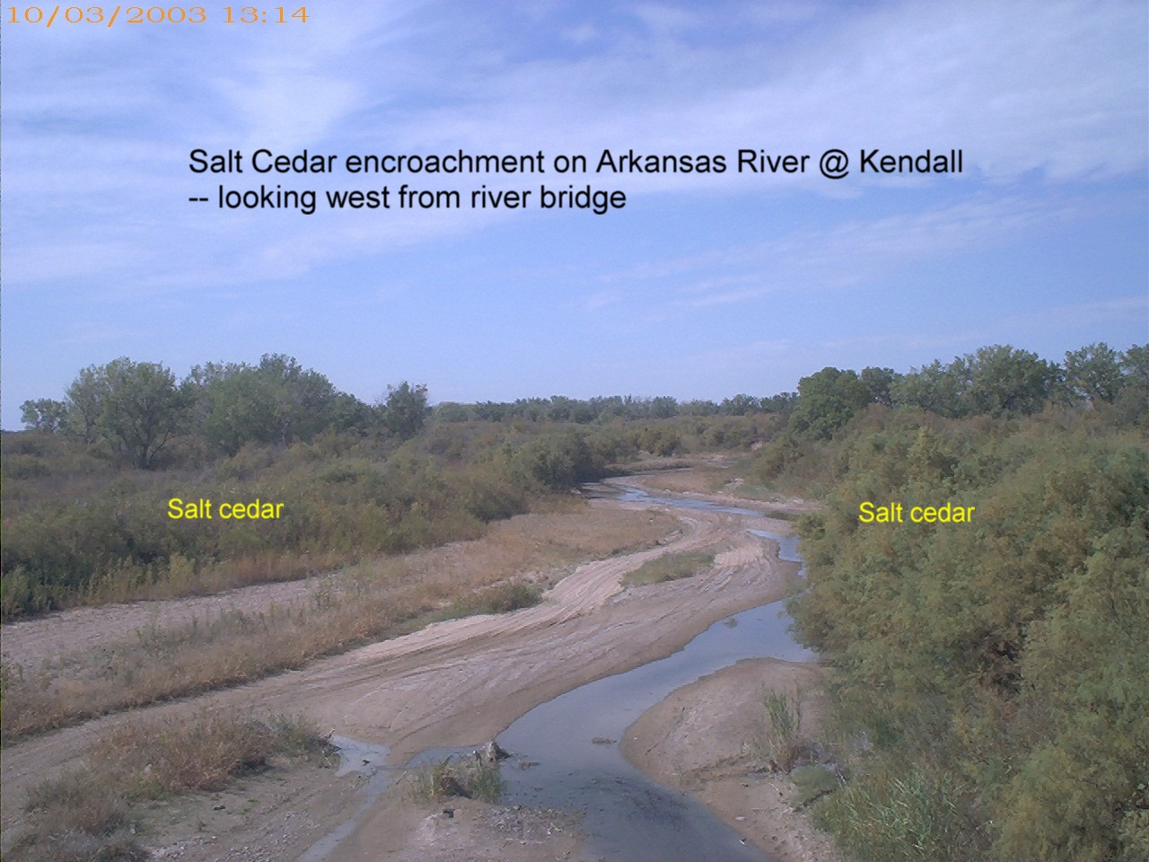
River Supply Management

Slide 28
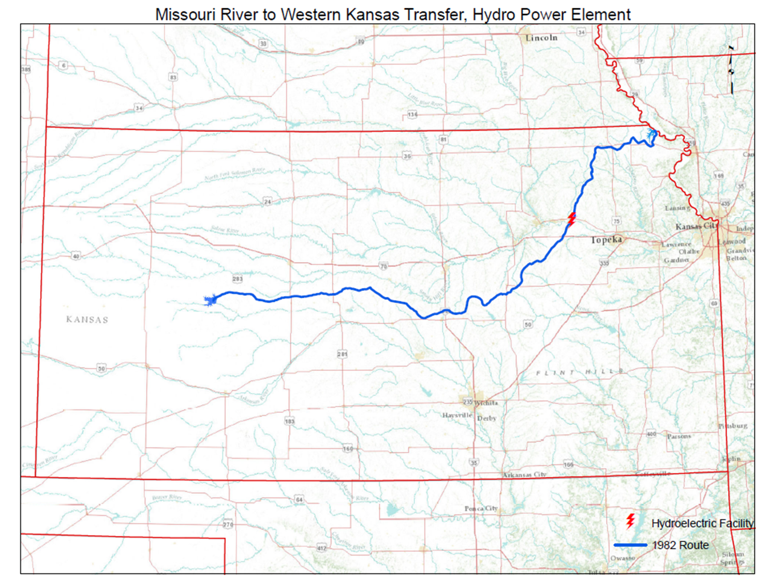
35 Years Ago
1976 Public Law for the High Plains Study (HPS)
  Section 193 of the 1976 Water Resource Development Act (Public Law 94-587) authorizes and directs the Secretary of Commerce to study the impacts of depletion of water resources of the Ogallala Aquifer and to develop plans to increase water supplies in the area.
Resulting 1982 HPS Report to the Secretary of Commerce.
Five progressive aquifer management elements evaluated:
  Kansas has implemented all but the fifth element; a major water transfer.
The U.S. Army Corp of Engineers was directed by Congress to examine the engineering feasibility of transferring water from the east to the High Plains.
The Kansas Water Transfer south route was found engineering feasible and the least expensive route identified.

Slide 29
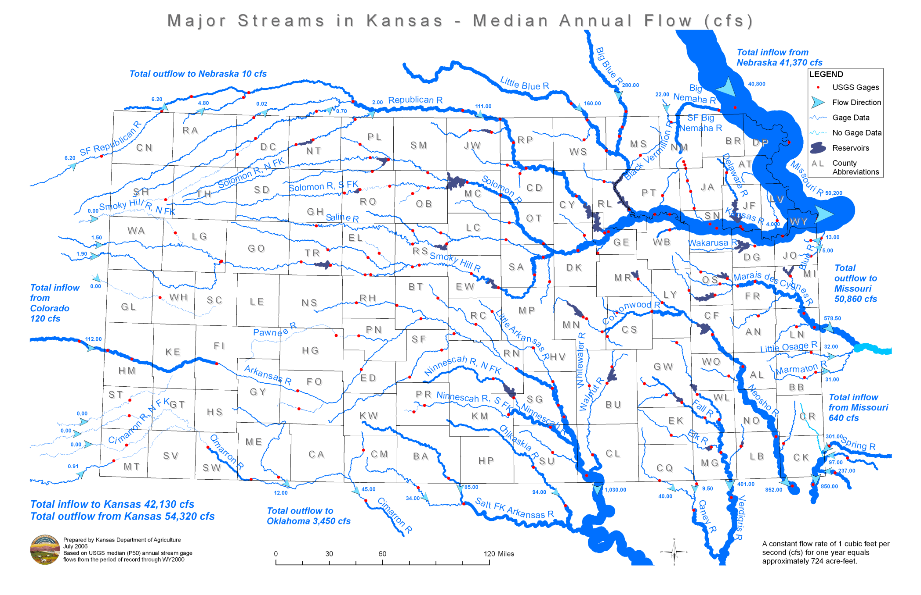
Kansas surface water supplies

Slide 30
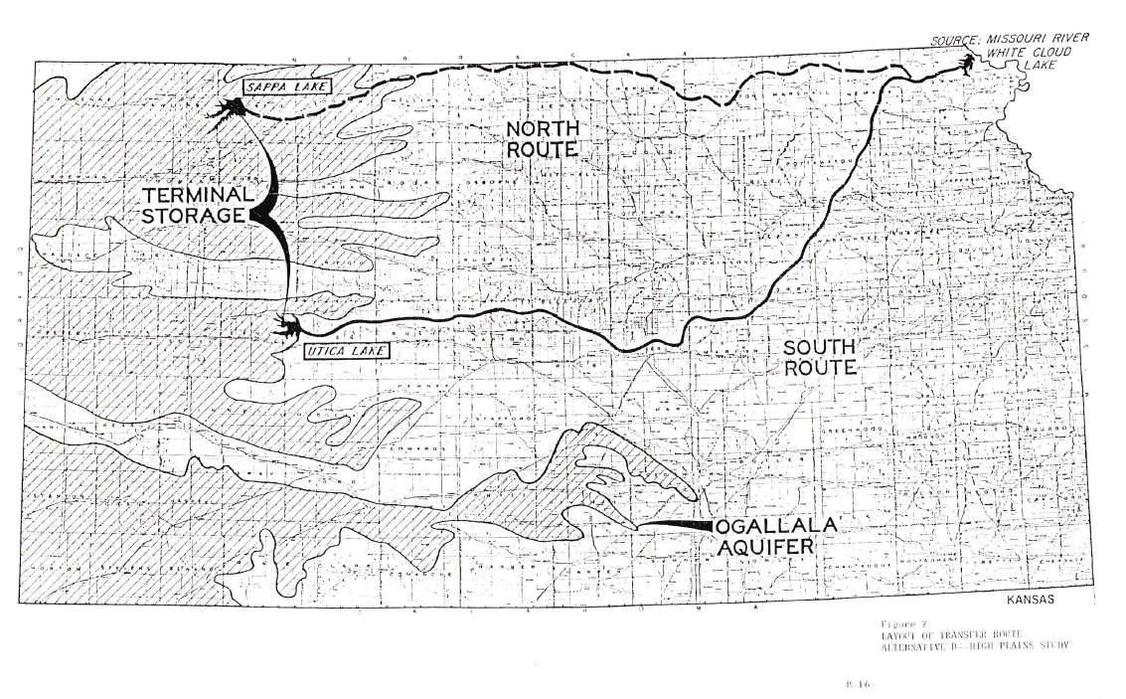
High Plains Study, water transfer element, 1982

Slide 31
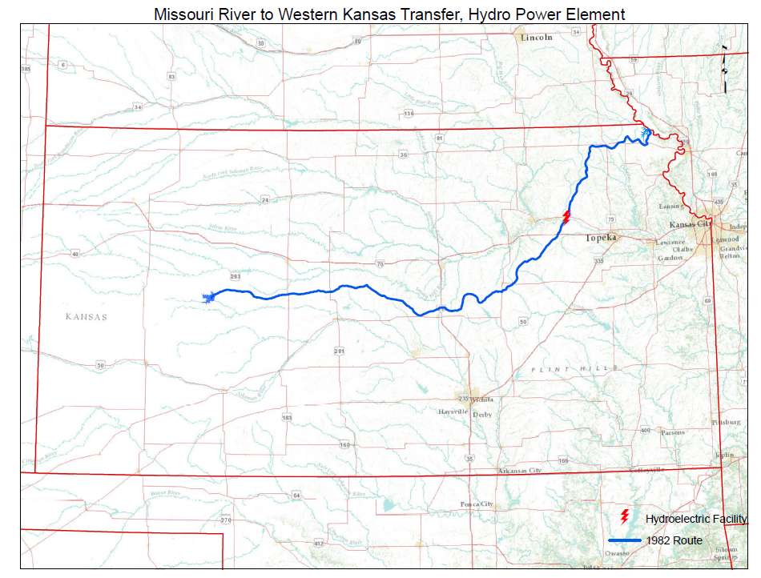
Potential for supply benefits all across Kansas
The Perry Loop
Flint Hills Ridgeline
Western Ridgeline

Slide 32
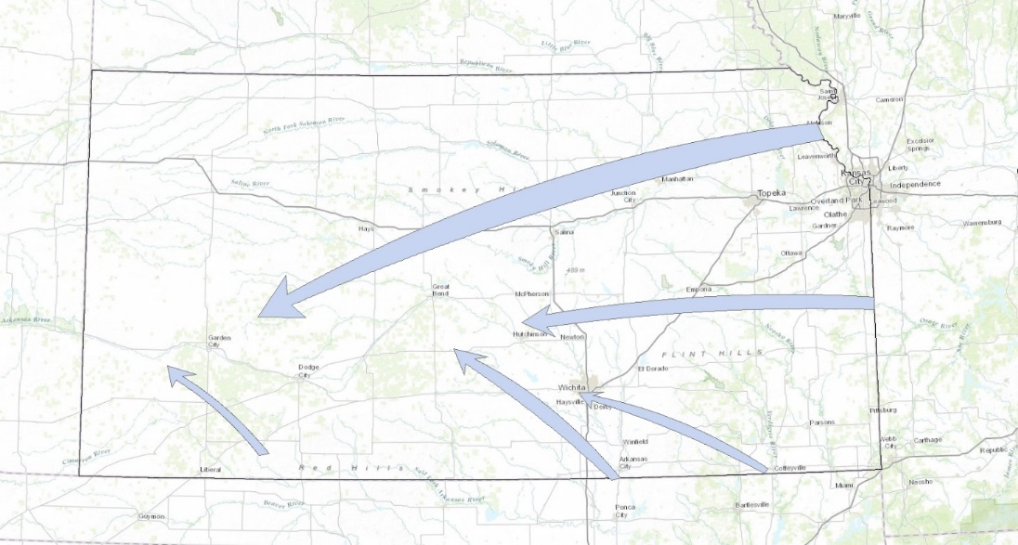
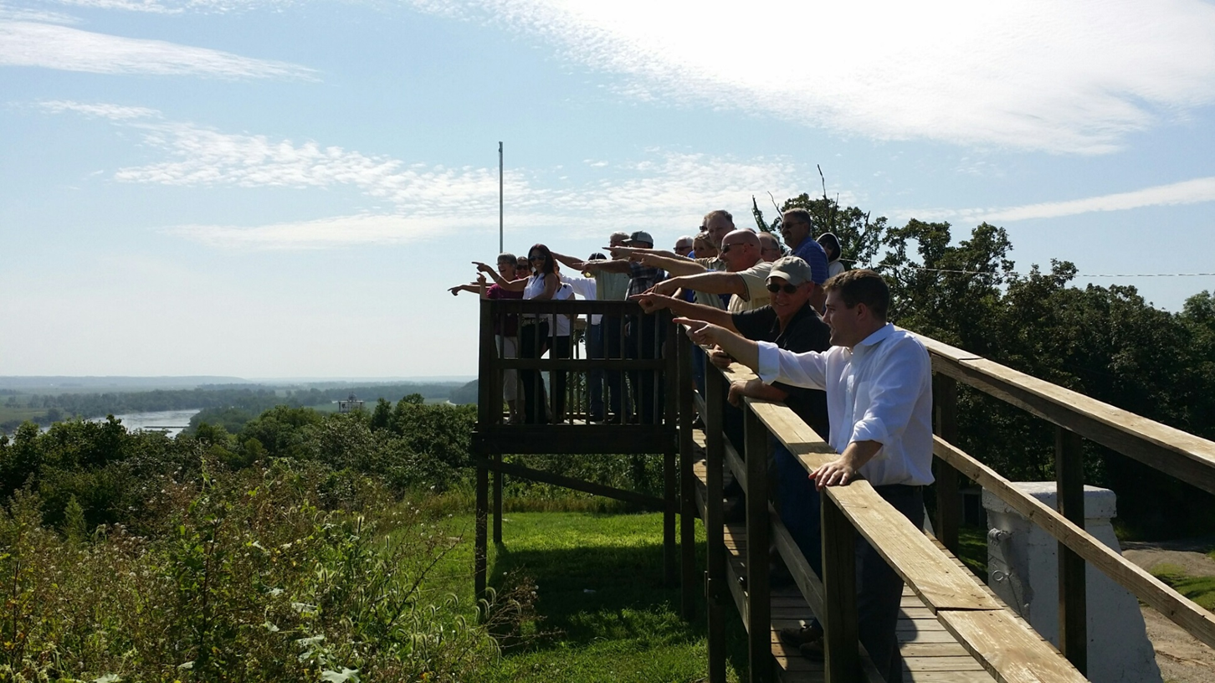
Potential appropriations of surface water for transfers to multiple uses in Kansas. S SUB HB1059
No Missouri River Basin
Compact Yet
Kansas - Oklahoma Compact
Arkansas River Subbasin, Conservation Storage Allocation, Remaining Storage Allocation
Grand-Neosho River Basin 650,000 acre-feet 513,028 acre-feet
Verdigris River Subbasin 300,000 acre-feet 1,214,930 acre-feet
Mainstem Arkansas River 600,000 acre-feet 598,515 acre-feet
Salt Fork River Subbasin 300,000 acre-feet 295,967 acre-feet
Cimarron River Subbasin 5,000 acre-feet 5,000 acre-feet
The Verdigris subbasin has an allocation above that allocated by the compact because it has been credited additional storage as a result of conservation storage constructed in Oklahoma.

Slide 33
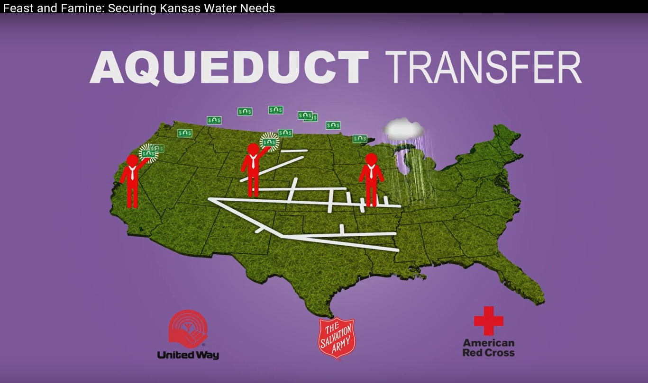
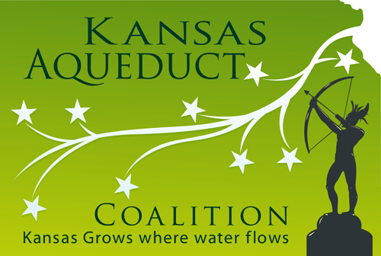
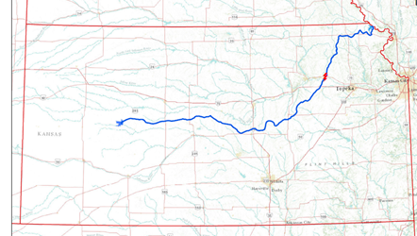
We’re off to see the Wizard
http://www.kansasaqueductcoalition.com/
View the 45 minute documentary.

Slide 34
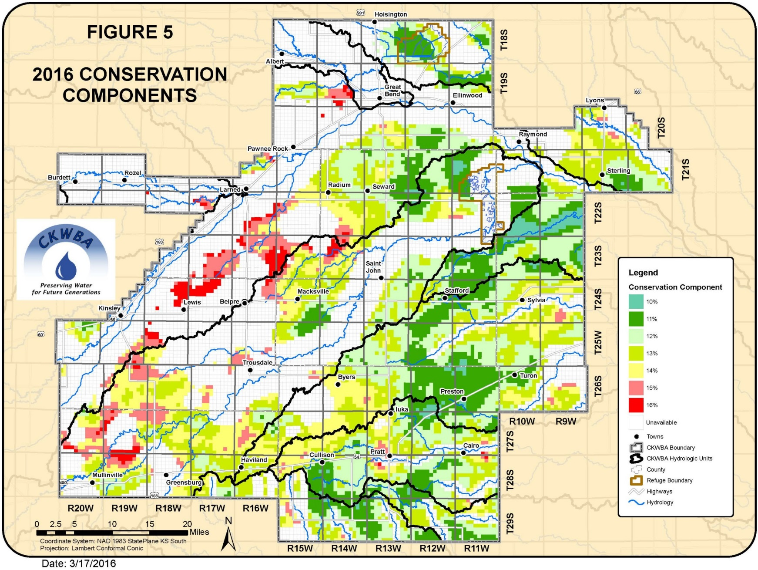
Central Kansas Water Bank
GMD5 area

Slide 35
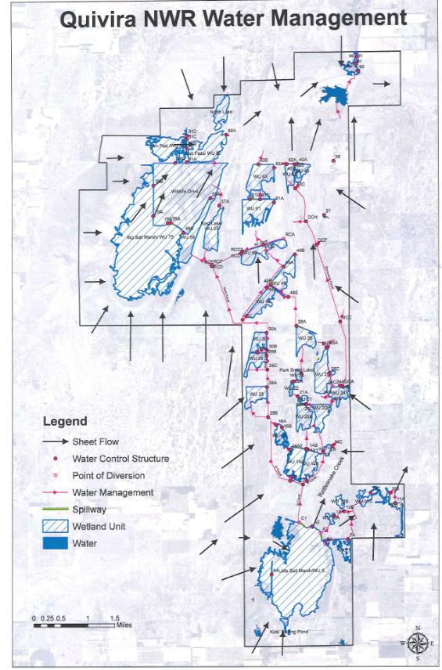
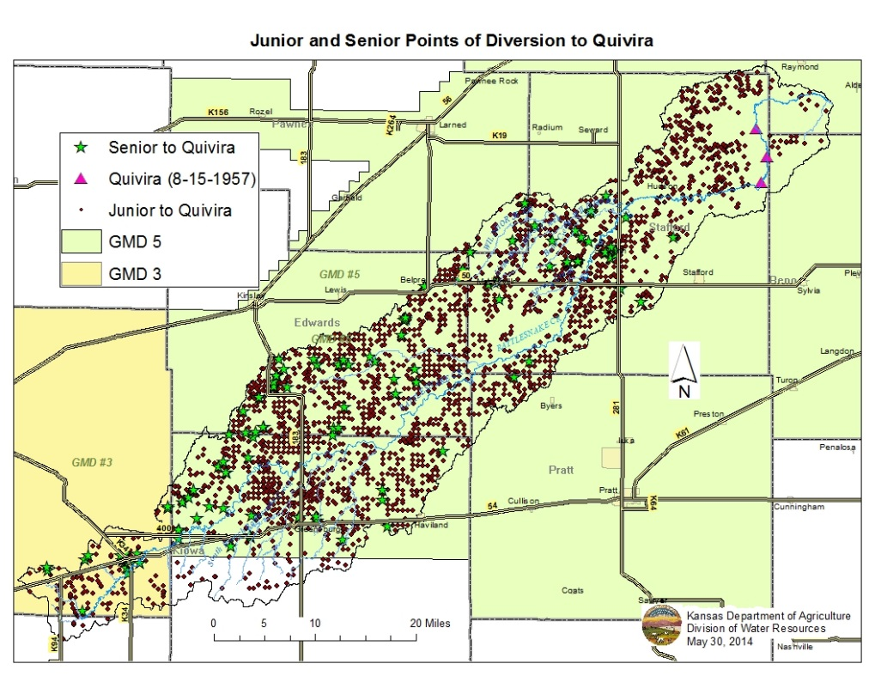
Quivira National Wildlife Area Water Right Impairment
Vision: Locally driven solutions have the highest opportunity for long-term success

Slide 36
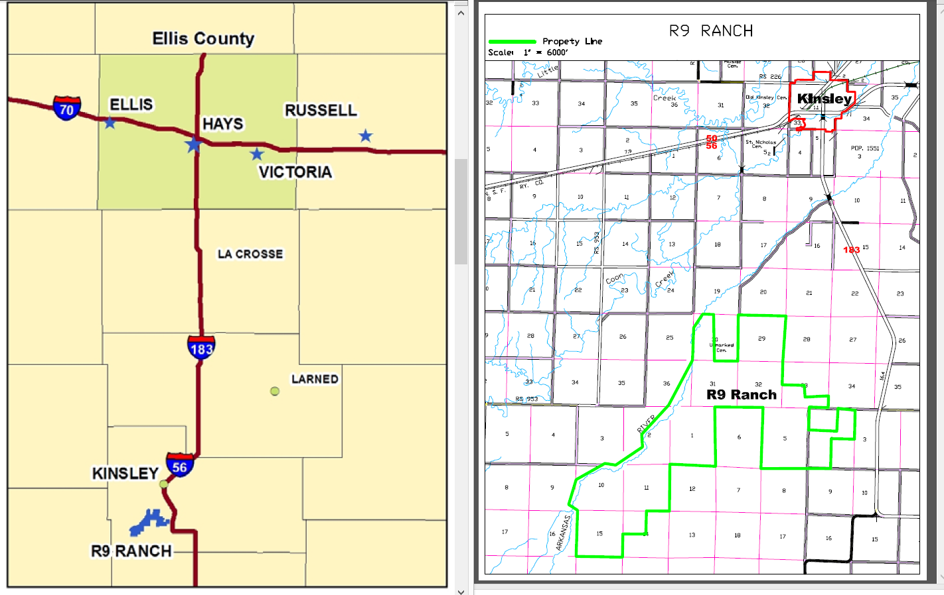
City of Hays/R9 Ranch Water Transfer
Vision: Allow for the transfer of water supplies between basins where feasible and cost effective

Slide 37
Water Conservation Areas (WCAs)
A state idea and initiative
Voluntary water conservation program for individual or groups of water right owners
Three completed consent agreements
Seeking adjustments to WCA statute in 2017 Legislative Session to clarify opportunities for water right flexibilities for those who enroll in WCAs
  Controversy with GMD’s, will state implementation overshadow GMD Act?
How to provide use flexibility in exchange for water conservation in a rapidly declining prior appropriation aquifer without someone's ox getting gored??
Vision: Expand the LEMA concept so a proposal can come forward to the Chief Engineer from either GMDs, directly from local water right holders or other entities such as county conservation districts

Slide 38
Well to Well Analysis

Slide 39
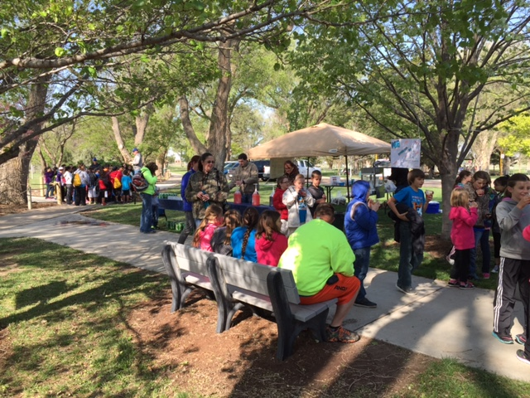
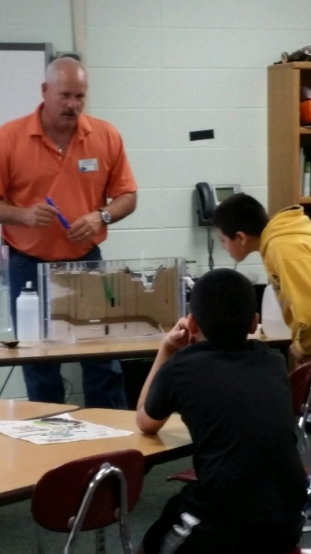
Educational outreach
Earthday
School demonstrations
Radio: every Friday @ 7:30 & 3rd Thursday @ 8:30
Local organizations

Slide 40
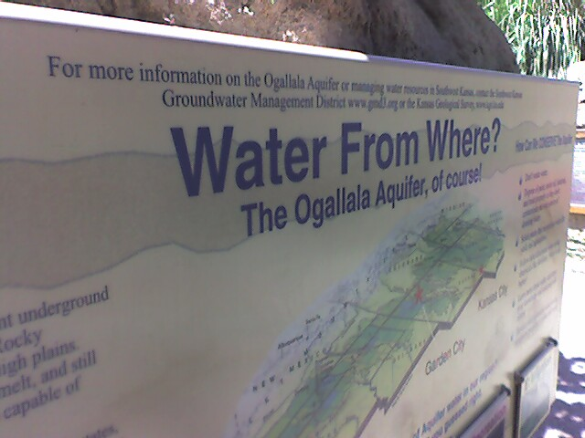
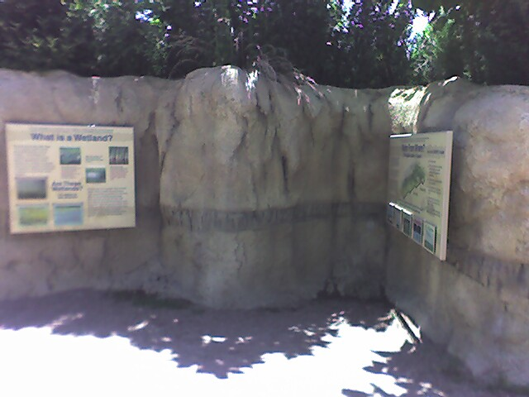
Groundwater
Display at the
Lee Richardson Zoo
Garden City, Ks

Slide 41
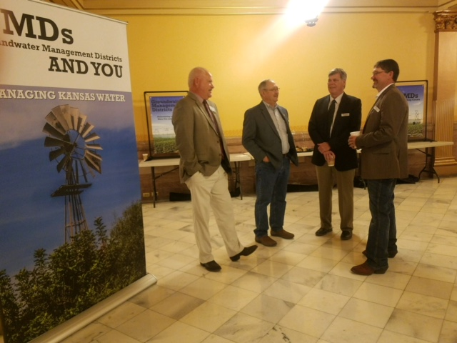
State Legislation Activity
Work on bills needed for the area
Possibly lobby against bills that are not beneficial to area
HR6019 & SR1729: went straight to floor, not committees, passed
Annual retreat with all GMDs

Slide 42
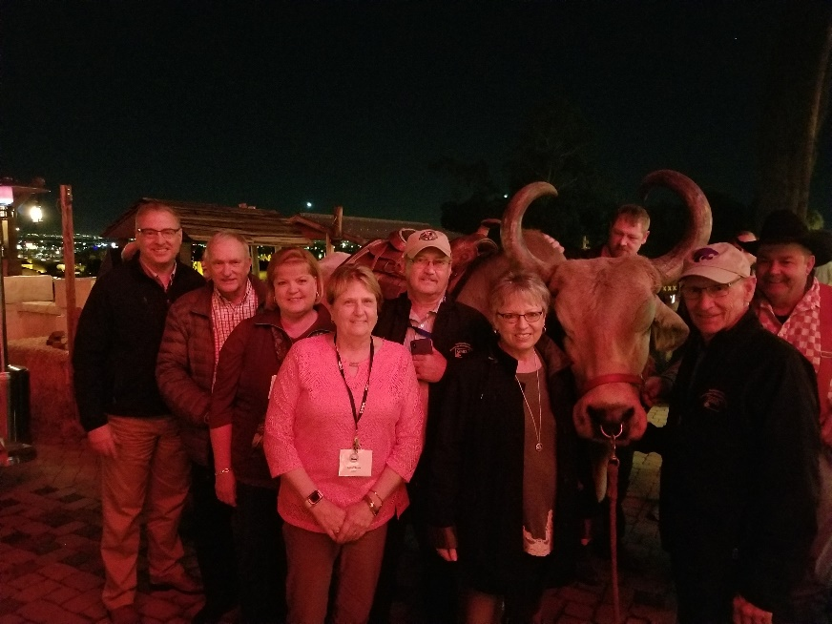

State Relationships
Members of GMDA
GMDA is the Water Caucus for NWRA
Multi-state organization
Meet twice a year
Kansas GMDs hosting 2019 Summer conference in Salt Lake City

Slide 43


Federal Relations
NWRA members
Yearly trips to DC for Water Issues Conference
Working with other States on water issues
RCPP program
CIG
Farm Bill

Slide 44
Southwest Kansas
Groundwater Management District No.3
620-275-7147
Or visit our Web-Sight
www.gmd3.org

