Slide 1
Groundwater Management Districts
Association
David Modeer
General Manager
CAP
January 7, 2015
Notes:
Agenda Number 11.

Slide 2
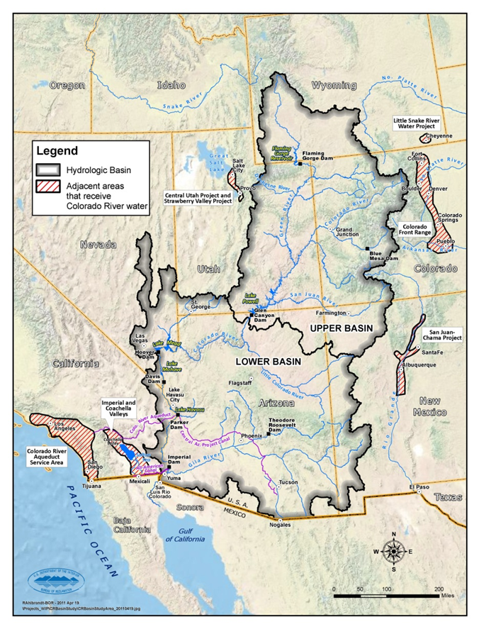
Colorado River System
$1.7 trillion economic activity
12th largest GDP
Serves US & Mexico
7 States in the US
~40 million people
~ 4 million irrigated acres
~ 10 million Mwhr/yr
~$5 billion/yr Ag Value
~ 14 MAF/yr runoff
10 major reservoirs
Notes:
From a global standpoint, the Colorado River is not in the top 10 in discharge, but the communities that rely on the River produce the equivalent of the 12th largest national GDP in the world. The river is relatively modest but through infrastructure (dams) and operational rules, the river supports over 40 million people, generates significant renewable energy, and provides about 15% of the US ag production as well as serving Mexico.
NOTE – the Missouri River is almost 5 times larger than the Colorado in terms of annual Discharge….

Slide 3
Law of the River Summary (items in red led to construction of CAP)
1922 Colorado River Compact
1928 Boulder Canyon Project Act
1944 Water Treaty
1948 Upper Basin Compact
1956 Colorado River Storage Project Act
1964 Arizona v. California
1968 Colorado River Basin Project Act
1973 Minute 242
1974 Colorado River Basin Salinity Control Act
1992 Grand Canyon Protection Act
2007 Colorado River Interim Guidelines for Lower Basin Shortages and Coordinated Operation of Lake Powell and Lake Mead
2012 Minute 319

Slide 4
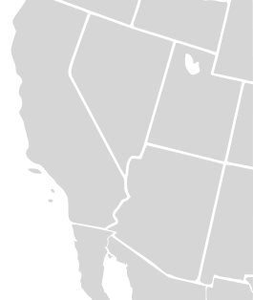
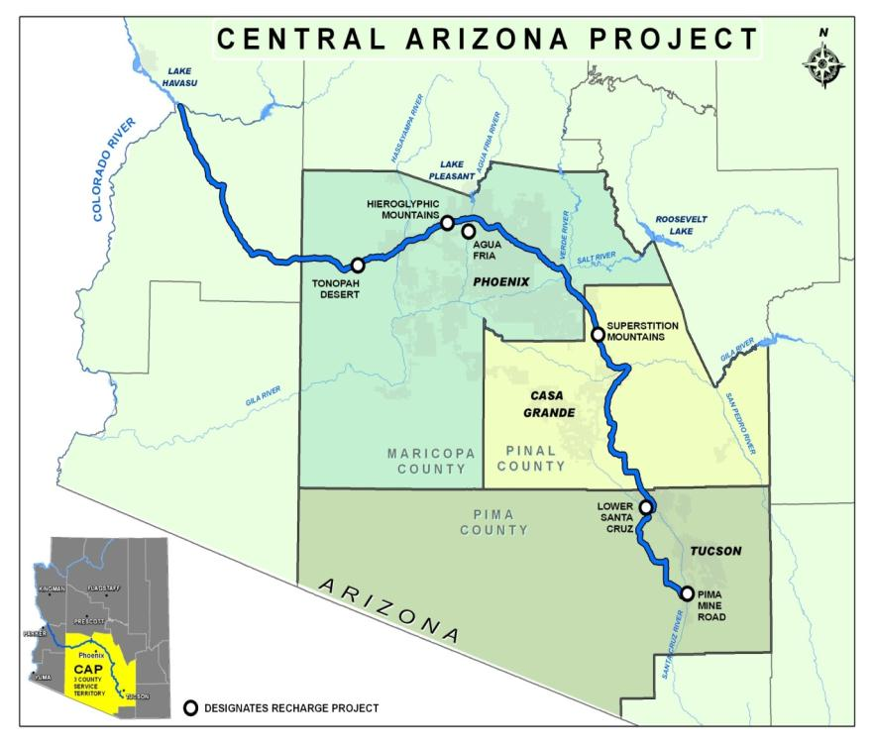
Central Arizona Project
336-mile aqueduct stretches from Lake Havasu to Tucson
14 pumping plants lift water nearly 3,000 feet
8 siphons, 3 tunnels
Lake Pleasant/New Waddell Dam
Navajo Generating Station
Largest water provider in the Colorado River watershed
Serving ~ 5 million residence
Serving ~ 350 irrigated acres
Serving 11 Indian Tribes
ARIZONA
Notes:
CAP is largest source of renewable water for AZ
1.6 million AF/year (521 billion gallons)
Serves 3 counties containing 80% of Arizona’s population
CAP has 80 regular customers and each year has specific contracts for excess water
History of CAP
1968 Federal Authorization through Colorado River Basin Projects Act
1973 Construction begins on CAP system
Declared Substantially Complete in 1993
Compromises along the way
CAP has junior priority
NGS built instead of additional hydroelectric dams

Slide 5
Colorado River Supply Risks
Over Allocation
16.5 MAF Allocations - Avg. system flow ~ 15.0 MAF
Lower Basin runs an annual deficit of 1.2 MAF
Drought and Climate Change
Current hydrology: 14 years of drought
Future hydrology: 10% reduction in supply by 2060
New uses
Increasing water needs for Arizona, Nevada, and Mexico from the Colorado River
Notes:
The current drought is the worst in the observed 106 year record, within the lower 25% of the climate change hydrology, but still not the worst observed in the paleo-record (tree-ring data for the previous 1242 years). The SW continues to be the fastest growing region in the country driving the need for new water supplies and the states of Baja California and Sonora are two of the fastest growing states in Mexico.

Slide 6
CAP Risks and Vulnerabilities
Near-term Shortage & Long-term Reliability
CAP has junior priority and will suffer the first cut back from Colorado River shortages
Facing reductions from 20% – 30% (320 kaf to 480 kaf) under existing rules
Reductions and operations uncertain in deeper shortages
Energy Availability
Single major energy source – Navajo Generating Station
Uncertain future for coal powered generation
New uses
Increasing water needs for Arizona, Nevada, and Mexico from the Colorado River

Slide 7
Questions?

