Slide 1
THE ECONOMIC VALUE OF WATER: THREE CASE STUDIES
Dr. Anthony Evans
August 7, 2015

Slide 2
Overview
Economic importance of Colorado River for Upper & Lower Basin Regions in 2012
Economic impact of the Central Arizona Project (1973-2010)
Economic losses associated with constrained water availability in 63 Kansas counties in 2062
The economic measures assessed are:
Gross State Product (GSP) – Synonymous with value added; represents the $ value of all goods and services produced for final demand in a state
Employment – Count of full- and part-time jobs, including wage and salary workers and the self-employed
Labor income – Includes both employee compensation (wages and benefits) and proprietor income

Slide 3
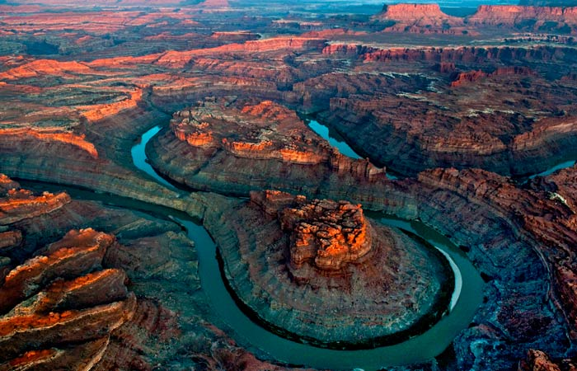
The Economic Importance of the Colorado River

Slide 4
Colorado River - Assumptions
Considers 6 states (Arizona, Colorado, Nevada, New Mexico, Utah and Wyoming) and 7 contiguous Southern California counties (Imperial, LA, Orange, Riverside, San Bernardino, San Diego, and Ventura) as an integrated economic area
Modified IMPLAN input-output models to account for inter-related nature of the economy
Economic values estimated based on:
Non-availability of Colorado River water for one full year (2012)
Non-substitutability of the Colorado River water - that is, no other sources of water are available to compensate for the loss of Colorado River water
Non-adaptability of producers and consumers

Slide 5
Estimated Total Water Consumption 2012
Geography | Agricultural |  | Municipal & Industrial
 | Total Requirement (MAF) | Percent Sourced from Colorado River | Total Requirement (MAF) | Percent Sourced from Colorado River
Arizona | 2.20 | 49% | 1.98 | 41%
Colorado | 6.13 | 31% | 1.25 | 41%
Nevada | 0 | 0% | 0.37 | 79%
New Mexico | 0.72 | 15% | 0.30 | 60%
Southern Cal. 7 Counties | 3.52 | 92% | 4.17 | 37%
Utah | 2.04 | 22% | 0.84 | 34%
Wyoming | 1.95 | 20% | 0.15 | 70%
Entire Basin Region | 16.56 | 43% | 9.05 | 41%

Slide 6
Estimated Impact of Colorado River Water Loss for the Entire Basin Region Economy
ECONOMIC IMPACT TYPE | GROSS STATE PRODUCT Billions 2014 $ | EMPLOYMENT Job Years | LABOR INCOME Billions 2014 $
Direct Losses | 694.78 | 7,859,245 | 434.29
Indirect Losses | 231.12 | 2,361,250 | 139.35
Induced Losses | 508.22 | 5,780,501 | 297.81
Total Estimated Economic Losses | 1,434.12 | 16,000,996 | 871.45

Slide 7
Top 5 Affected GSP Loss Sectors
Real Estate and Rental - $174.3 billion
Healthcare and Social Services - $148.6 billion
Finance and Insurance - $137.1 billion
Professional, Scientific and Technical Services - $130.6 billion
Retail Trade - $96.2 billion

Slide 8
Estimated Total Economic Impacts of Colorado River Water Loss by Basin Region
GEOGRAPHY | GROSS STATE PRODUCT Billions 2014 $ | EMPLOYMENT Job Years | LABOR INCOME Billions 2014 $
Arizona | 185.01 | 2,147,770 | 107.80
Colorado | 188.95 | 2,147,141 | 115.97
Nevada | 115.39 | 1,417,283 | 70.57
New Mexico | 59.76 | 771,618 | 34.17
Southern Cal. 7 Counties | 657.45 | 7,046,110 | 406.58
Utah | 69.79 | 969,735 | 43.30
Wyoming | 21.67 | 284,276 | 13.18

Slide 9
Percent GSP Losses in the Absence of Colorado River Water for One Year

Slide 10
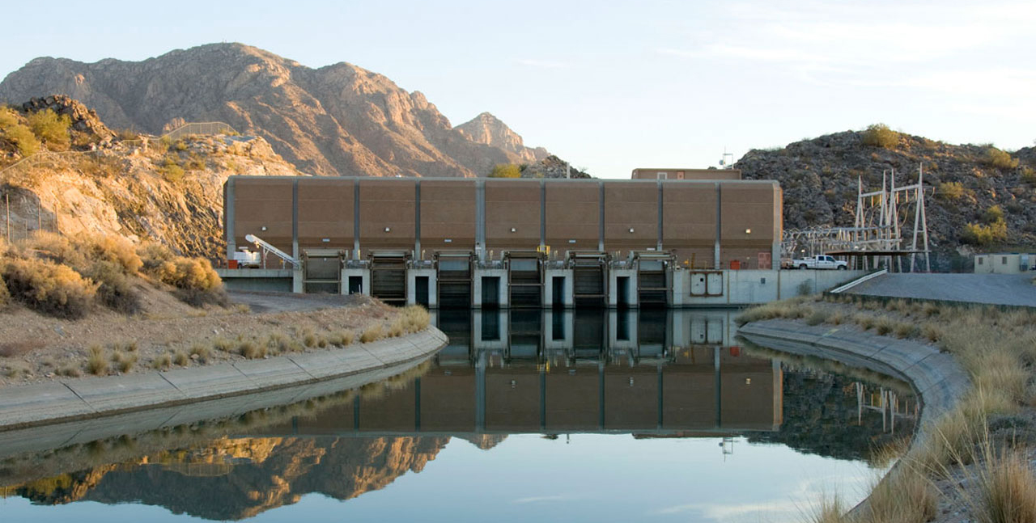
The Economic Importance of the Central Arizona Project

Slide 11
Central Arizona Project (CAP) - Assumptions
Considers the economic impact of the construction of CAP (1973-1993) and CAP’s water supply delivery operations (1986-2010) for the State of Arizona
Modified IMPLAN input-output models to account for inter-related nature of the economy
Total field construction costs: $3.3 billion (nominal $)
CAP delivered 27.3 MAF water to municipal, industrial, and agricultural customers in Maricopa, Pima and Pinal Counties, 1986-2010
Economic impact of water supply delivery operations, 1986-2010, based on:
Non-availability of CAP water
Non-substitutability of the CAP water
Non-adaptability of producers and consumers
Exclusion of leisure benefits associated with O&M of CAP

Slide 12
Estimated Total Economic Impacts of CAP’s Construction (1973-1993) for the State of Arizona
ECONOMIC IMPACT TYPE | CUMULATIVE GROSS STATE PRODUCT Millions 2013 $ | EMPLOYMENT Job Years
Direct Impacts | 996.1 | 0 - 5,030
Indirect Impacts | 653.0 | 0 – 1,892
Induced Impacts | 715.8 | 0 – 2,490
Total Estimated Economic Impacts | 2,364.8 | 18 – 9,412

Slide 13
CAP’s Contribution to Annual GSP
CAP’s water supply is cumulatively estimated to generate $1,090 billion GSP (2013 $) – that is 23.3% of cumulative statewide GSP throughout the 25-year study period

Slide 14
Estimated Employment Losses by Year Without CAP Water
Without the availability of CAP water, the economic development of the State of Arizona would have followed a radically different trajectory

Slide 15
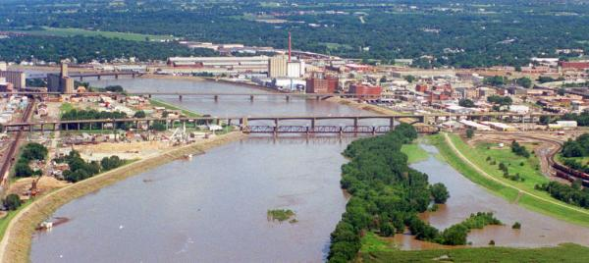
The Economic Importance of Water Availability in Kansas

Slide 16
State of Kansas - Assumptions
Compares the estimated value of the economy in 2062 if water is freely available with a counterfactual scenario in which the level of water availability is constrained
Considers 7 areas in the state (63 counties), 5 of which are estimated to experience a water deficit by 2062
Constrained water estimates are supplied by Kansas Groundwater Management District, primarily based on depletion of groundwater supplies and silting (no droughts)
Modified IMPLAN input-output models used in conjunction with 10-year average BEA sector-specific growth estimates for the State of Kansas
Economic values are estimated based on:
Reduced availability of water in Areas 1-5 in 2062
Non-substitutability of water to compensate for the loss
Non-adaptability of producers and consumers

Slide 17
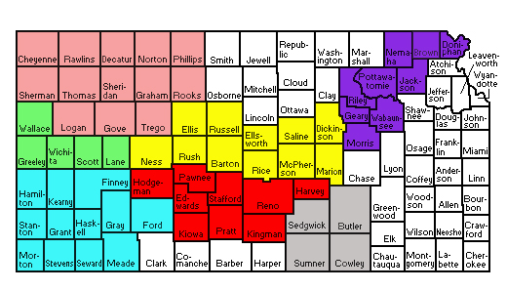
Kansas – Areas of Study
Area 1 Area 2 Area 3 Area 4 Area 5 Area 6 Area 7

Slide 18
Total Water Availability by Area (Actual and Estimated)
STATE OF KANSAS AREA | Agricultural |  | Municipal & Industrial |  | TOTAL
 | 2012 Base Data (AF) | 2062 Estimated Availability (AF) | 2012 Base Data (AF) | 2062 Estimated Availability (AF) | 2012 Base Data (AF) | 2062 Estimated Availability (AF)
Area 1 | 650,244 | 368,442 | 13,549 | 7,677 | 663,793 | 376,119
Area 2 | 1,207,950 | 1,009,715 | 21,447 | 17,927 | 1,229,397 | 1,027,642
Area 3 | 2,130,583 | 879,790 | 57,965 | 23,936 | 2,188,548 | 903,726
Area 4 | 148,858 | 133,838 | 40,766 | 36,653 | 189,624 | 170,491
Area 5 | 664,083 | 600,369 | 50,457 | 45,616 | 714,540 | 645,985
Area 6 | 1,102,670 | 1,102,670 | 173,893 | 173,893 | 1,276,563 | 1,276,563
Area 7 | 30,851 | 30,851 | 44,702 | 44,702 | 75,553 | 75,553

Slide 19
Estimated Losses Associated with Constrained Water Scenario for the State of Kansas Economy in 2062
ECONOMIC IMPACT TYPE | GROSS STATE PRODUCT Billions 2015 $ | EMPLOYMENT Job Years | LABOR INCOME Billions 2015 $
Direct Losses | 12.3 | 157,764 | 6.29
Indirect Losses | 3.0 | 35,047 | 1.4
Induced Losses | 3.0 | 47,897 | 1.7
Total Estimated Economic Losses | 18.3 | 240,708 | 9.4

Slide 20
Estimated Total Economic Losses Associated with Constrained Water Scenario by Area in 2062
STATE OF KANSAS AREA | GROSS STATE PRODUCT Billions 2015 $ | EMPLOYMENT Job Years | LABOR INCOME Billions 2015 $
Area 1 | 2.5 | 38,441 | 1.3
Area 2 | 1.4 | 20,116 | 0.7
Area 3 | 10.4 | 123,961 | 5.3
Area 4 | 2.6 | 36,842 | 1.4
Area 5 | 1.4 | 21,348 | 0.7
Area 6 | - | - | -
Area 7 | - | - | -

Slide 21
Percent GSP Losses in Constrained Water Scenario, 2062

Slide 22
Estimated GSP Sector Losses in 2062
SECTOR | GROSS STATE PRODUCT Billions 2015 $
Agriculture, Forestry, Fishing & Hunting | 3.604
Real Estate & Rental | 3.012
Government & Non NAICs | 1.666
Health & Social Services | 1.660
Wholesale Trade | 1.226
Transportation & Warehousing | 1.142
Professional, Scientific & Technical Services | 1.121
Finance & Insurance | 0.988
Retail Trade | 0.964
Information | 0.696
Administrative & Waste Services | 0.537
Manufacturing | 0.422
Accommodation & Food Services | 0.298
Electricity, Natural Gas, Water, Sewage & Other Treatment/Delivery Systems | 0.238
Educational Services | 0.202
Management of Companies | 0.194
Mining | 0.119
Other Services | 0.110
Arts, Entertainment & Recreation | 0.078
Construction | 0.052
Estimated Total GSP Losses | 18.328

Slide 23
Estimated Total Job Losses by Sector in 2062

Slide 24
Contact Details
Dr. Tim James
E: apparet14@gmail.com
Dr. Anthony Evans
E: antccfc@aol.com

