Slide 1
A Quick Look at the 2017 Water Level
Results and Other Aquifer Properties
Southwest Kansas GMD #3 Annual Meeting
March 8th, 2016
Geohydrology Section Kansas Geological Survey
University of Kansas

Slide 2
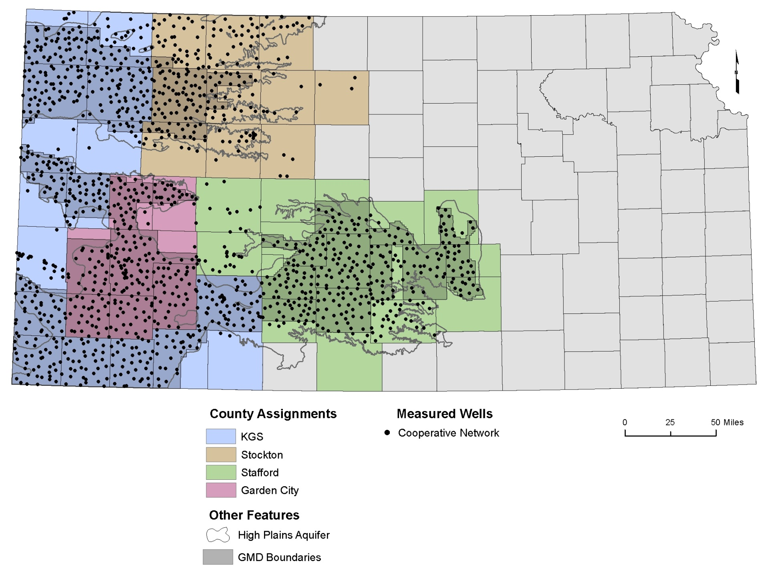
Cooperative Water Level Network
Kansas Geological Survey
Notes:
Normal precipitation is just the average of the last 30 year decal period. The precipitation patterns in Kansas have a major influences on the both the landscape and associated land use in the state.

Slide 3
Average Change (by well)
Region | 1996_1997 | 1997_1998 | 1998_1999 | 1999_2000 | 2000_2001 | 2001_2002 | 2002_2003 | 2003_2004 | 2004_2005 | 2005_2006 | 2006_2007 | 2007_2008 | 2008_2009 | 2009_2010 | 2010_2011 | 2011_2012 | 2012_2013 | 2013_2014 | 2014_2015 | 2015_2016 | 2016_2017
GMD #1 | -0.11 | 0.53 | -0.68 | -0.39 | -0.55 | -0.72 | -1.49 | -0.99 | 0.18 | -0.38 | -0.73 | -1.15 | -0.27 | -0.39 | -0.81 | -1.24 | -1.66 | -0.72 | -0.67 | -0.01 | -0.68
GMD #2 | 0.03 | 1.25 | 0.24 | 0.22 | -0.88 | -0.99 | -0.61 | -0.18 | 0.88 | -0.05 | -2.20 | 1.87 | 1.59 | -0.19 | -0.71 | -3.02 | -1.64 | 2.68 | -1.22 | 1.44 | 2.10
GMD #3 | -0.49 | -0.13 | -1.24 | -0.84 | -2.21 | -1.99 | -3.24 | -1.88 | -0.41 | -1.23 | -2.41 | -1.98 | -2.95 | -1.50 | -3.17 | -3.78 | -3.56 | -2.46 | -2.10 | -1.04 | -1.09
GMD #4 | -0.39 | -0.20 | -0.23 | 0.06 | -1.08 | -0.47 | -1.49 | -1.28 | -0.48 | -0.58 | -0.28 | -0.93 | -0.33 | 0.05 | -0.50 | -0.56 | -1.38 | -0.71 | -0.43 | -0.58 | -0.51
GMD #5 | 0.87 | 1.04 | -0.12 | -0.08 | -0.50 | -0.65 | -1.56 | -1.01 | 0.13 | -0.11 | -1.18 | 3.15 | 0.57 | 0.62 | -0.49 | -2.84 | -1.85 | 0.53 | -0.72 | -0.25 | 0.58
Entire Network | 0.10 | 0.24 | -0.46 | -0.33 | -1.19 | -1.00 | -1.93 | -1.19 | -0.15 | -0.56 | -1.17 | -0.13 | -0.73 | -0.23 | -1.23 | -2.11 | -2.06 | -0.92 | -0.94 | -0.39 | -0.21
*Results are based only on the cooperative network (KGS and KDA-DWR) and do not include sub-regional networks from the KGS, KDA-DWR, KGS, or local GMDs. 2017 water levels are provisional.
Kansas Geological Survey
Notes:
Normal precipitation is just the average of the last 30 year decal period. The precipitation patterns in Kansas have a major influences on the both the landscape and associated land use in the state.

Slide 4
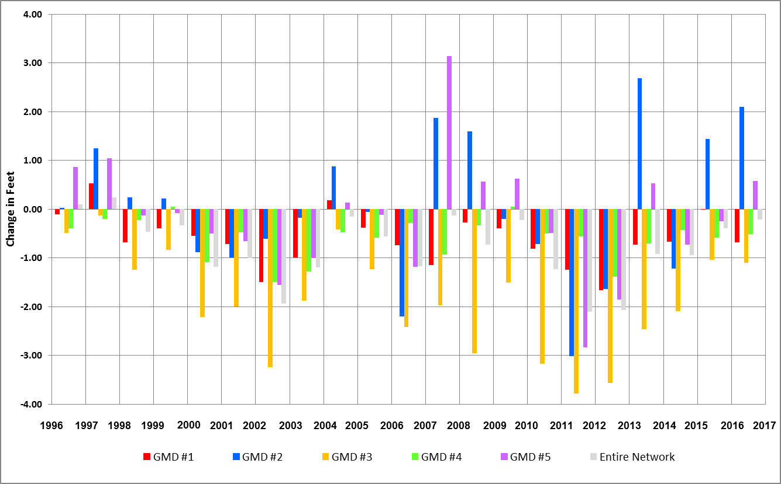
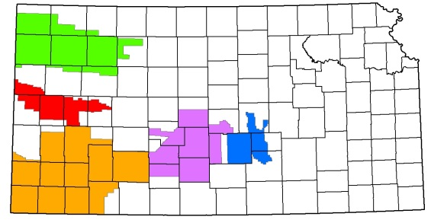
Average Change (by well)
*Results are based only on the cooperative network (KGS and KDA-DWR) and do not include sub-regional networks from the KGS, KDA-DWR, KGS, or local GMDs. 2017 water levels are provisional.
Notes:
Normal precipitation is just the average of the last 30 year decal period. The precipitation patterns in Kansas have a major influences on the both the landscape and associated land use in the state.

Slide 5
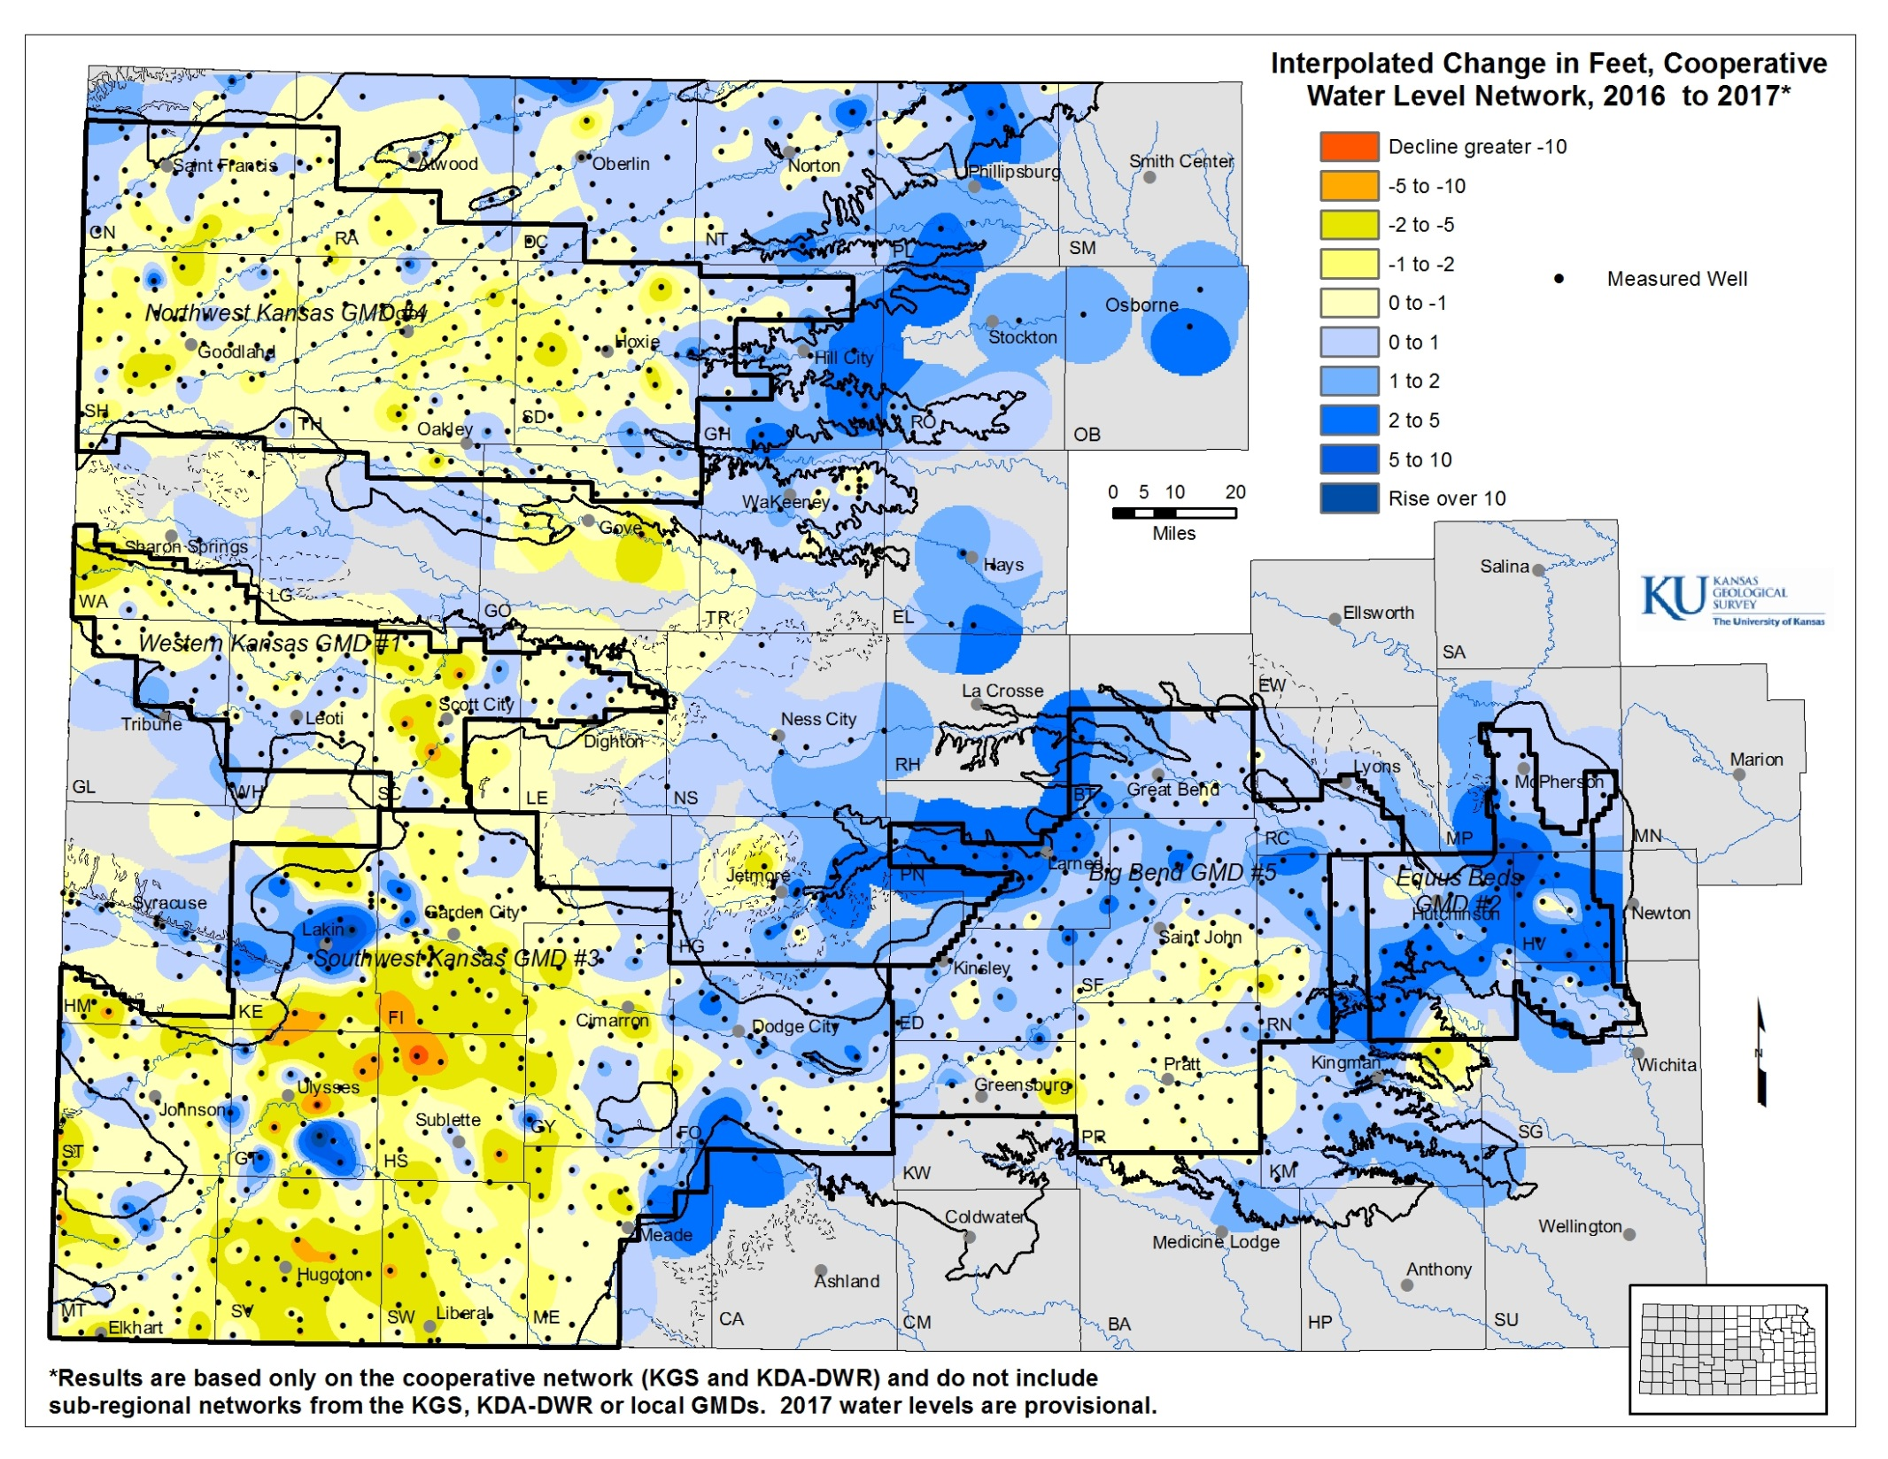
Notes:
Normal precipitation is just the average of the last 30 year decal period. The precipitation patterns in Kansas have a major influences on the both the landscape and associated land use in the state.

Slide 6
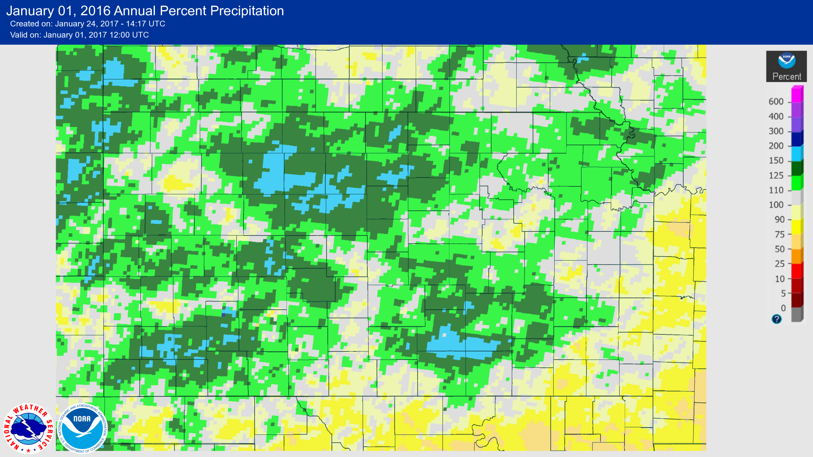
Percent Departure from Normal Precipitation
Source- National Oceanic and Atmospheric Administration (NOAA)
2016
Kansas Geological Survey

Slide 7
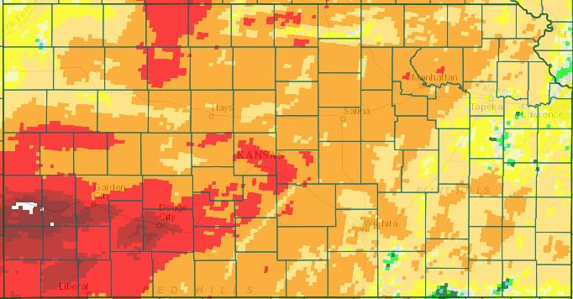
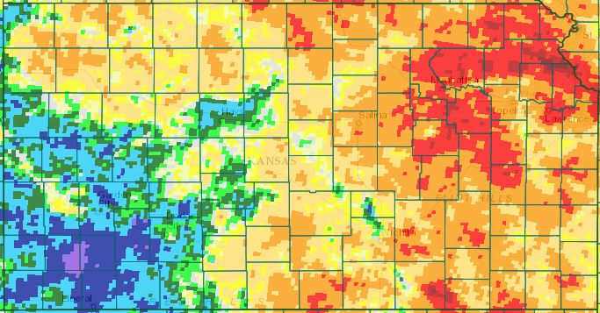
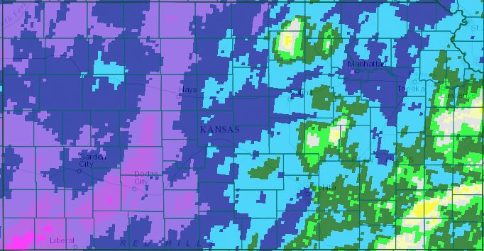
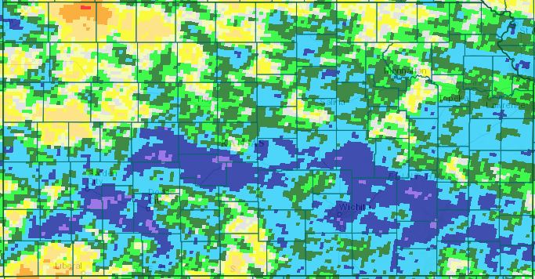
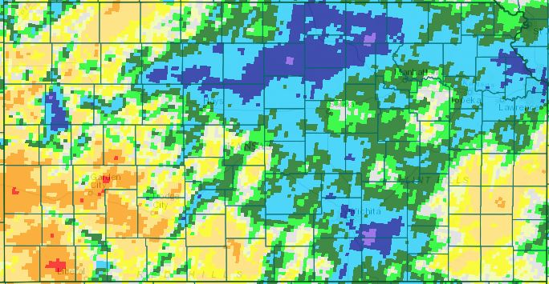
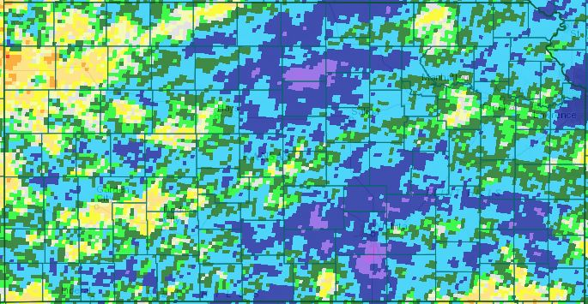
March
2016
June
April
July
May
August

Slide 8
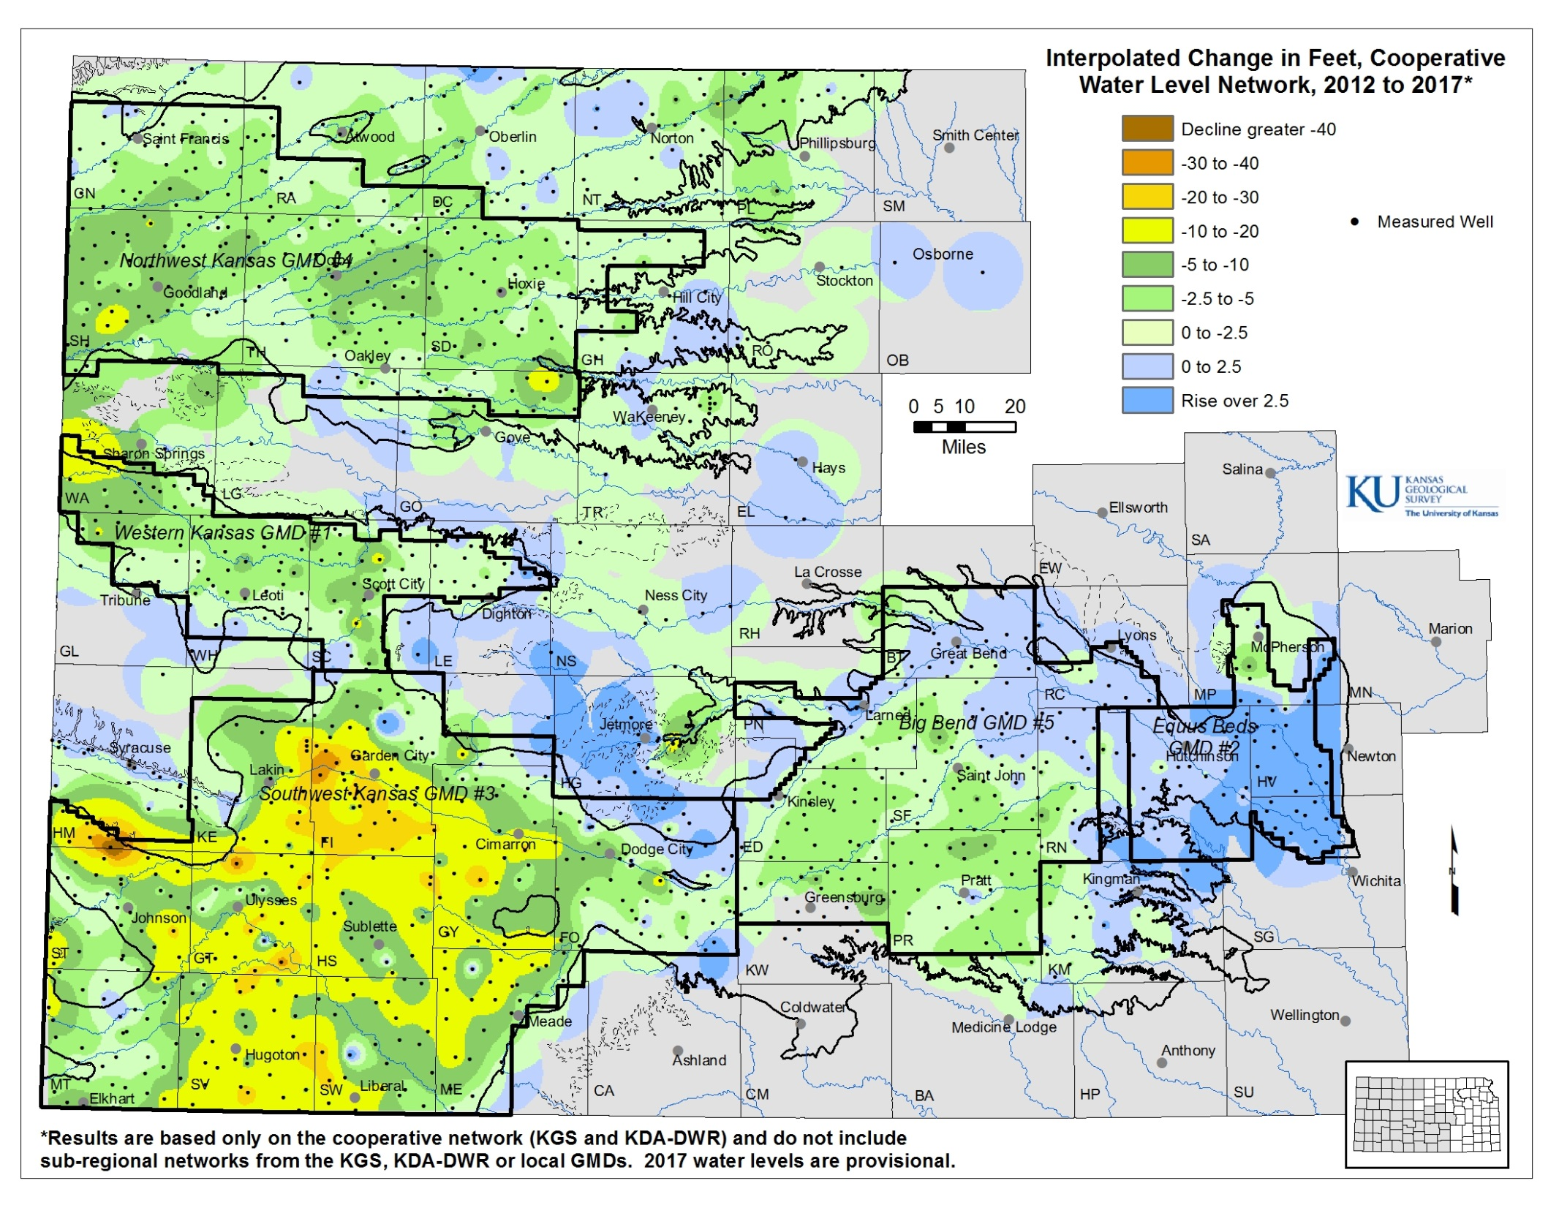
Notes:
Normal precipitation is just the average of the last 30 year decal period. The precipitation patterns in Kansas have a major influences on the both the landscape and associated land use in the state.

Slide 9
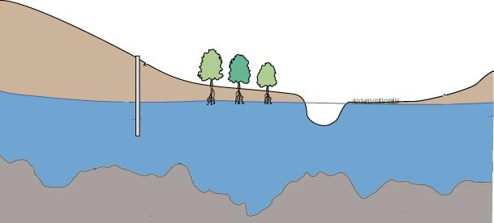
Simple Water Balance Equation
Water Volume Change in Aquifer =
Inflows into Aquifer – Outflows from Aquifer
Pumping Well
Transpiration
Recharge
Return Flows
Streambed
Interactions
Inflow
Outflow
Kansas Geological Survey
Notes:
Normal precipitation is just the average of the last 30 year decal period. The precipitation patterns in Kansas have a major influences on the both the landscape and associated land use in the state.

Slide 10
Focusing on Net Inflow and Pumping
Water Volume Change in Aquifer =
Inflows into Aquifer – Outflows from Aquifer
Water Volume Change in Aquifer =
Net Inflow – Pumping
Pumping Well
Transpiration
Recharge
Return Flows
Streambed
Interactions
Inflow
Net Inflow
Outflow
Kansas Geological Survey
Notes:
Normal precipitation is just the average of the last 30 year decal period. The precipitation patterns in Kansas have a major influences on the both the landscape and associated land use in the state.

Slide 11
Isolating Change from Water Level Volume
Water Volume Change in Aquifer =
Net Inflow – Pumping
Water Level Change x Area x Specific Yield =
Net Inflow – Pumping
Pumping Well
Transpiration
Recharge
Return Flows
Streambed
Interactions
Inflow
Net Inflow
Outflow
Kansas Geological Survey
Notes:
Normal precipitation is just the average of the last 30 year decal period. The precipitation patterns in Kansas have a major influences on the both the landscape and associated land use in the state.

Slide 12
Isolating Water Level Change
Water Level Change x Area x Specific Yield =
Net Inflow – Pumping
Water Level Change =
(Net Inflow / Area x Specific Yield) –
(Pumping / Area x Specific Yield)
Pumping Well
Transpiration
Recharge
Return Flows
Streambed
Interactions
Inflow
Net Inflow
Outflow
Kansas Geological Survey
Notes:
Normal precipitation is just the average of the last 30 year decal period. The precipitation patterns in Kansas have a major influences on the both the landscape and associated land use in the state.

Slide 13
Isolating Water Level Change
Water Level Change =
(Net Inflow / Area x Specific Yield) –
(Pumping / Area x Specific Yield)
Water Level Change ≈ b – a * Pumping
Pumping Well
Transpiration
Recharge
Return Flows
Streambed
Interactions
Inflow
Net Inflow
Outflow
Kansas Geological Survey
Notes:
Normal precipitation is just the average of the last 30 year decal period. The precipitation patterns in Kansas have a major influences on the both the landscape and associated land use in the state.

Slide 14
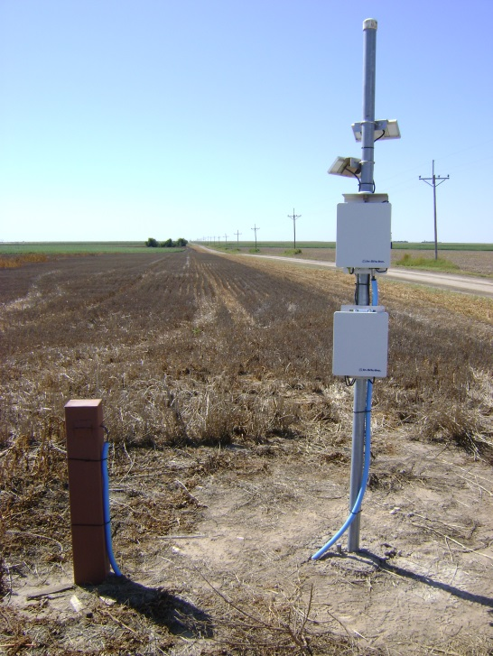
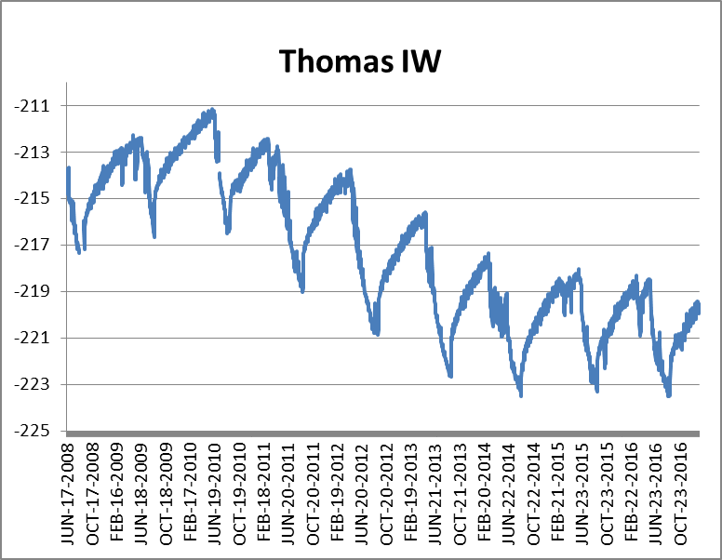
Thomas County Index Well
Kansas Geological Survey
Notes:
Normal precipitation is just the average of the last 30 year decal period. The precipitation patterns in Kansas have a major influences on the both the landscape and associated land use in the state.

Slide 15
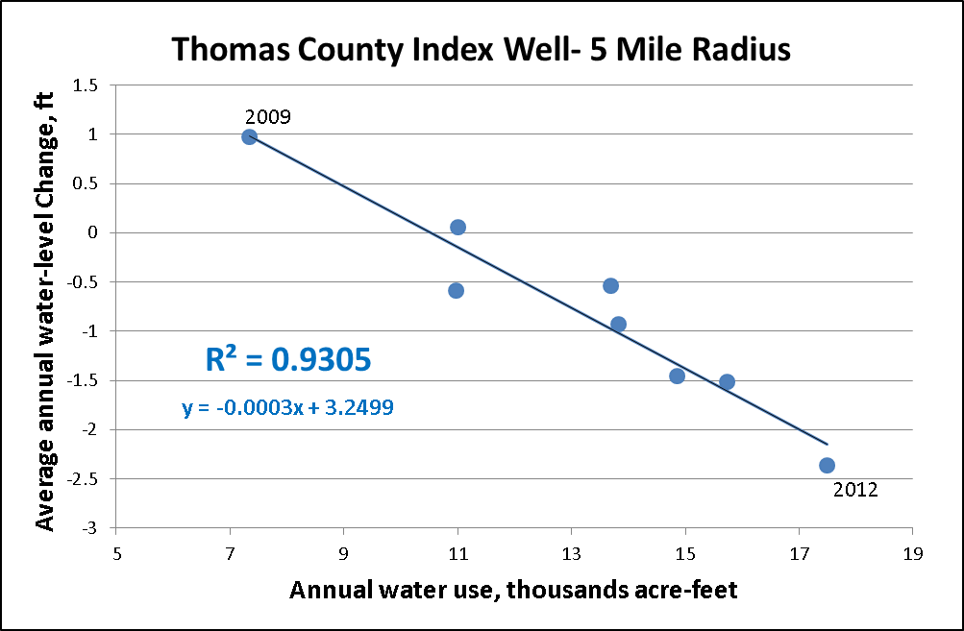
Water Level Change and Pumping Best Fit Line
Kansas Geological Survey
Notes:
Normal precipitation is just the average of the last 30 year decal period. The precipitation patterns in Kansas have a major influences on the both the landscape and associated land use in the state.

Slide 16
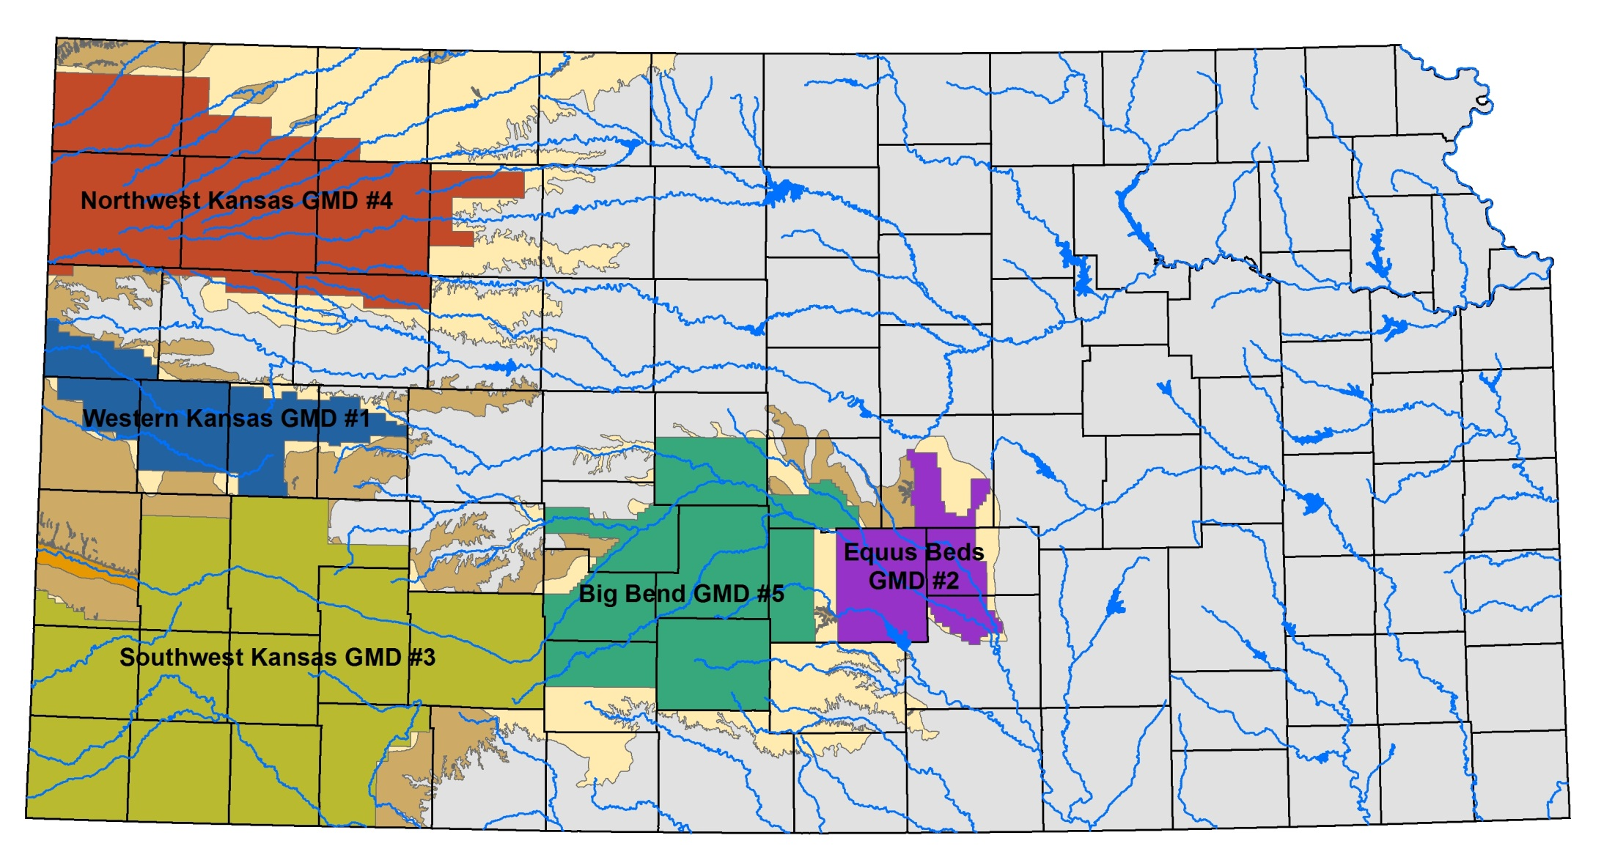
Groundwater Management Districts
Kansas Geological Survey

Slide 17
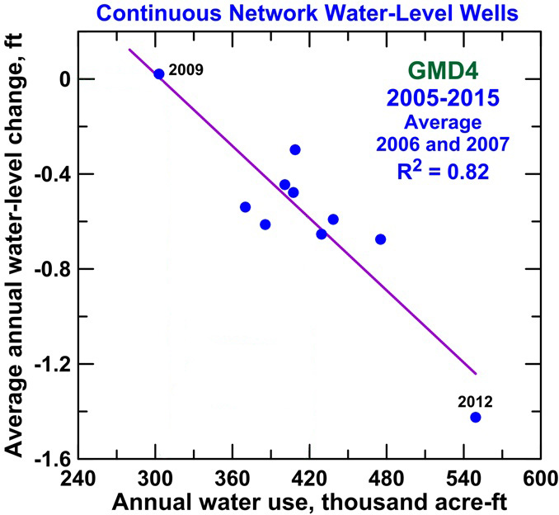
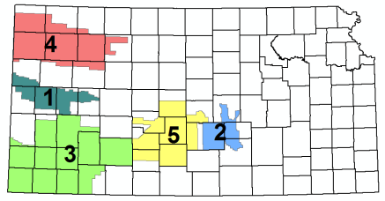
Water Use vs Water Level Change, GMD #4
Kansas Geological Survey

Slide 18
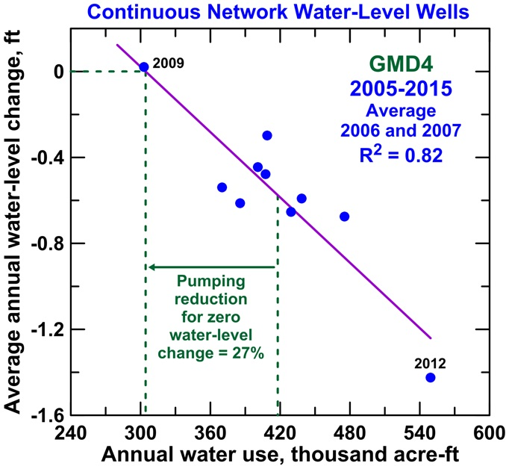
Water Use vs Water Level Change, GMD #4
Kansas Geological Survey

Slide 19
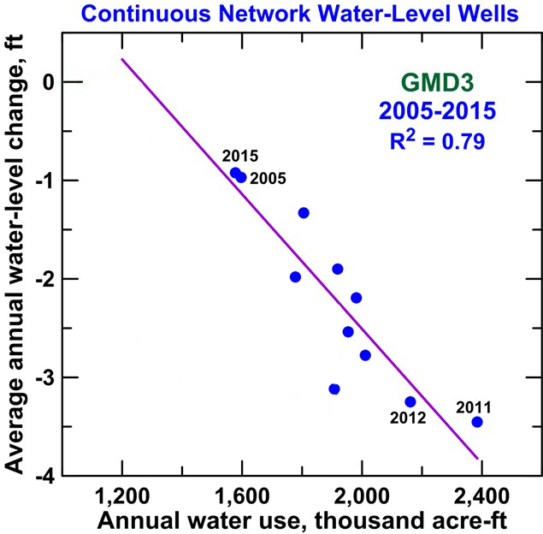
Water Use vs Water Level Change, GMD #3
Kansas Geological Survey

Slide 20
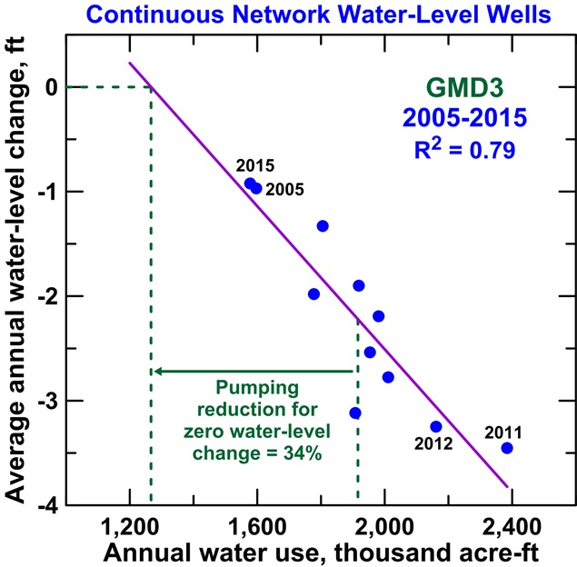
Water Use vs Water Level Change, GMD #3
Kansas Geological Survey

Slide 21
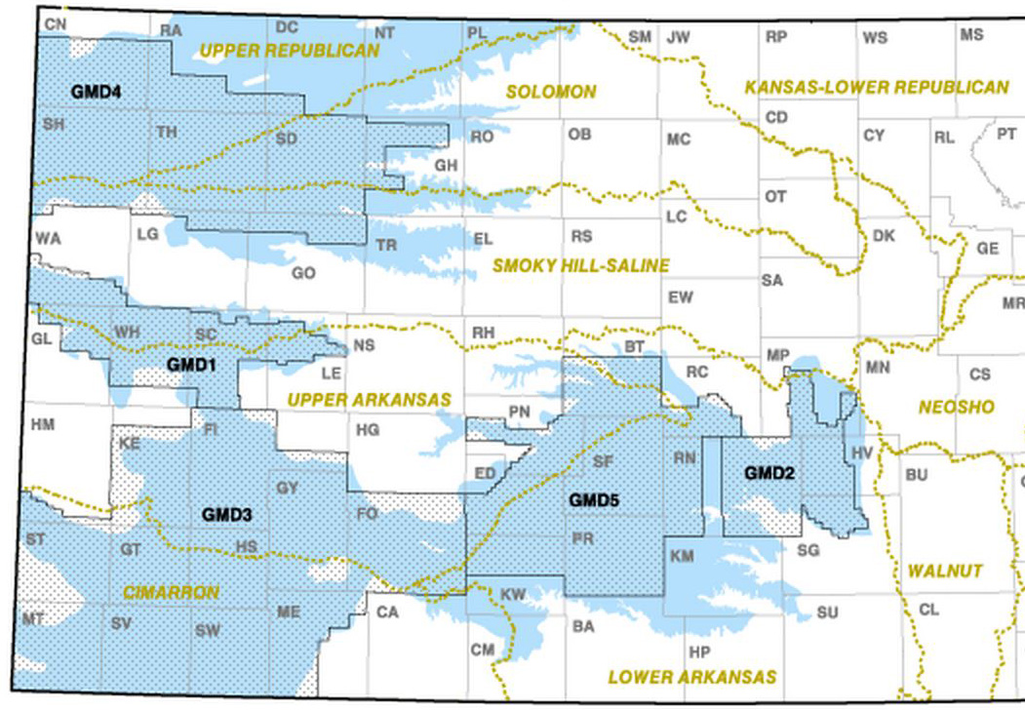
Percent Reduction in Pumping to Achieve Q Stable (1998 to 2014)
Mean of values for continuous and maximum wells for 1998-2014 where R² >0.24 for both or >0.2 for one and >0.3 for the other
37
19
2.6
38
30
20
19
5.4
1.9
6.4
7.3
32
2.8
0.4
1.4
2.1
7.3
0.0
30
17
13
5.7
34
69
28
31
42
35

Slide 22
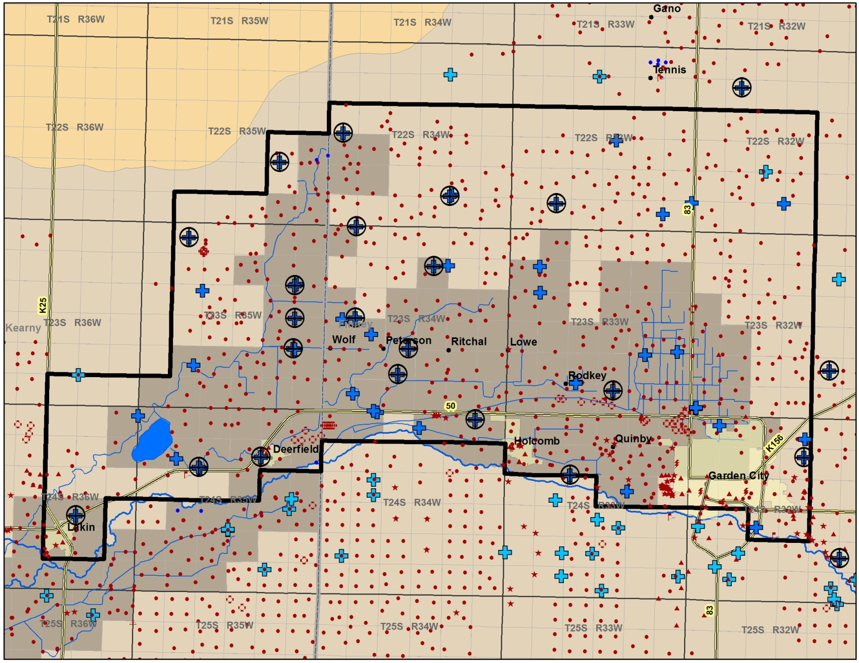
Measured Water Levels, 2005-2016
Kansas Geological Survey

Slide 23
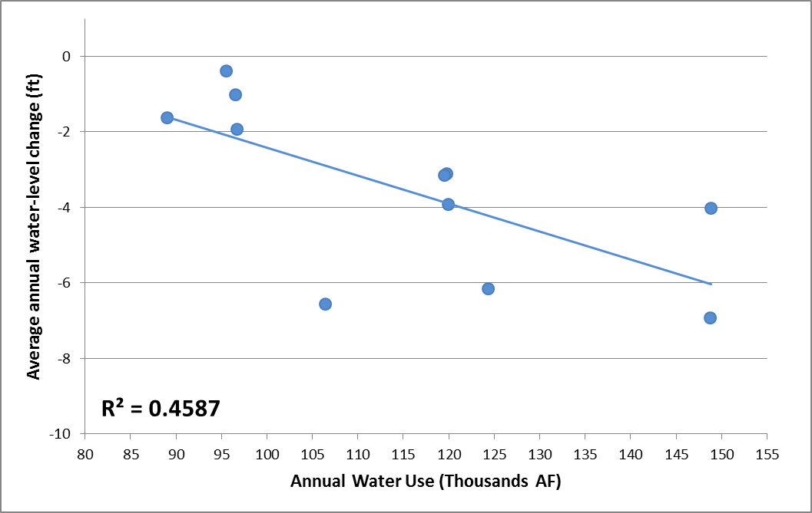
Water Use vs Water-level Change- All Continuous Wells
Kansas Geological Survey

Slide 24
Water Use vs Water-level Change- All Continuous Wells
2010
(2010 – 2011)
Kansas Geological Survey

Slide 25
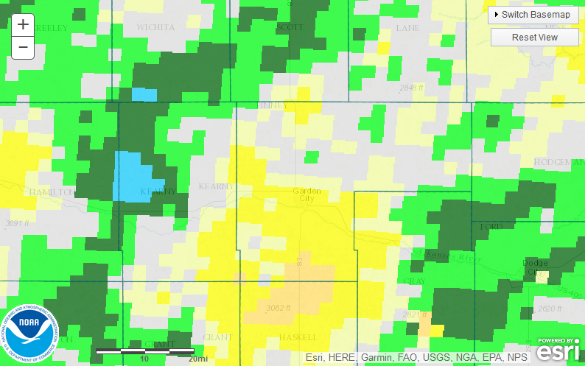
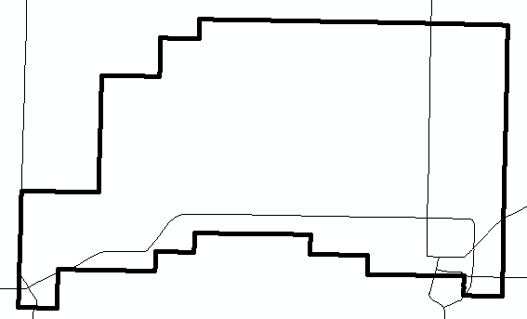
Percent Departure from Normal Precipitation, 2010
Water Year (October 1)
Kansas Geological Survey

Slide 26
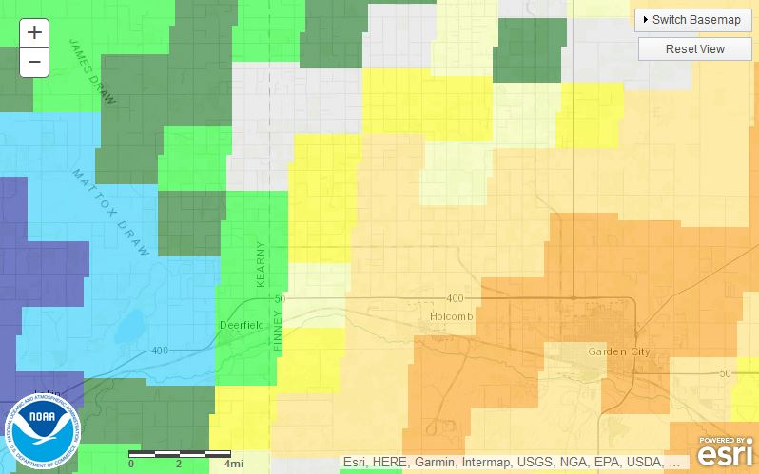
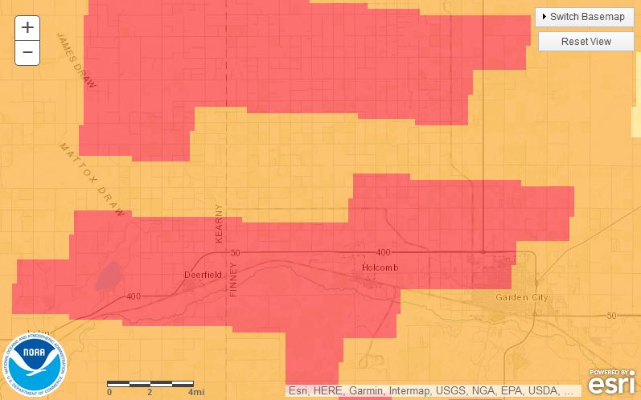
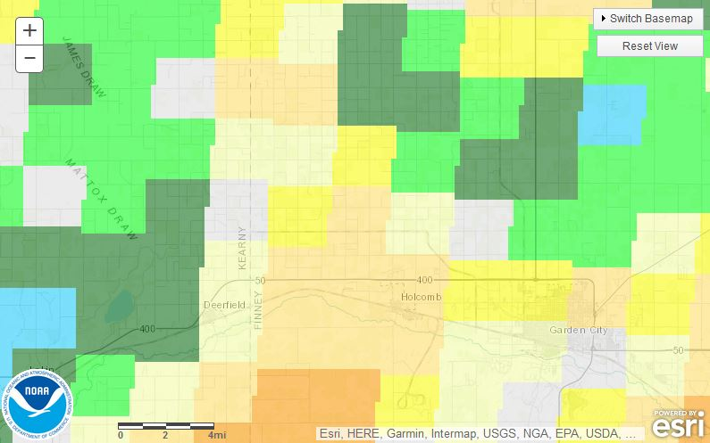
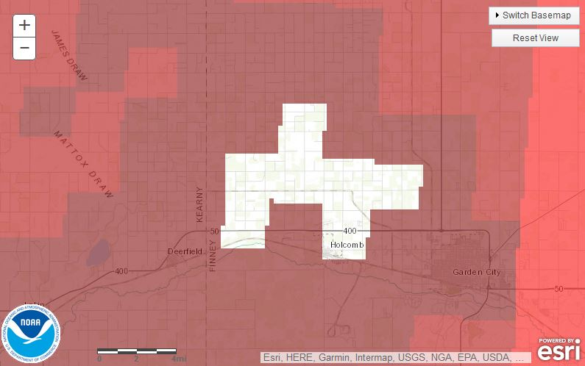
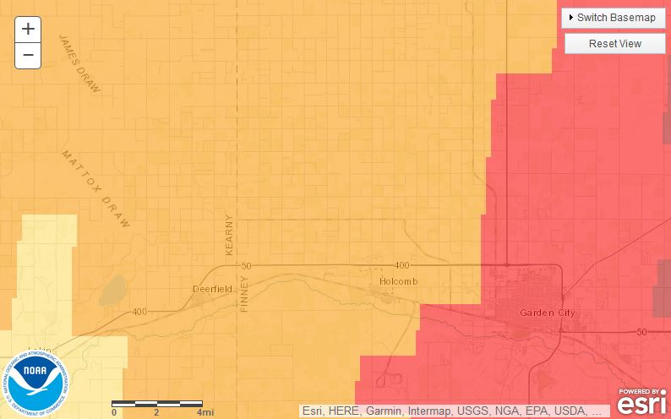
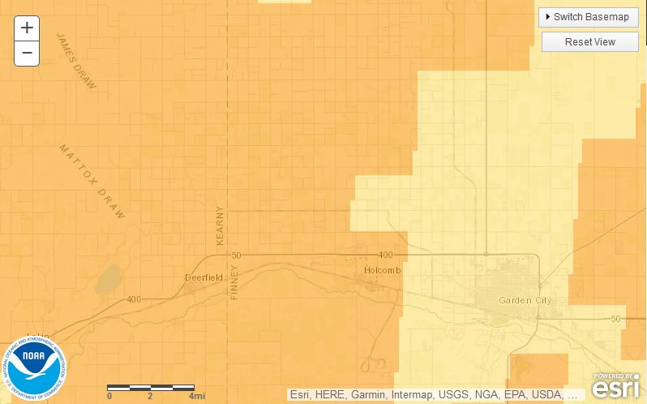
Monthly Percent Departure from Normal Precipitation, 2010
July
October
August
November
September
December
Kansas Geological Survey

Slide 27
Water Use vs Water-level Change- All Continuous Wells
2010
(2010 – 2011)
Kansas Geological Survey

Slide 28
Water Use vs Water-level Change- All Continuous Wells
2011
(2011 to 2012)
2010
(2010 – 2011)
Kansas Geological Survey

Slide 29
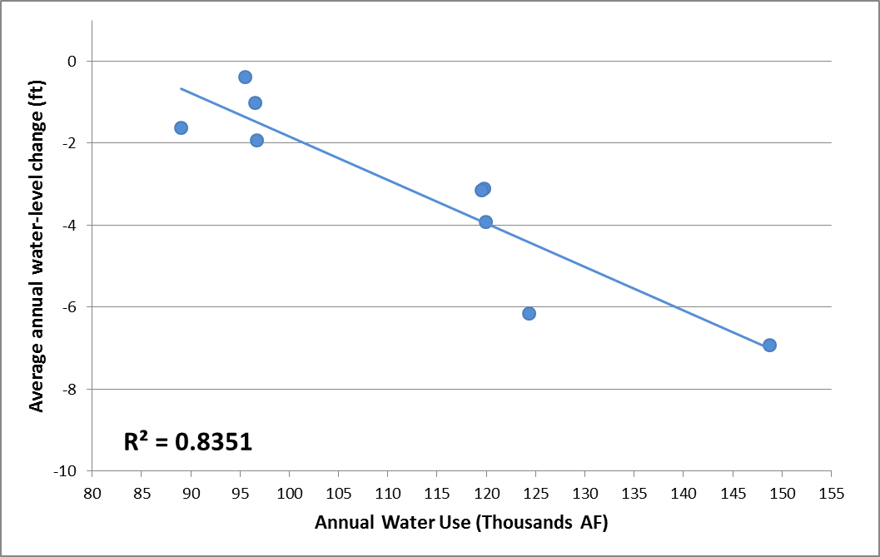
Water Use vs Water-level Change- All Continuous Wells
2010 and 2011 Excluded or Averaged
Kansas Geological Survey

Slide 30
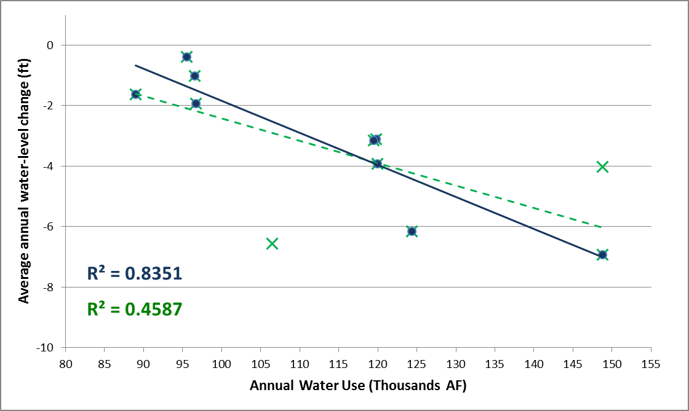
Q Stable Computed Results
Average Groundwater Use = ~115,000 AF
Average Water Level Decline = ~ 3.3 ft
26 to 40% reduction in average use = Stable water levels = Sustainable
20% reduction in average use = 0.75 to 1.8 ft declines = decline reduced 50 to 76%
10% reduction in average use = 1.9 to 2.7 declines = decline reduced 24 to 38%
Kansas Geological Survey

Slide 31
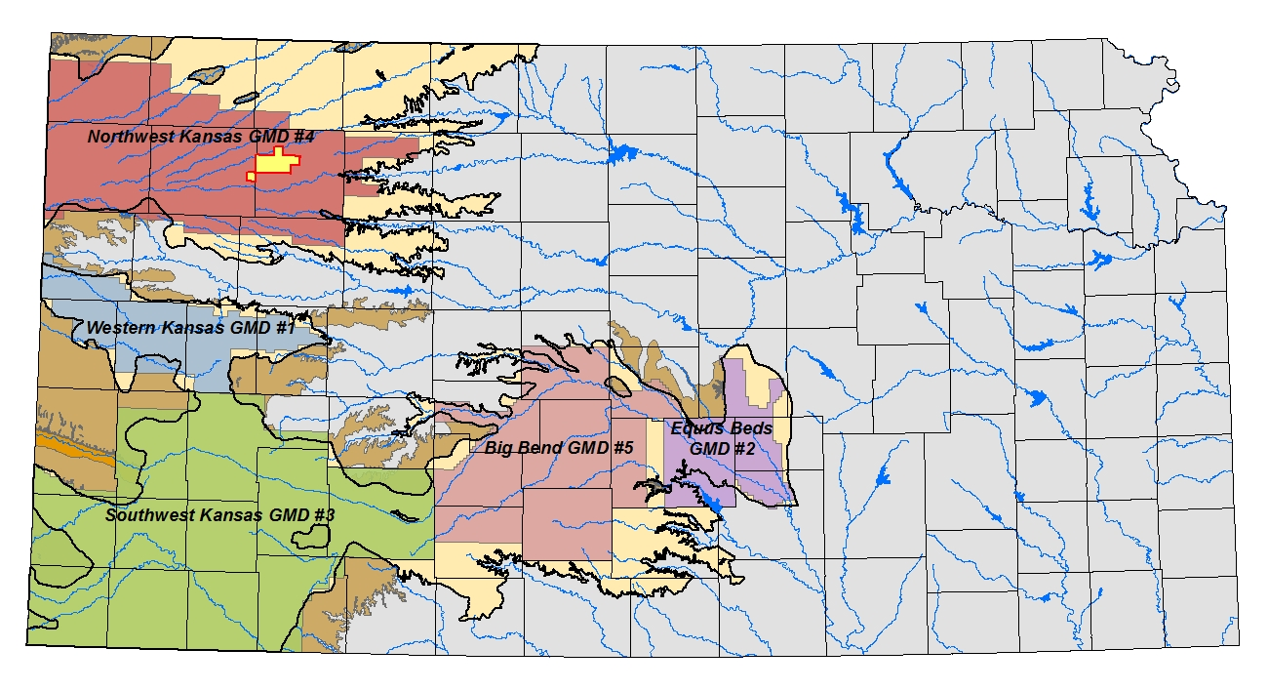
SD 6 Local Enhanced Management Area
Kansas Geological Survey

Slide 32
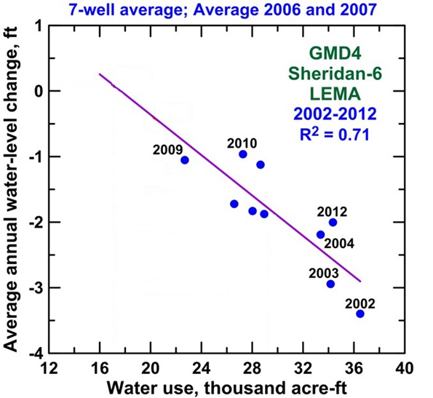
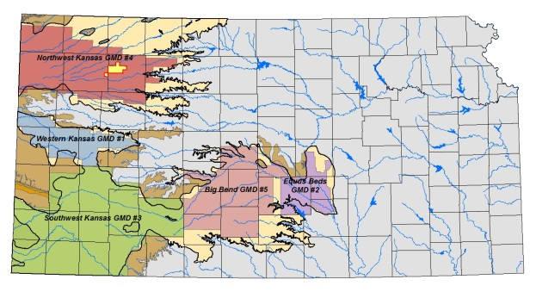
Water Use vs Water Level Change, Pre-SD 6
Kansas Geological Survey

Slide 33
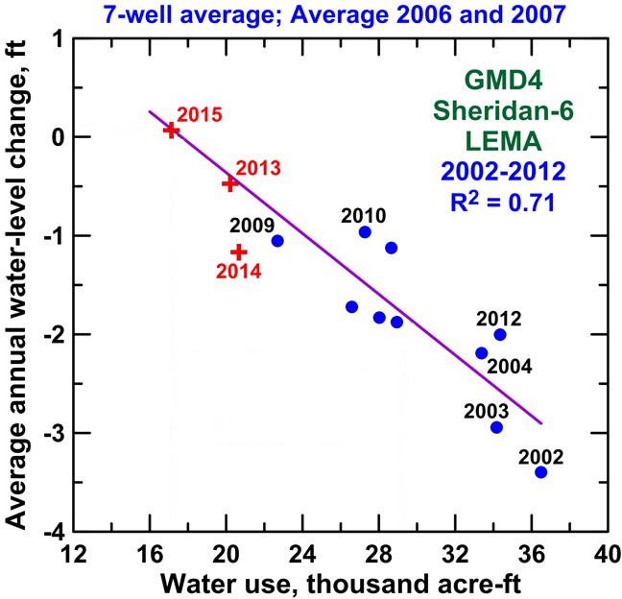
Water Use vs Water Level Change, with SD 6
Kansas Geological Survey

Slide 34
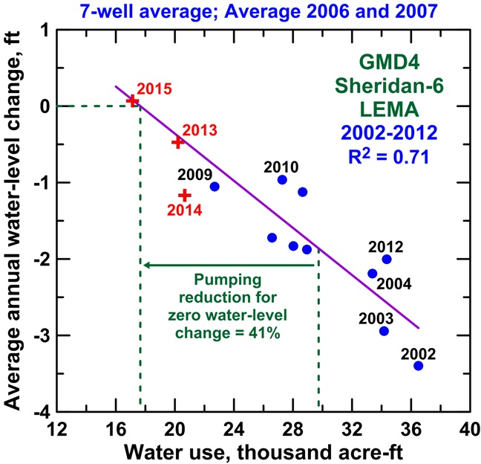
Water Use vs Water Level Change, SD 6
Kansas Geological Survey

Slide 35
Questions????
Kansas Geological Survey
1930 Constant Ave
Lawrence, KS 66047
785-864-2118
Visit our site at http://www.kgs.ku.edu
Notes:
Thank You!

Slide 36
Isolating Water Level Change
Water Level Change x Area x Specific Yield =
Net Inflow – Pumping
Water Level Change =
(Net Inflow / Area x Specific Yield) –
(Pumping / Area x Specific Yield)
In the Kansas HPA, Net Inflow and Specific Yield change little with time because:
Annually-based data
Seasonally pumped aquifer
Relatively large areas
Significant depths to water
Reliable water–level and water-use data
Pumping Well
Transpiration
Recharge
Return Flows
Streambed
Interactions
Inflow
Net Inflow
Outflow
Kansas Geological Survey
Notes:
Normal precipitation is just the average of the last 30 year decal period. The precipitation patterns in Kansas have a major influences on the both the landscape and associated land use in the state.

Slide 37
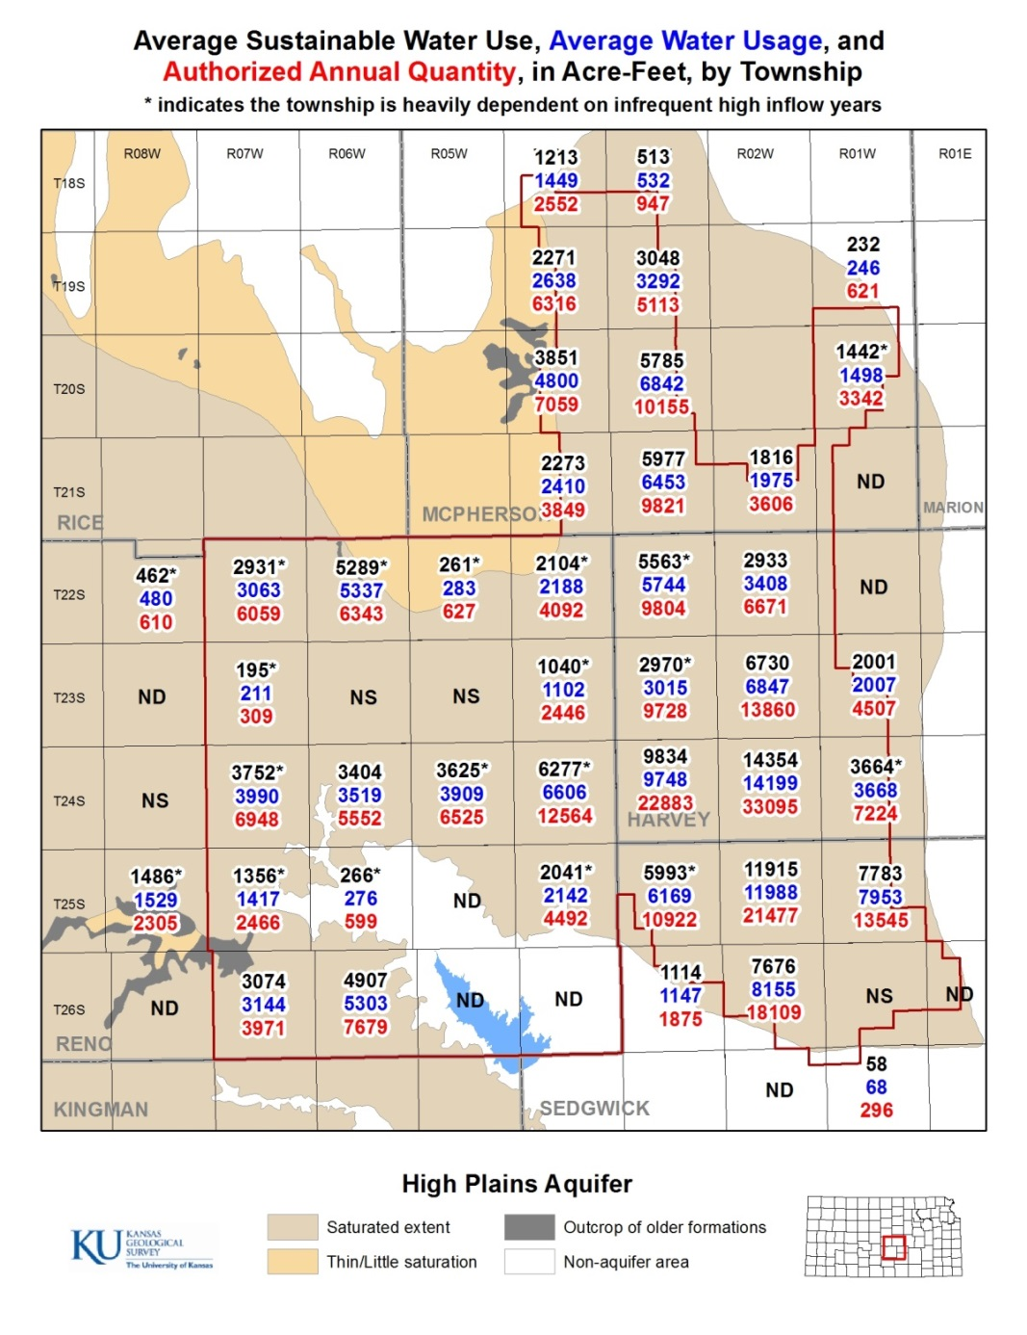
Q Stable, by Township, GMD2
Kansas Geological Survey

Slide 38
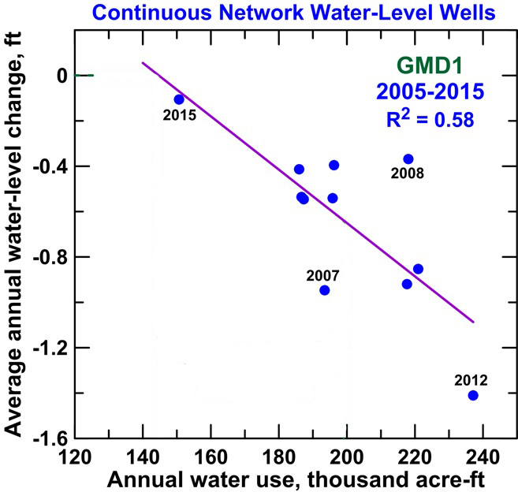
Water Use vs Water Level Change, GMD #1
Kansas Geological Survey

Slide 39
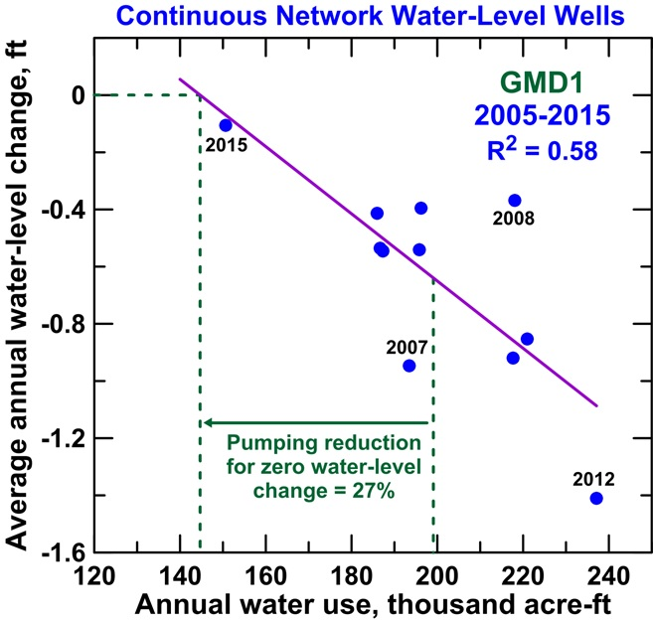
Water Use vs Water Level Change, GMD #1
Kansas Geological Survey

Slide 40
Water Use vs Water Level Change, GMD #3
Kansas Geological Survey

Slide 41
Water Use vs Water Level Change, GMD #3
Kansas Geological Survey

Slide 42
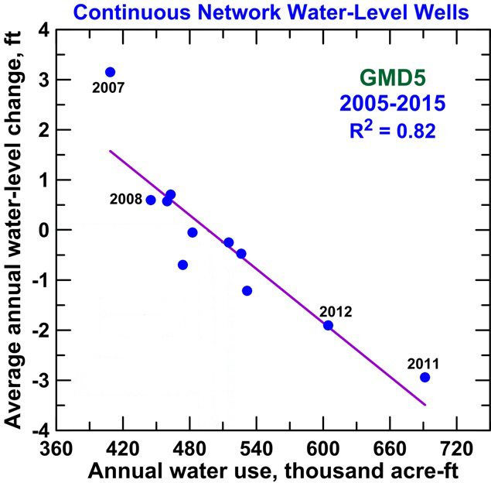
Water Use vs Water Level Change, GMD #5
Kansas Geological Survey

Slide 43
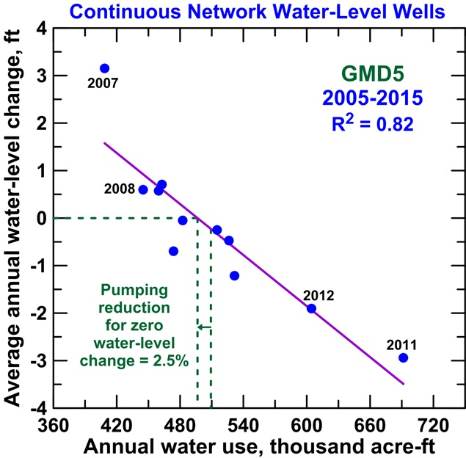
Water Use vs Water Level Change, GMD #5
Kansas Geological Survey

Slide 44
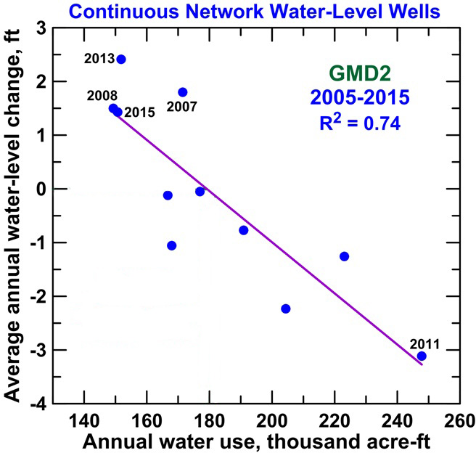
Water Use vs Water Level Change, GMD #2
Kansas Geological Survey

Slide 45
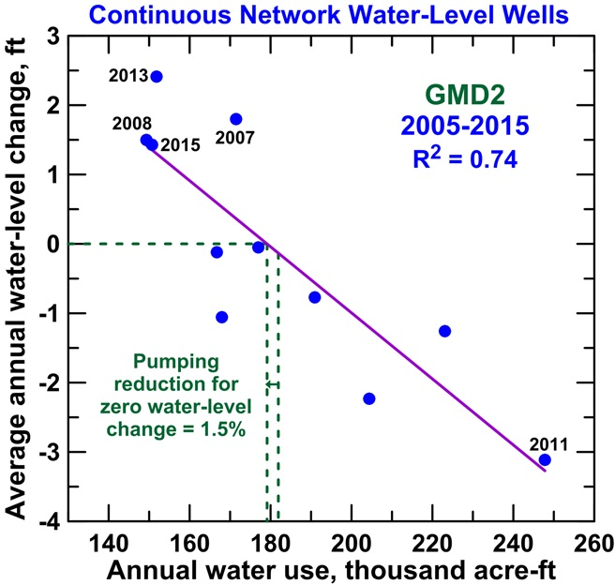
Water Use vs Water Level Change, GMD #2
Kansas Geological Survey

Slide 46
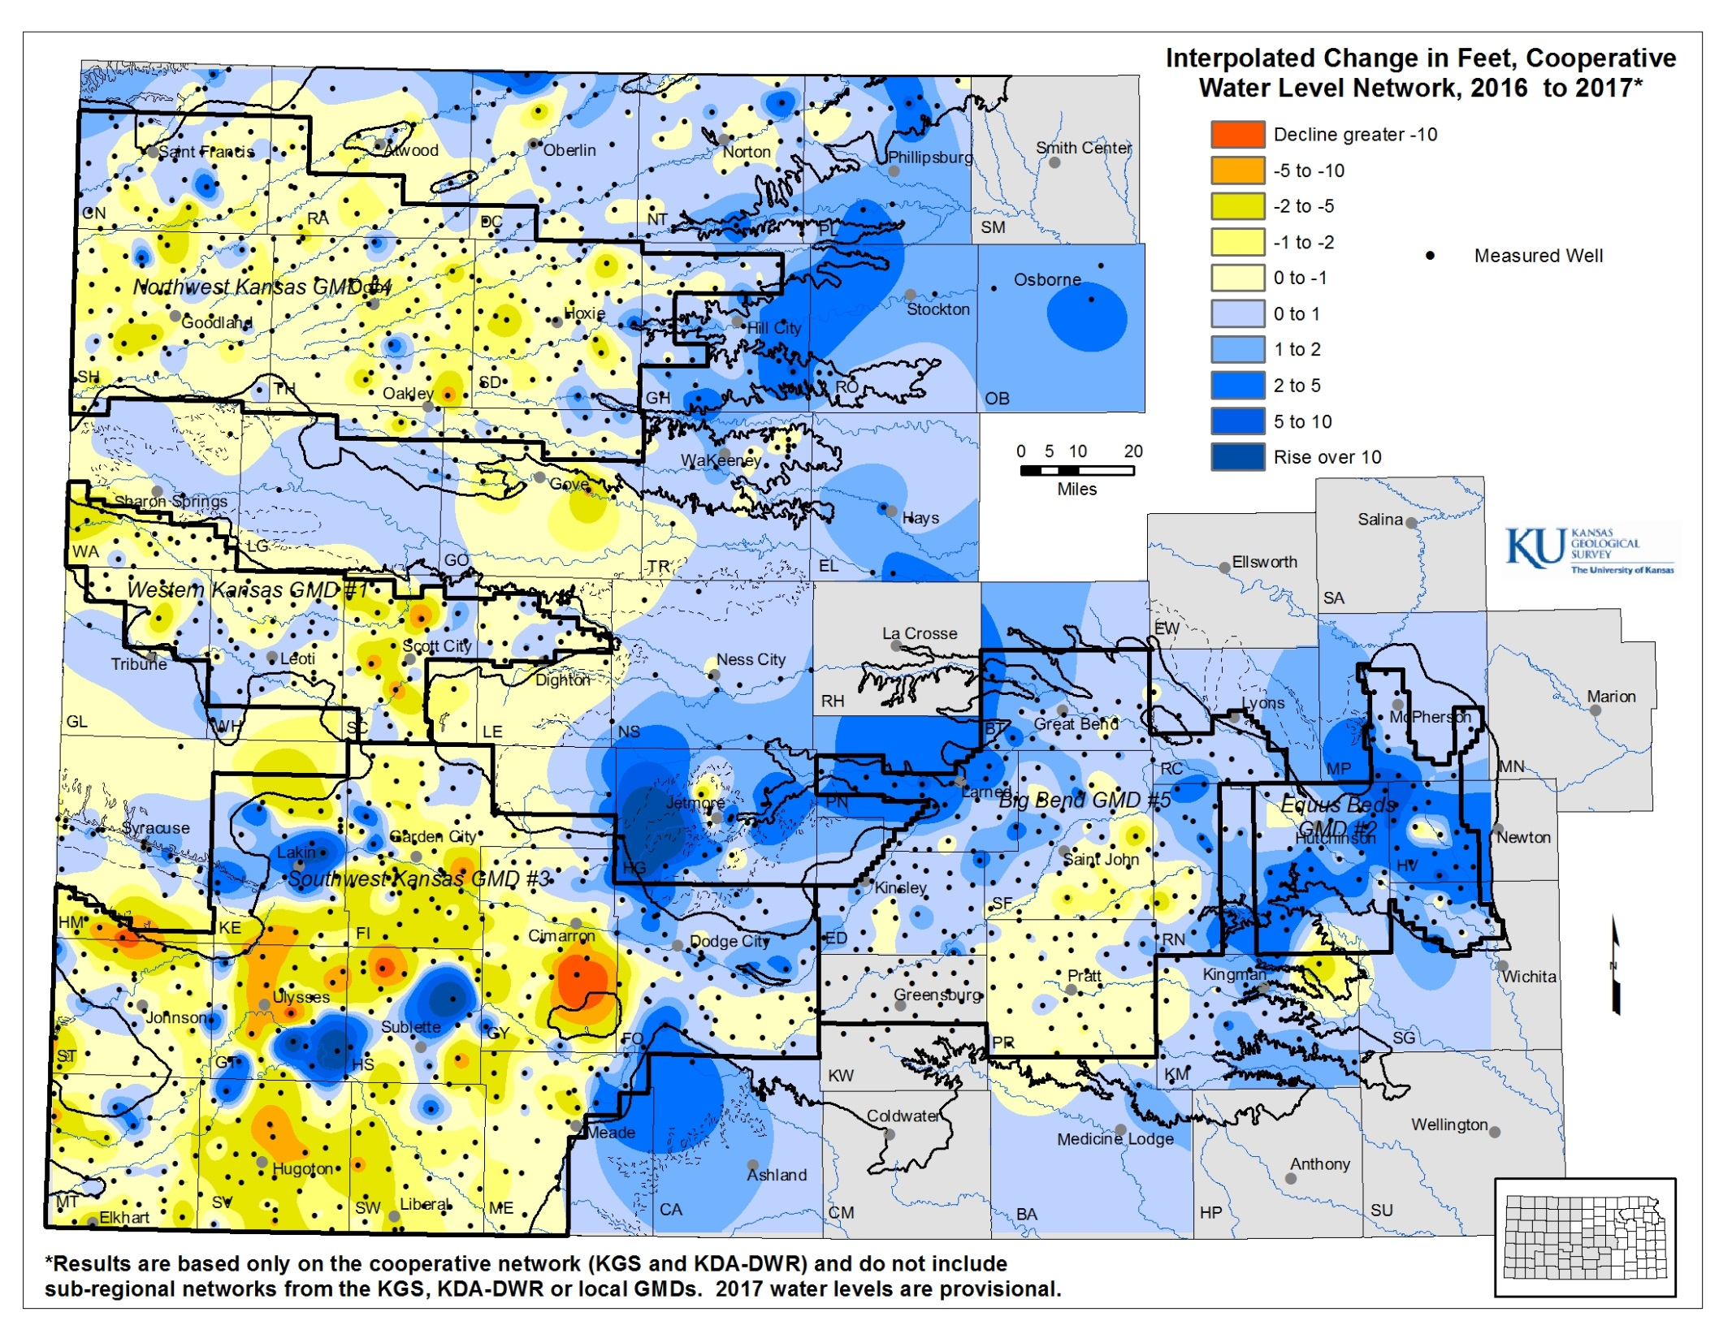
Notes:
Normal precipitation is just the average of the last 30 year decal period. The precipitation patterns in Kansas have a major influences on the both the landscape and associated land use in the state.

