Slide 1

David Barfield, Chief Engineer
Division of Water Resources
Kansas Department of Agriculture
Impairment in groundwater systems/Hays water transfer
GMD 3 annual meeting
March 8, 2017

Slide 2
Kansas Water Appropriations Act’s fundamental charge to the Chief Engineer
  K.S.A. 82a-706: The Chief Engineer shall enforce and administer the laws of this state pertaining to the beneficial use of water and shall control, conserve, regulate, allot and aid in the distribution of the water resources of the state for the benefits and beneficial uses of all its inhabitants in accordance with the rights of priority of appropriation.
  K.S.A. 82a-706b – “It shall be unlawful for any person to prevent, by diversion or otherwise, any waters of this state from moving to a person having a prior right to use the same…”

Slide 3
Impairment process
1) Complaint
2) DWR Investigation
3) DWR Report of Findings
4) If impairment is found and action desired, complainant must file a request to secure water
5) Action by the Chief Engineer as long as required

Slide 4
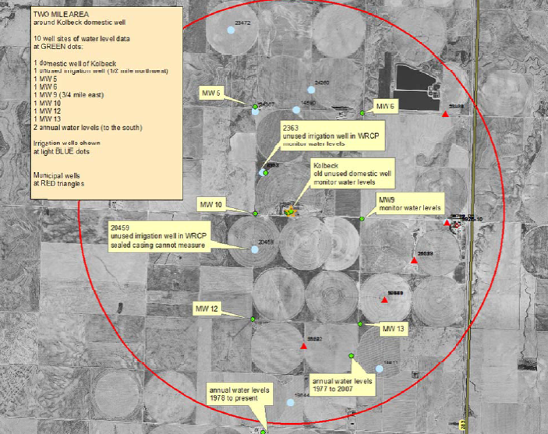

Slide 5
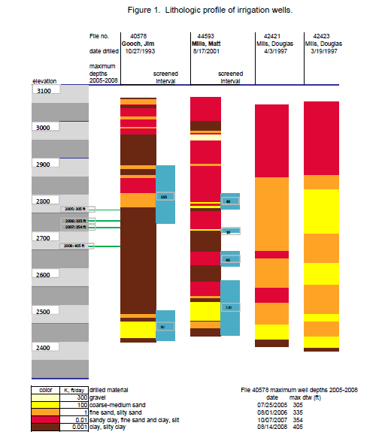

Slide 6
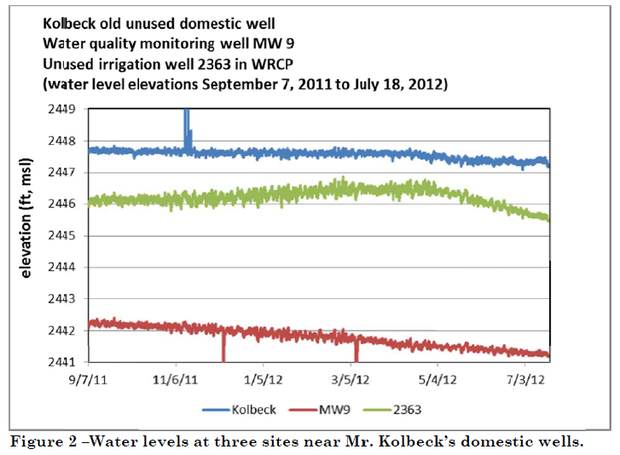
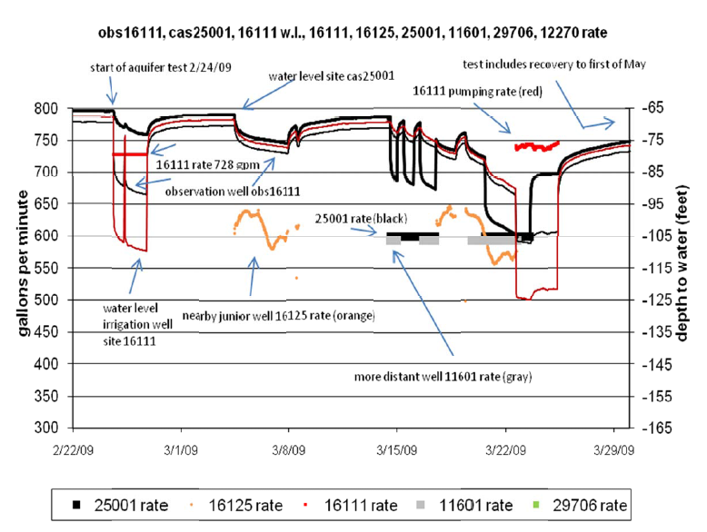

Slide 7
Initial High Plains aquifer impairment action
Stevens County (Gooch – Mills)
  2008 – first water administration in the Ogallala.
  2009, 2010 – DWR developed alternative water administration methods, eventually establishing trigger elevations in the aquifer to determine action
DWR Developed revised rules on our impairment process, adding specifics on groundwater investigations

Slide 8
Groundwater Impairment investigations process
Determine if complainant has good well/pumping plant
Review well logs; geologic information.
Install monitoring equipment (pumping rate/quantity; well depths), conduct pump test to determine local aquifer properties; extent of direct well to well interference
Prepare initial report, provide to GMD and neighbors for opportunity for comment
Final report
If impairment found, determine remedy

Slide 9
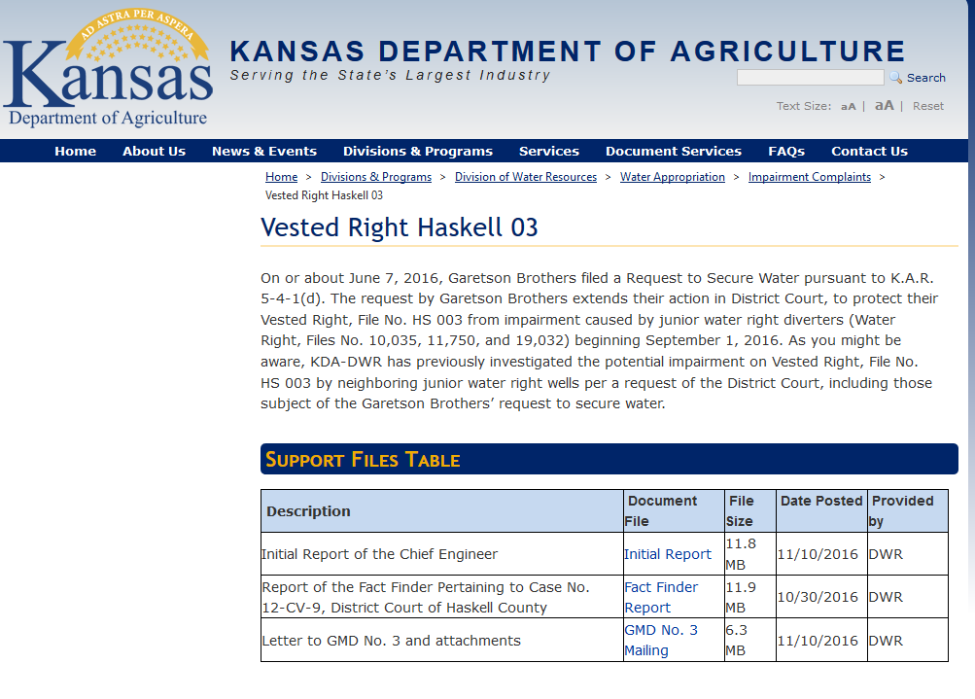

Slide 10
Wells that interfere with HS3
Well 19032 stopped pumping 6/29/13
(out of water)
Well 10467 stopped pumping 5/26/13
Well 25275 not pumped in 2013
Pumping rate loggers and telemetry installed
at wells 10035 and 11750 July 2013

Slide 11
Haskell County impairment (Garetson)
2005 – Garetson files impairment compliant with the Chief Engineer
  Expressed interest in an IGUCA to address concerns
2007 - Compliant withdrawn
2012 - Garetson files an impairment compliant in District Court
  K.S.A. 82a-716/717a – Allows water right holders to file directly to District Court to seek redress
  K.S.A. 82a-725- Allows Court to appoint chief engineer as referee
2014 – District Court grants temporary injunction
2015 - KS Court of Appeals upholds
2017 – District Court grants permanent injunction

Slide 12
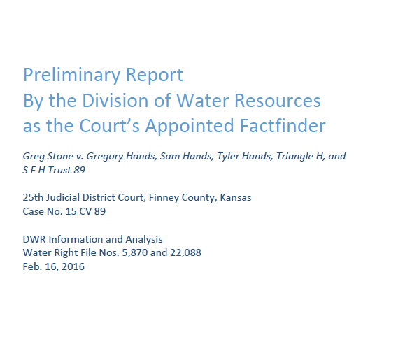
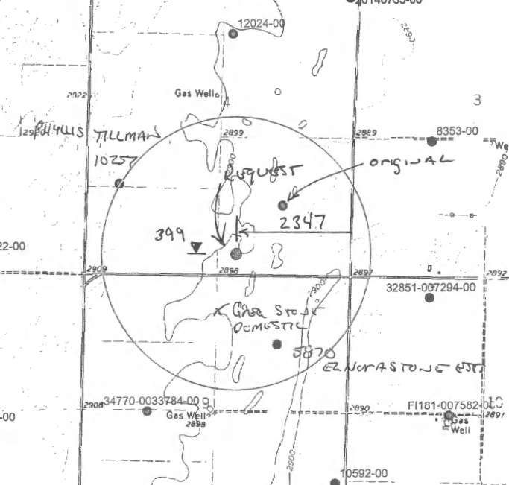
Stone v. Hands litigation - dismissed

Slide 13
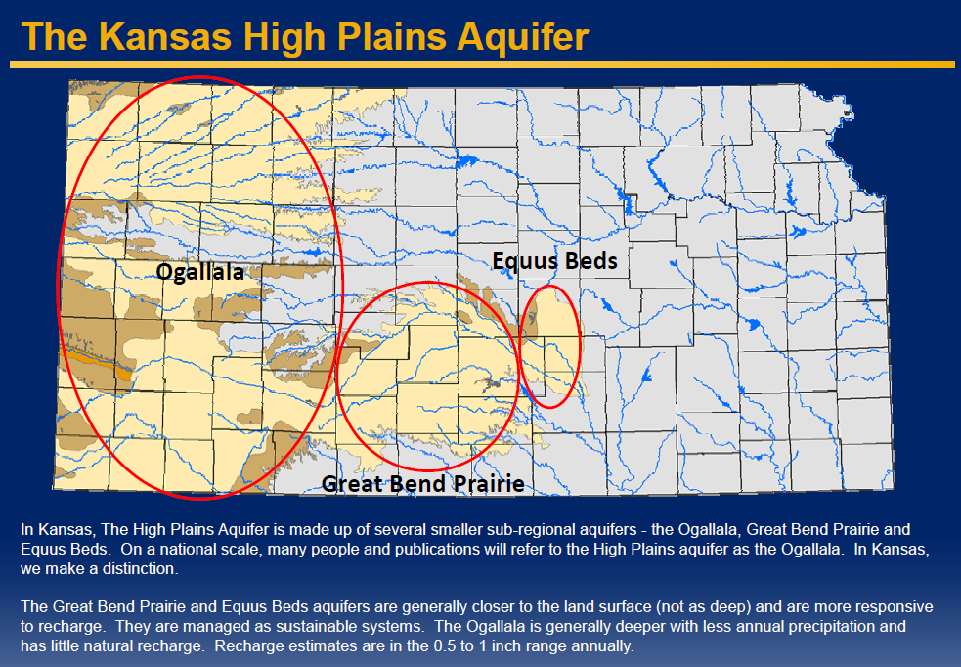
Notes:
Total usable groundwater in storage equals about 200 million acre-feet (from USGS and KGS data compiled in an unpublished report, “Water Supplies and Use in Kansas” by Kansas Department of Agriculture, Division of Water Resources, April 24, 2007; rounded down from 219 million acre-feet considering estimated declines of about 2 to 3 million acre-feet per year).
Total renewable groundwater supply equals about 4 million acre-feet of annual recharge (from USGS and KGS data compiled in an unpublished report, “Water Supplies and Use in Kansas” by Kansas Department of Agriculture, Division of Water Resources, April 24, 2007). However, most of the recharge is in central and eastern Kansas whereas most of the groundwater use is in western Kansas.

Slide 14
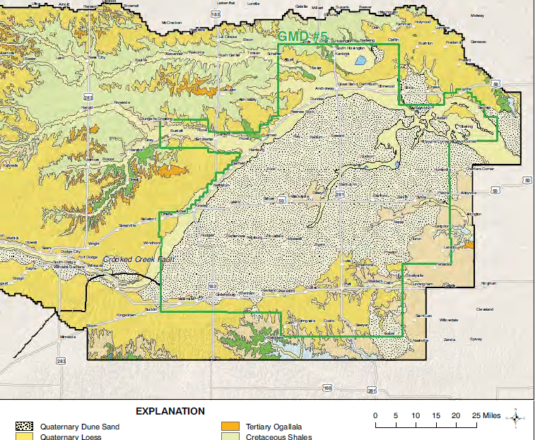

Slide 15
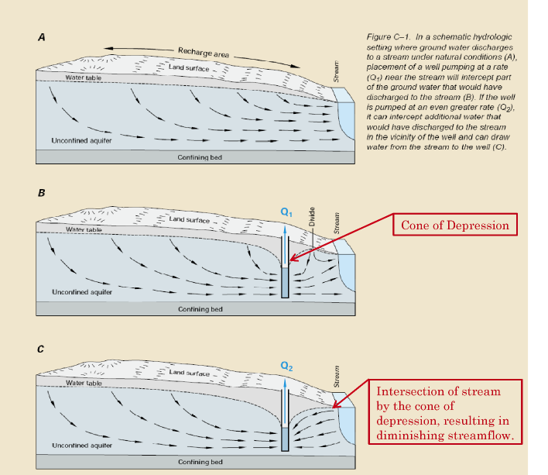

Slide 16
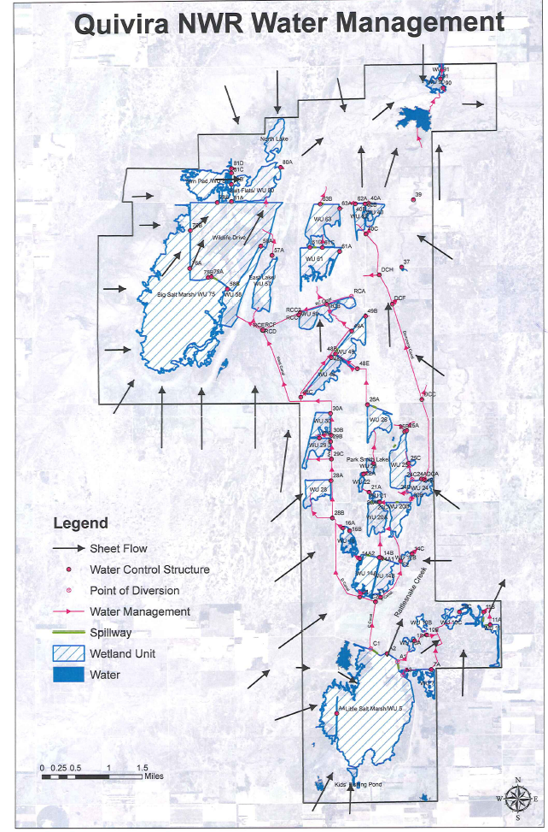
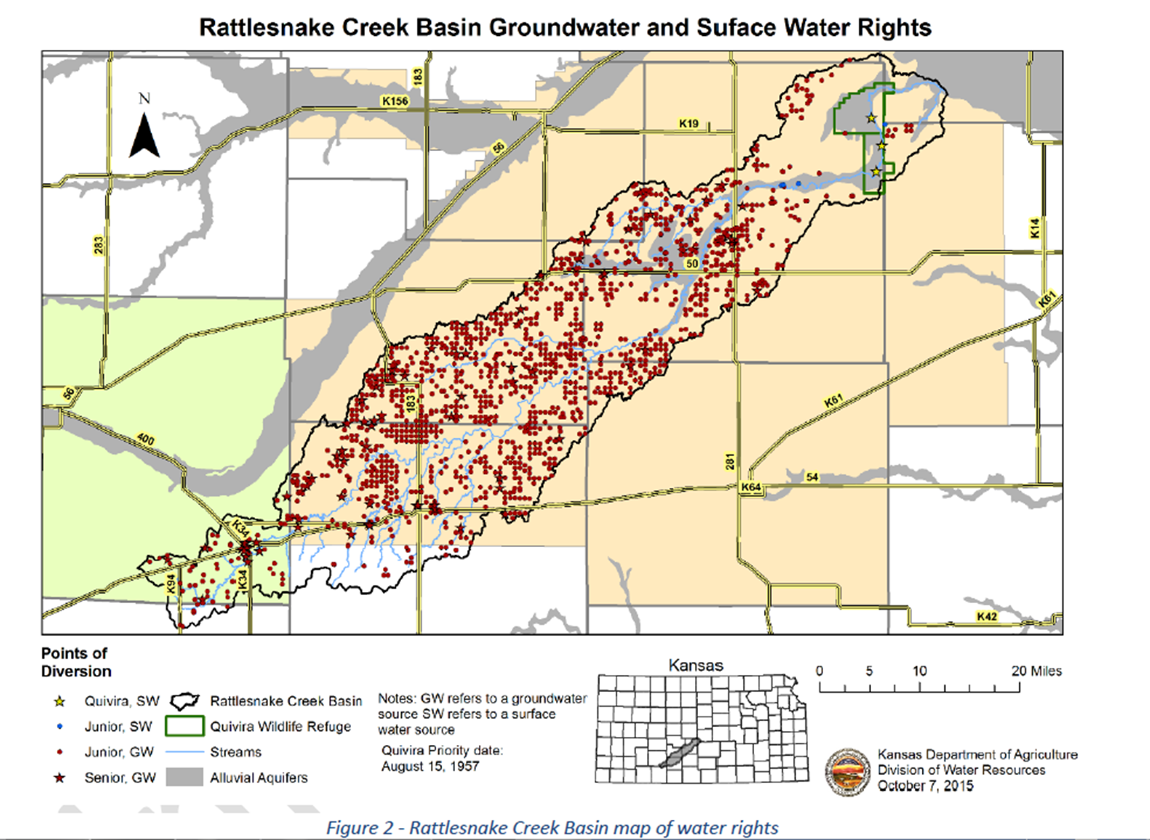
Quivira National Wildlife Refuge impairment investigation

Slide 17
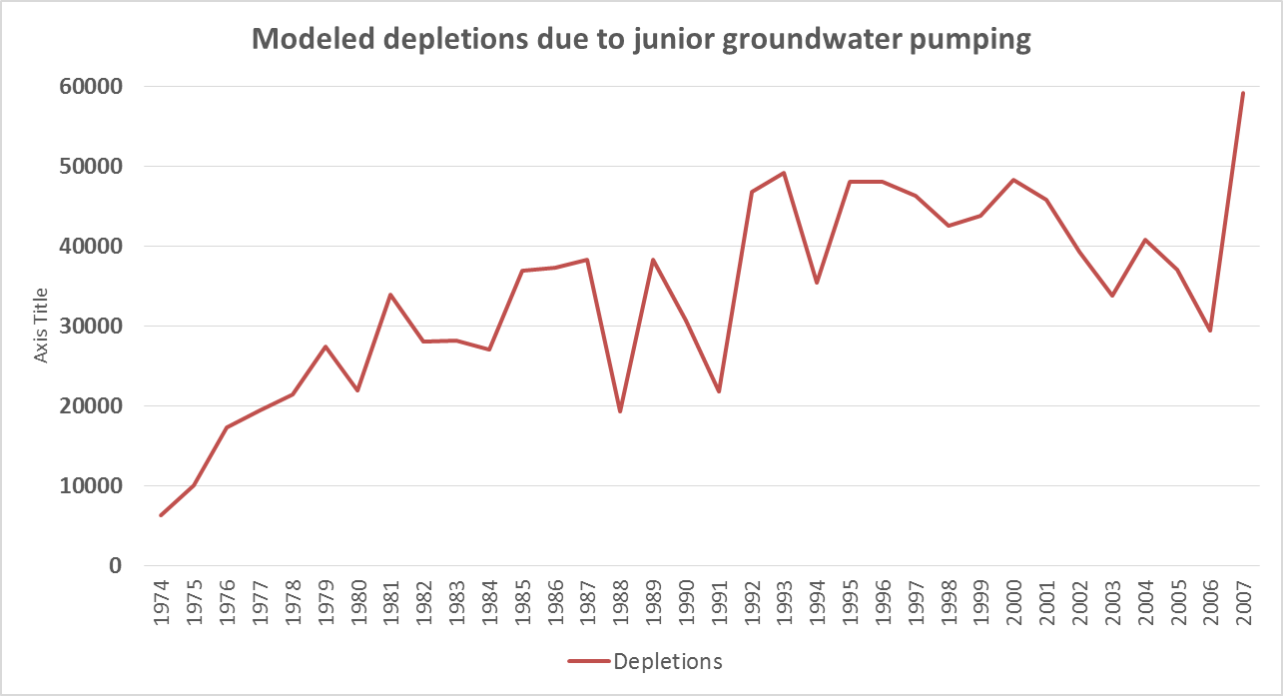
Depletions to Rattlesnake streamflows (baseflows) at Zenith due to junior groundwater pumping
Determined by use of the GMD 5 groundwater model

Slide 18
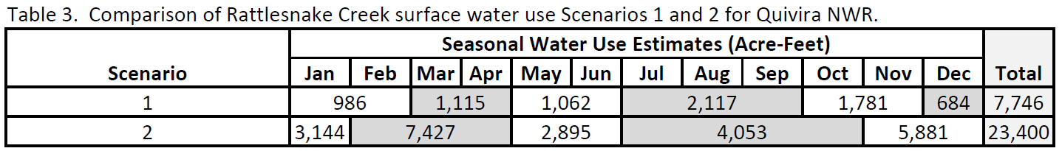
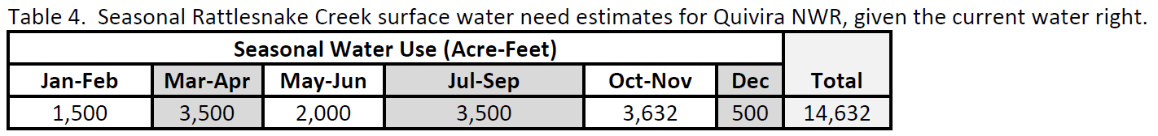
Refuge needs within its water right
May, 2015 – Attachment 5 of Initial Report

Slide 19
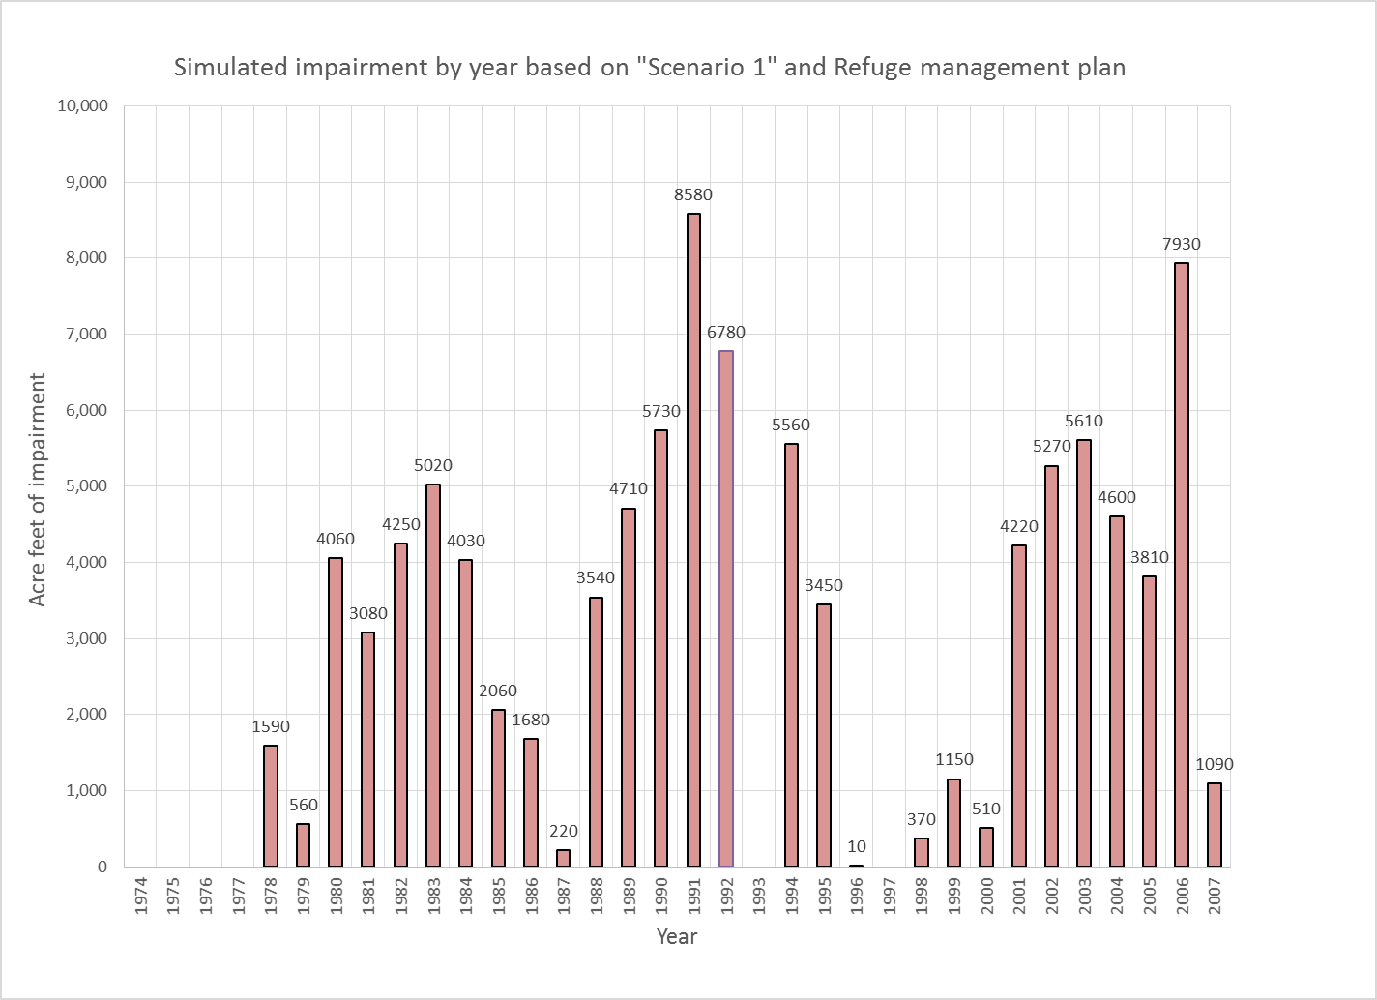
Notes:
Figure 10 in initial report

Slide 20
Quivira: current status
Impairment investigation report finalized July 15, 2016 found junior, upstream groundwater pumping is regularly interfering with the U.S. Fish and Wildlife Service’s senior use.
  Regularly 3,000 – 5,000 acre-feet per year
Working with water users to develop a workable solution
  2015 Legislative action states that augmentation can be considered as a remedy for impairment
  Basin’s Sept. 2016 offer: augmentation only, 1500 AF/year, 15 cfs, on the Refuge
  Rejected by Service in December 1 as insufficient in quantity and noting that placing augmentation infrastructure on the refuge as described in the offer poses “significant legal obstacles

Slide 21
Quivira: current status
Our Dec 8, 2016 letter to the basin
  Requested basin stakeholders develop a revised settlement offer by February 15, 2017.
  Should an agreement not be reached, we will be obligated to develop an administrative remedy for implementation in 2018 and beyond.
  No administration again in 2017
On 1/1/2017, the Service filed a “Request to Secure Water,” with a request to begin administration on 1/1/2018
On 2/15/2017, GMD 5 made a second offer, up to 5,000 acre-feet/year of augmentation

Slide 22
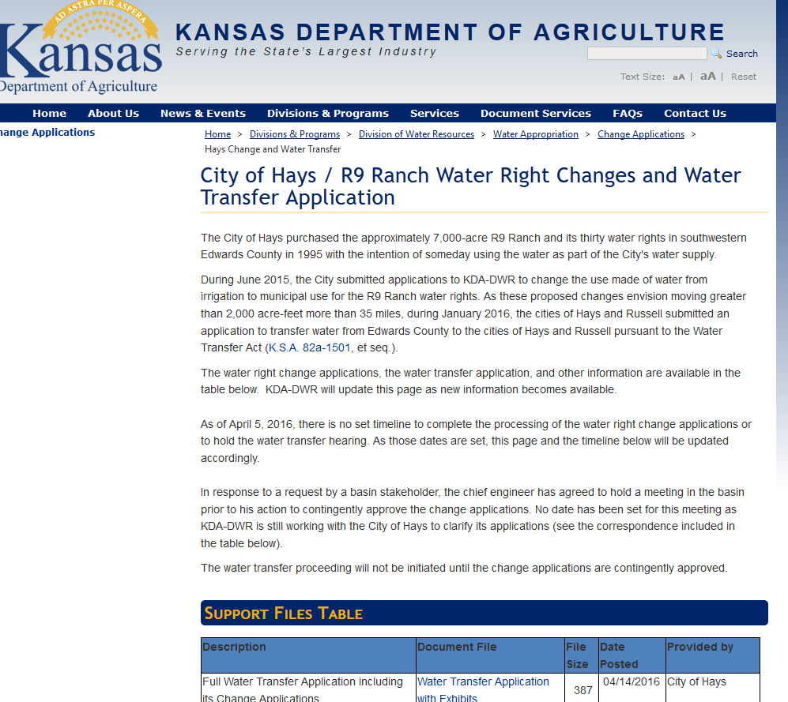

Slide 23
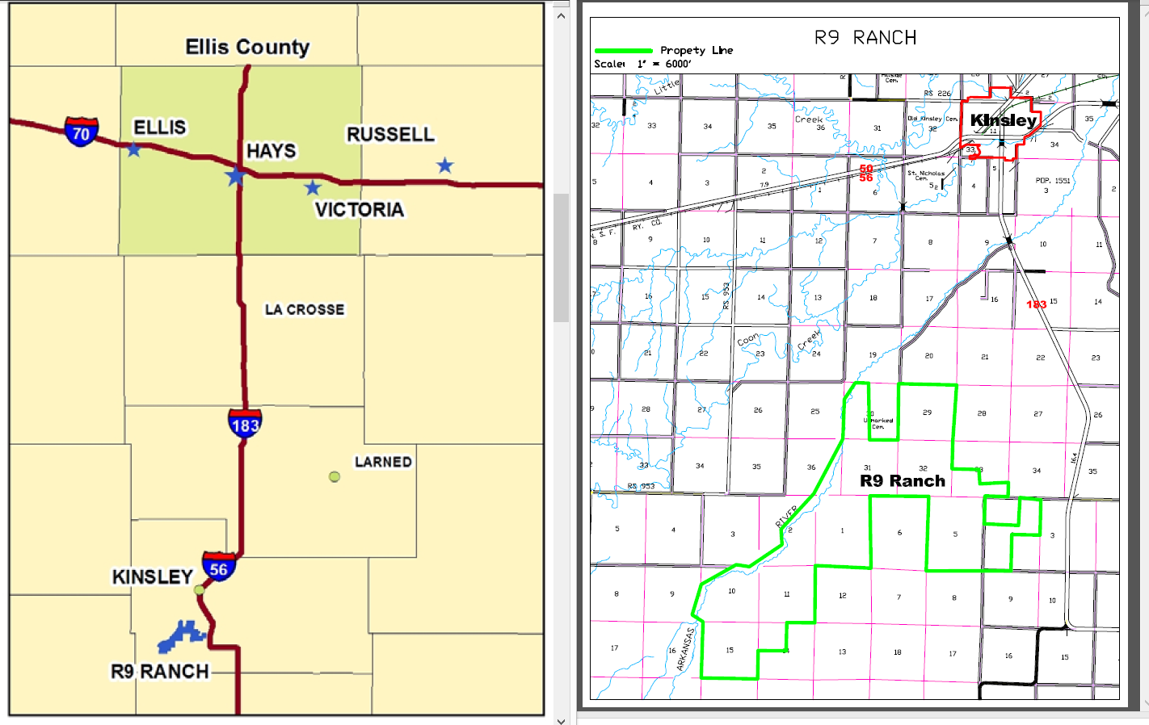
Water transfer for Hays 7000 AF; 80 miles.

Slide 24
Two Distinct Approval Processes required
Change application approval under the Kansas Water Appropriation Act….
  This process is first as the changes applications must be contingently approved prior to the water transfer process
Water Transfer Process

Slide 25
Changes in water rights
K.S.A. 82a-708b. Application for change in place of use, point of diversion or use; fee; review of action on application.
(a) Any owner of a water right may change the place of use, the point of diversion or the use made of the water, without losing priority of right, provided such owner shall:
(1) Apply in writing to the chief engineer for approval of any proposed change;
(2) demonstrate to the chief engineer that any proposed change is reasonable and will not impair existing rights;
(3) demonstrate to the chief engineer that any proposed change relates to the same local source of supply as that to which the water right relates; and
(4) receive the approval of the chief engineer with respect to any proposed change…

Slide 26
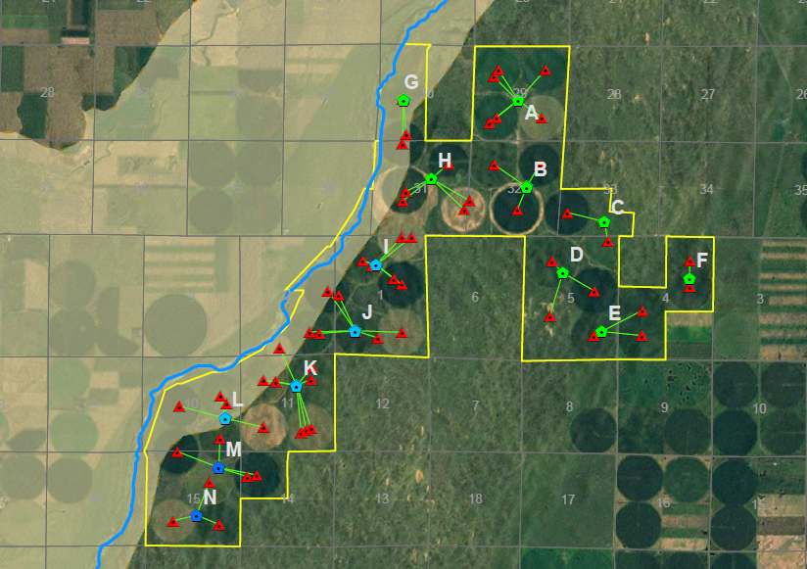

Slide 27
Process from here
DWR to complete its review of change applications and negotiations with the Cities on terms and conditions, including drafting of a master order and the individual approval documents
Send to GMD 5 and basin for review.
  Public meeting to gather input
Provisional approval of the change applications
Water Transfer Hearing and review

Slide 28
Questions & Discussion
Notes:
LANE

Slide 29
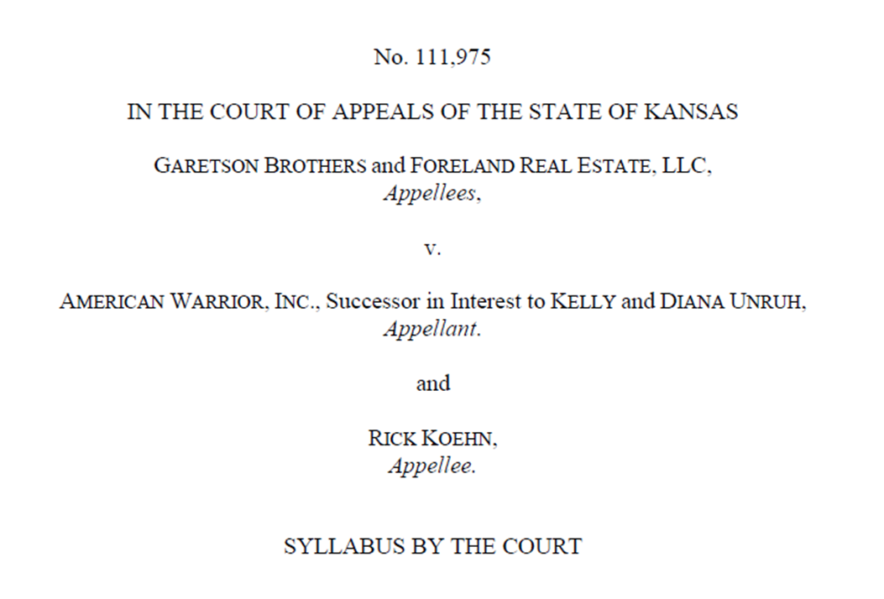
Court of appeals decision
K.S.A. 2014 Supp. 82a-707(c) provides that the first person to divert water from any source and use it for beneficial purposes has prior right thereto. In other words, "the first in time is first in right.“
K.S.A. 82a-716 and K.S.A. 82a-717a afford a senior water right holder the right to seek injunctive relief—and in some cases monetary damages—in order to protect his or her prior right against a junior water right holder.
Looking to the plain and unambiguous language of K.S.A. 82a-716 and K.S.A. 82a-717a, it is apparent that the legislature intended that the holder of a senior water right may seek injunctive relief to protect against a diversion of water by a holder of a junior water right when that diversion does or would diminish, weaken, or injure the prior right.

Slide 30
When does yes, become no?
At the meeting, the question was posed as to when DWR's "yes" in approving a new application or change application, becomes a "no" in our real-time administration of water rights. I replied that all approvals are done so as to minimize the potential for future impairment but are also approved contingent on vested and senior appropriator's rights being satisfied. Our approvals are thus a permission to use the water until such use interferes with the rights of a vested right user or senior appropriator. A requirement that our consideration of impairment in our approval processes determine that NO future impairment would EVER occur would lead us to routinely deny the majority of applications and cross purposes with the KWAA's intent to make water available for appropriation. In summary, the "yes" becomes "no" when we have a complaint and our investigation finds that the junior use is interfering with the senior use of the water.

Slide 31
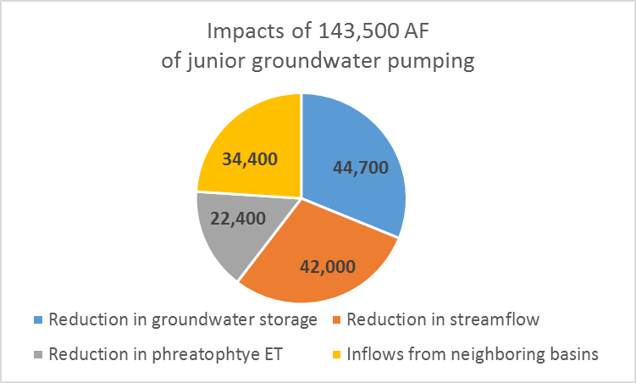

Slide 32
US FWS “Conditions on potentially acceptable solutions”, Dec 2016
1. Quantity - The impaired amount is already determined by the impairment report, so the combined remedy actions should be able to deliver a capacity of 5,000 AF.
2. Quality - water should be equal or better quality than what is being received currently.
3. Deadline or Timeline Based - Water delivery remedies should be based on a reasonable schedule of time, and not take years to begin implementation...Timelines for implementation should be identified in the plan.
4. Enforceable Actions - Any planning or proposal put in place must be enforceable, and not voluntary or incentive driven.
5. Minimal Legal Obstacles - Use options and solutions with the least amount of legal and statutory obstacles. Building pipelines and infrastructure on the refuge is big legal obstacle.
6. Augmentation - As the Service has mentioned on many occasions, the use of augmentation could be part of the remedy, but not the entire remedy. The Service prefers to maximize the use of other remedy actions prior to augmentation.
7. Augmentation Location - Any proposal that includes augmentation as part of the remedy would be more acceptable if planned from west of the refuge.

