Slide 1
Kansas Water Office & Kansas Department of Agriculture
March 2016

Slide 2
More than 80% of Phase I Action Items Complete or Actively Underway

Slide 3
Regional Advisory Committees

Slide 4
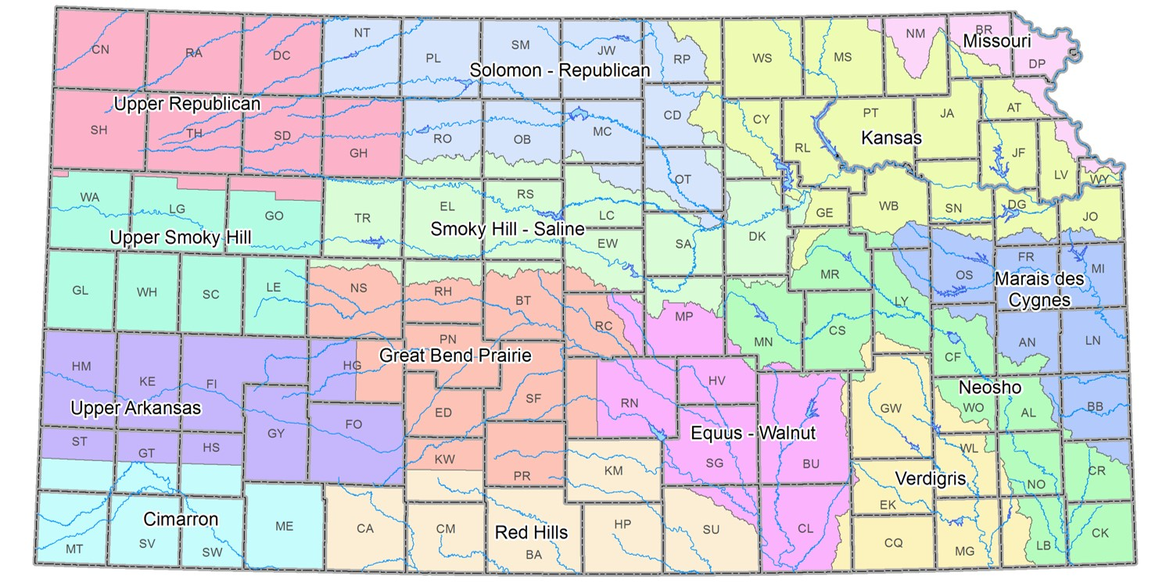

Slide 5
Regional goals prioritized
Newly formed Advisory Committees hit the ground running….
Reducing groundwater declines in the Ogallala top priority for western regions
Cimarron promoting conservation with flexibility and technology adoption
Upper Ark focused on LEMA and WCA development to achieve goal
Upper Smoky proposes 25% reduction by 2025. Net irrigation requirement not exceeded in the region
Upper Republican looking to partner with GMD #4 for goal setting and implementation
Great Bend Prairie and Equus-Walnut propose to achieve and maintain sustainability

Slide 6
Blue Ribbon Funding Task Force
Randall Allen—Kansas Association of Counties
John Bridson—Westar Energy
Colin Hansen—Kansas Municipal Utilities
Gary Harshberger—Kansas Water Authority
Terry Holdren—Kansas Farm Bureau
Karma Mason—KS Chamber & KWA
Erik Sartorius—League of Kansas Municipalities
Dennis Schwartz—KRWA & KWA
Matt Teagarden—Kansas Livestock Association
Tom Tunnell—Kansas Grain and Feed Association
Senator Jim Denning, Overland Park
Senator Tom Hawk, Manhattan
Senator Larry Powell, Garden City
Representative Jerry Henry, Atchison
Representative Steven Johnson, Assaria
Representative Sharon Schwartz, Washington
Robin Jennison— KDWP&T
Jackie McClaskey—KDA
Susan Mosier—KDHE
Tracy Streeter—Kansas Water Office

Slide 7
BRFTF Schedule
March 18 – 1-3pm
Funding demands from a state perspective
Follow up discussion from January meeting
April 19 – All day
Stakeholder/public input on funding needs and potential sources
RSVP requested to determine number of conferees
May – Establish revenue needs and begin identifying revenue options
August – Review draft report and public input
September – Consideration adoption of final report
November – Present recommendations at Governor’s Water Conference

Slide 8
Water Technology Farms

Slide 9
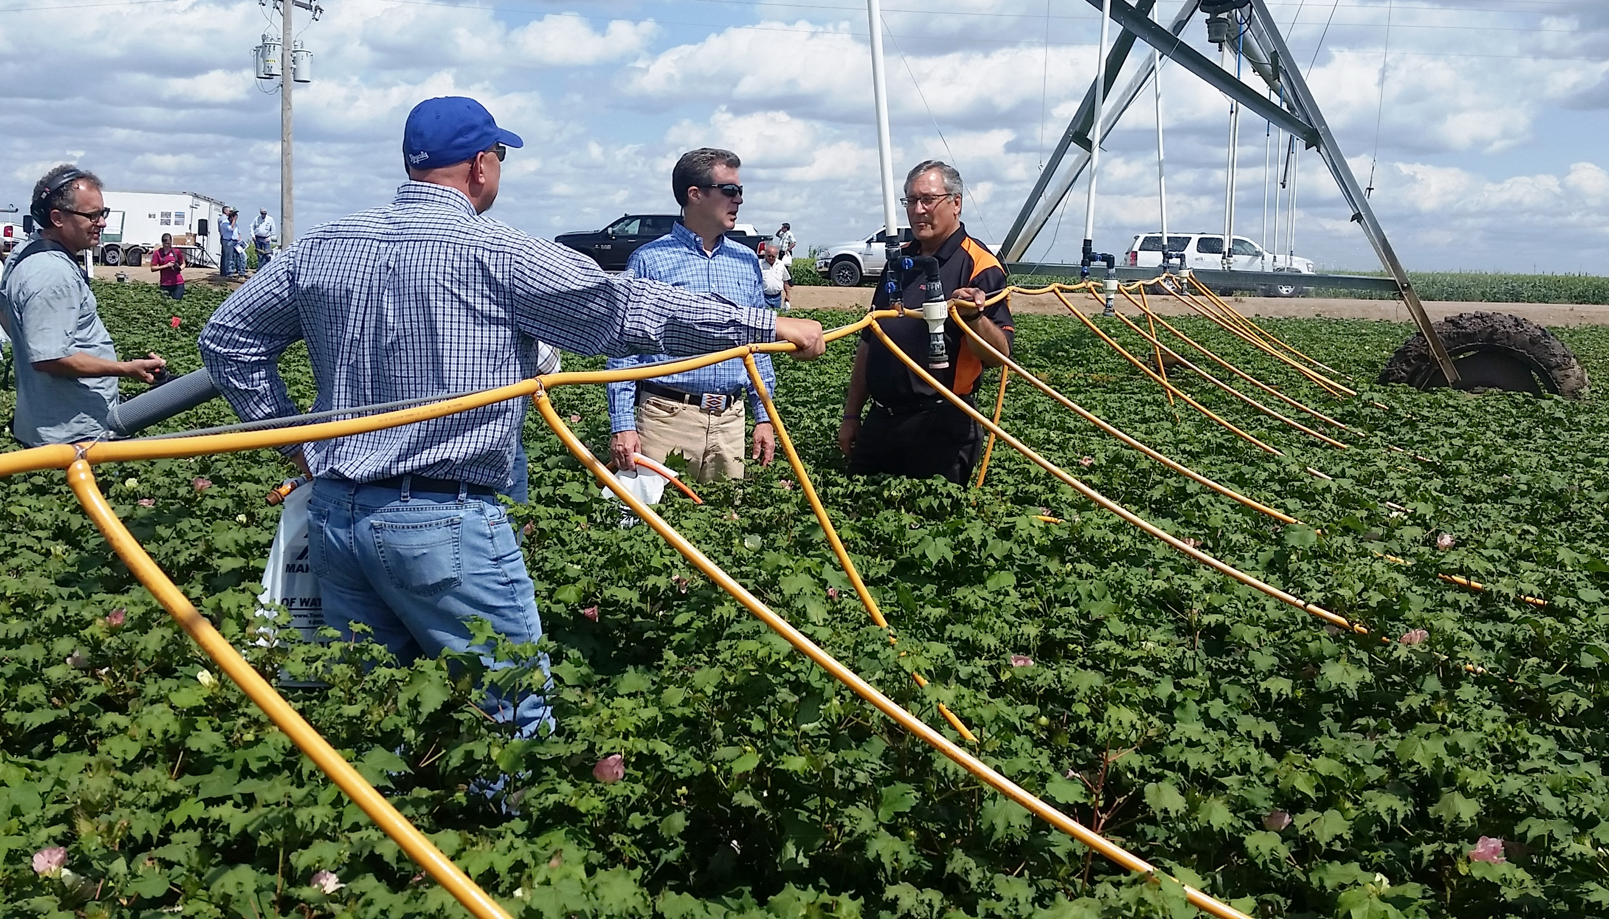
Technology farms gaining momentum……..
Provides for public/private partnerships
Local, state & federal contributions are possible
KWO has devoted funding to this effort
KSU and crop consultants play major roles
WCAs or LEMAs recommended to provide structure for water conservation goal
Education and outreach component included
Our goal is to have at least one technology farm in each of the western planning regions
So far, three farms exist….
Two in the Upper Ark
One in the Great Bend Prairie
Major component in the Water Vision
Objective – Reduce groundwater declines and maintain economic returns
Designed to promote field scale demonstration of various water saving opportunities
irrigation equipment
water management
cropping alternatives
telemetry

Slide 10
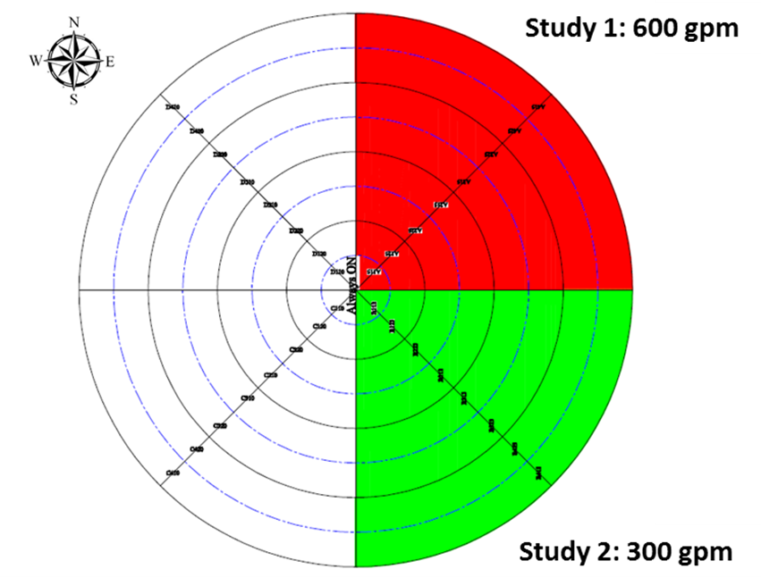
MDI Evaluation – KSU
2015 results comparing MDI to spray nozzles
30% reduction in evaporation
14” applied @ 600 gpm - 8” @ 300 gpm
247 bu/ac @ 600 gpm – 243 bu/ac @ 300 gpm
10% increase in yield with MDI on the 300 gpm well
Water evenly distributed in soil profile
Dry soil surface
Minimal wheel tracks

Slide 11
Water Conservation Areas (WCA)

Slide 12
Intensive Groundwater Use Control Areas (IGUCAs)
Local Enhanced Management Areas (LEMAs)
Red Tape
Water Conservation Areas (WCAs)

Slide 13
Water Conservation Areas (WCAs)
Local Enhanced Management Areas (LEMAs)
Local Control
Intensive Groundwater Use Control Areas (IGUCAs)

Slide 14
What are Water Conservation Areas (WCAs)
Signed into law in April 2015 by Governor Sam Brownback
Provide a tool to water right owners to extend the usable lifetime of the Ogallala-High Plains Aquifer
Developed by a water right owner or group of water right owners with the consent of the chief engineer to reduce water withdrawals while maintaining economic value via water right flexibility

Slide 15
Who is eligible?
Any groundwater water right owner(s) in an area of need of conservation:
Groundwater levels in the area are declining or have declined excessively;
Rate of withdrawal of groundwater within the area in question equals or exceeds the rate of recharge in the area;
Preventable waste of water is occurring or may occur in the area; or
Unreasonable deterioration of the quality of water is occurring in the area.

Slide 16
What are the benefits?
Conserving water resources extends the usable lifetime of the water supply
Participation may afford flexibilities that are not available to water right owners outside of a WCA
WCAs do not make any permanent change in enrolling water rights
Can be limited in duration to allow water right owners to try out the controls

Slide 17
Franklin Family WCA Terms
Water rights: Six across two townships in Sherman County
Conservation: Limit irrigation to no more 4,800 acre-feet every five years (~12 inches per acre, more than 2 inches less than NIR and far below GMD and county average)
Flexibility: Pooled allocation provided no single authorized quantity exceeded
Length: 15 years, evaluated every five years

Slide 18
Westside Dairy Terms
Water rights: Two water rights across four irrigated circles
Conservation: Limit diversions by a 15% conservation factor
Flexibility: Pooled allocation provided no single authorized quantity exceeded; term permit to allow rotation of irrigated acres
Length: Three consecutive one-year terms until 2018; review and renew for additional 5-year period

Slide 19
Rules and Regulations & legislation

Slide 20
Rules and Regulations
Civil and other penalties for overpumping and other violations of the Kansas Water Appropriation Act (To Be Submitted to Department of Administration)
Authority to seal meters (To Be Submitted to Department of Administration)
Demonstration needed for point of diversion moves in areas of significant decline (Delayed for Additional Evaluation)
Civil and other penalties for failure to submit a water use report (Legislative Change)

Slide 21
Category | Level A <24 Hours | Level B 24 – 72 Hours | Level C More than 72 Hours
No Penalty w/in 5 yrs | Written Notice of Non-Compliance | $1000 per day and a reduction in quantity equal to 2X quantity overpumped (not to exceed one year suspension) | $1000 per day and a reduction in quantity equal to 3X quantity overpumped (not to exceed one year suspension)
One Penalty w/in 5 yrs | $1000 per day and a reduction in quantity equal to 2X quantity overpumped (not to exceed one year suspension) | $1000 per day and a one year suspension | $1000 per day and a three year suspension
Two Penalties w/in 5 yrs | $1000 per day and a one year suspension | $1000 per day and a three year suspension | $1000 per day and a four year suspension
Three Penalties w/in 5 yrs | $1000 per day and a three year suspension | $1000 per day and a four year suspension | $1000 per day and a five year suspension

Slide 22
Authority to Seal Meters
Retain existing regulation authorizing seals to enforce a cease and desist to render pump or other diversion decide inoperable
K.A.R. 5-3-6a revised to allow the Chief Engineer or representatives to place a seal on flowmeters (bolt, chain, lock or any combination thereof) to prevent removal of flowmeter and access to internal working parts
Delegate authority to GMDs

Slide 23
Demonstration for PD Moves > 300 Feet
K.S.A. 82a-708b provides that water holders can apply for changes in a water right’s place of use, point of diversion or use made of water, without losing priority of right, provided:
the owner demonstrate to the chief engineer that any proposed change is reasonable and will not impair existing rights;

Slide 24
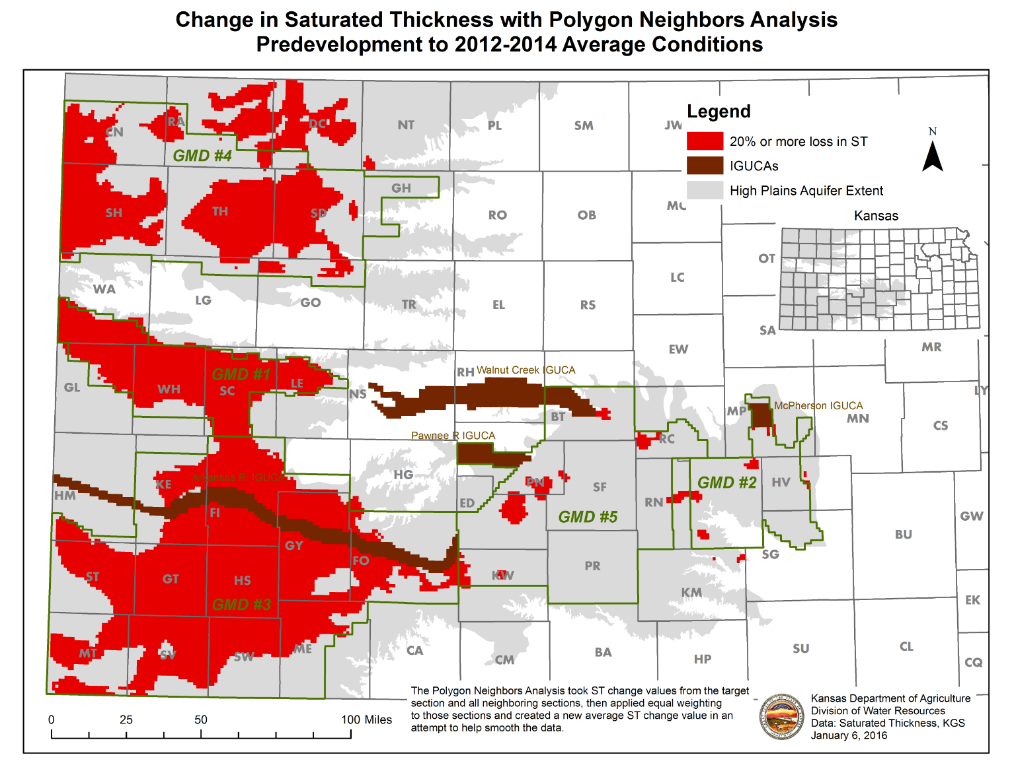

Slide 25
Demonstration for PD Moves > 300 Feet
No moves can be more than 1320 feet
No hop-scotching. No moves more than 1320 feet from the location of the point of diversion when the rule is implemented.
No moves more than 300 feet where the projected future saturated thickness is less than 40 feet, EXCEPT
Where a GMD has developed a regulation to specify a less future saturated thickness in their district

Slide 26
Demonstration for PD Moves > 300 Feet
Changes greater than 300 feet will still be permitted if they meet the demonstration. Many will.
Moves permitted when the effect of the change in location would not decrease the 50-year future saturated thickness by more than 20%
The effect of the change is the difference in two Theis analyses:
the maximum impact of the pumping well to the nearest neighboring well, at current location (with the current pumping rate and quantity) vs.
the maximum effect at the proposed location (with the proposed rate and quantity)
Spreadsheet of 50-Year Calculations http://dwr.kda.ks.gov/TempTransfer/TheisForExcel2010For300ftMoveRulev3.xlsm

Slide 27
Example Demonstration
Current location is 2398 feet from nearest well, pumping 196 acre-feet at 450 gpm.
Proposed location is 1795 feet fro nearest well, would pump 254 acre-feet at 915 gpm.
Best aquifer parameters used from GMD 3 model.
Projected future saturated thickness after 50 years is 62 feet.
20% of 62 feet is 12.4 ft, allowed as additional impact
Max. future impact at current location is 6.81 feet. At proposed location is 10.59 ft.
Difference is 3.78 ft. Ok.
Notes:
DAVID

Slide 28
Integrated stockwatering irrigation permits (ISIWR)
Notes:
LANE

Slide 29
Integrated stockwatering irrigation permits
Concept:
Allow for an existing water right associated with a stockwatering facility to be authorized for both irrigation and stockwatering use under the same right
Provide flexibility between uses as head count and the nutrient management plan fluctuates
Notes:
LANE

Slide 30
Integrated stockwatering irrigation permits
Certified irrigation water right can be changed to add stockwatering use if the irrigation water right current authorized point of diversion and place of use are retained
Authorize irrigation and stockwatering uses on the same water right, add the new place of use and use made of water allowing the flexibility of the quantity to be used for either use during a calendar year
Original irrigation right remains as authorized prior to the approval of the dual use water right if the dual use right should no longer be needed for stockwatering use
Conditioned requiring totalizing flowmeters installed to current specifications in a manner that will accurately measure both uses the right separately
Require filing a separate annual water use report for each beneficial use
Notes:
LANE

Slide 31
Stockwatering Facility Permit (SFP)
Notes:
LANE

Slide 32
Stockwatering Facility Permit (SFP)
Purpose: Approval of a 20 year term permit using multiple stockwatering water rights as base water rights to provide the quantity for the term permit.
Primary Focus: Existing stockwatering water rights; allow for flexibility in water use and application; Should alleviate overpumping on single wells and the need for after the fact term permits to cover the unauthorized use.
Goal: Improve water management by enabling flexibility in the use and application of water, while neither impairing existing water rights, nor increasing the total amount of water diverted from a source of supply, such that this flexibility has no long-term additional negative effect on the source of supply
Notes:
LANE
Purpose: Approval of a 20 year term permit using multiple stockwatering water rights as base water rights to provide the quantity for the term permit.
Primary Focus: Existing stockwatering water rights so there is no new water. The term permit will allow for flexibility in water use and application at an existing stockwatering facility. This should alleviate overpumping on single wells and the need for after the fact term permits to cover the unauthorized use.
Goal: To recognize that an opportunity exists to improve water management by enabling flexibility in the use and application of water, while neither impairing existing water rights, nor increasing the total amount of water diverted from a source of supply, such that this flexibility has no long-term additional negative effect on the source of supply

Slide 33
Requirements for the Stockwatering Facility Permit (SFP)
Must have certified water rights (base rights) that currently operate under common management and are currently authorized for STK.
Must establish a boundary for the SFP Term Permit, limited to the current combined physical limits of the STK facility which will become the overall place of use for the SPF.
Must determine a total quantity for the SFP that equals the current combined quantities for the STK water rights and must line up with KDHE’s waste permit.
The Base Water Rights selected for the SFP will overlap in place of use and shall be suspended while the SFP is authorized. The base water rights will retain full authority if and when the SFP is requested to be dismissed by the applicant.
The points of diversion of the base water rights placed into the SFP must be within 2 miles of the SFP point of diversion (geographic center of the project area).
Surface Water source of supply and Groundwater source of supply cannot be included on the same SFP application.
All base water rights must be in the same source of supply.
A base water right cannot be enrolled in multiple SFPs.
Notes:
LANE
Must have certified water rights (base rights) that currently operate under common management and are currently authorized for STK.
Must establish a boundary for the SFP Term Permit, limited to the current combined physical limits of the STK facility which will become the overall place of use for the SPF.
Must determine a total quantity for the SFP that equals the current combined quantities for the STK water rights and must line up with KDHE’s waste permit.
The Base Water Rights selected for the SFP will overlap in place of use and shall be suspended while the SFP is authorized. The base water rights will retain full authority if and when the SFP is requested to be dismissed by the applicant.
The points of diversion of the base water rights placed into the SFP must be within 2 miles of the SFP point of diversion (geographic center of the project area).
Surface Water source of supply and Groundwater source of supply cannot be included on the same SFP application.
All base water rights must be in the same source of supply.
A base water right cannot be enrolled in multiple SFPs.

Slide 34
Steps to Obtain a SFP
Step 1. The applicant determines which base water rights the owner wishes to enroll (suspend) under the SFP.
Step 2. Completes the application form listing each of the base rights the owner is suspending. The SFP Term Permit point of diversion is a specified geographic center for the SFP area, which will encompass all of the proposed base water rights.
Step 3. Designate the STK Place of Use.
Step 4. Sum up total quantity of water and proposed rate of diversion for the SFP.
Notes:
LANE

Slide 35
Legislative Items
Multi-Year Flex Accounts (SB 329)
Penalties for failure to submit water use reports (SB 337 & HB 2491)
Conservation Reserve Enhancement Program (CREP) (SB 330)
Water Right Filing Fee (SB 322/ S Sub H2059)

Slide 36
Questions & Discussion

