Slide 1
Balancing Surface and Groundwater Supplies
Groundwater Management Districts Association – Winter Conference
January 7, 2015
Michael J. Lacey, Director
Arizona Department of Water Resources

Slide 2
ADWR’s Role & Scope
Administers the state’s water laws, explores methods of augmenting water supplies to meet future demands, and works to develop public policies that promote conservation and equitable distribution of water
Innovative system of laws, rules and management authorities that differ for each type and source of water that has supported Arizona’s Economic Development
Bifurcated system where surface water is regulated separately from groundwater
Title 45 of the Arizona Revised Statutes

Slide 3
ADWR’s Critical Functions
Colorado River Management
Administer Assured and Adequate Water Supply Program
Administer Recharge and Recovery Program
Administer Groundwater Rights and Surface Water Rights Programs
Statewide Regional Planning
Represents the State of Arizona in Indian Water Rights Settlements
Dam Safety and Flood Mitigation
Hydrology

Slide 4
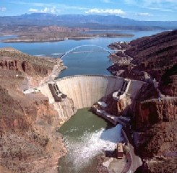
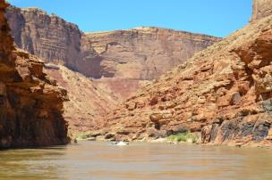
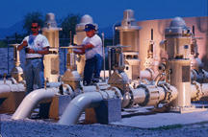
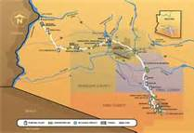
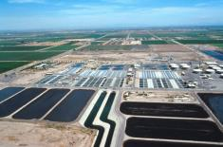
Sources of Water In Arizona
Groundwater
Surface Water
Colorado River Water
Main Stem
Central Arizona Project
Reclaimed Water

Slide 5
Arizona’s Water Supply Annual Water Budget
Water Source | Million Acre-Feet (maf) |  | % of Total
SURFACE WATER
Colorado River |  | 2.8 | 39.4 %
CAP | 1.6 |  | 22.5%
On-River | 1.2 |  | 16.9%
In-State Rivers |  | 1.4 | 19.7%
Salt-Verde | .9 |  | 12.7%
Gila & others | .5 |  | 7.0%
GROUNDWATER |  | 2.7 | 38.0%
RECLAIMED WATER |  | 0.2 | 2.8%
Total |  | 7.1 maf
Source: ADWR, 2014

Slide 6
Surface Water Management
Definition: “waters of all sources, flowing in streams, canyons, ravines or other natural channels, or in definite underground channels, whether perennial or intermittent, floodwaters, wastewater, or surplus water, and of lakes, ponds, and springs on the surface” (A.R.S. § 45-141)
Doctrine of prior appropriation governs use
Pre - June 12, 1919 Process
Public Water Code (1919)

Slide 7
Public Water Code
Enacted on June 12, 1919
Provides that a person must apply for and obtain a permit in order to appropriate surface water
Pre-1919 Statement of Claim
Post-1919 Statutory Permit
Stockpond Registration
Sever and Transfers
Court Decreed
Federal Reserved Right (Winters Rights)
The Adjudication

Slide 8
Beneficial Uses
Basis, Measure and Limit to the use of water
Beneficial uses are:
domestic (which includes the watering of gardens and lawns not exceeding one-half acre),
municipal
irrigation
stockwatering
recreation
wildlife including fish
Non-recoverable water storage
mining

Slide 9
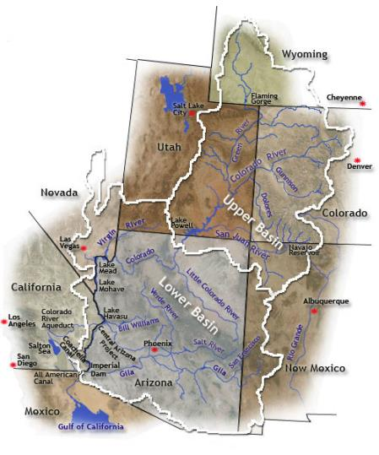
Colorado River Basin
Approx. 1,400 miles
Connecting Seven States and the Country of Mexico
Drainage of approximately 242,000 square miles
Serves approximately 40 million people
Irrigates approximately 5 million acres of land
Historic Flows between 5MAF and 25MAF
Average Annual Flow 15MAF
Governed By “The Law of the River”

Slide 10
Law of the River
1922 - Colorado River Compact
1928 - Boulder Canyon Project Act
1929 - California Limitation Act
1931 - Seven Party Agreement (California)
1944 - Arizona Contract for Delivery of Water
1944 - Mexican Water Treaty
1948 - Upper Colorado River Basin Compact
1956 - Colorado River Project Storage Act
1964 - AZ. v. CA. Decree
1968 - Colorado River Basin Project Act
1970 - Criteria for Coordinated Long-Range Operation of Colorado River Reservoirs
1972 - Grand Canyon Protection Act
1973 - Minute 242*
1974 - Salinity Control Act
2001 - Colorado River Interim Surplus Guidelines
2007 - Colorado River Interim Guidelines for Lower Basin Shortages and the Coordinated Operations of Lake Powell and Lake Mead
2012 - Minute 319*
* Part of the 1944 Water Treaty with Mexico. There are also several other Minutes that are part of the Law of the River

Slide 11
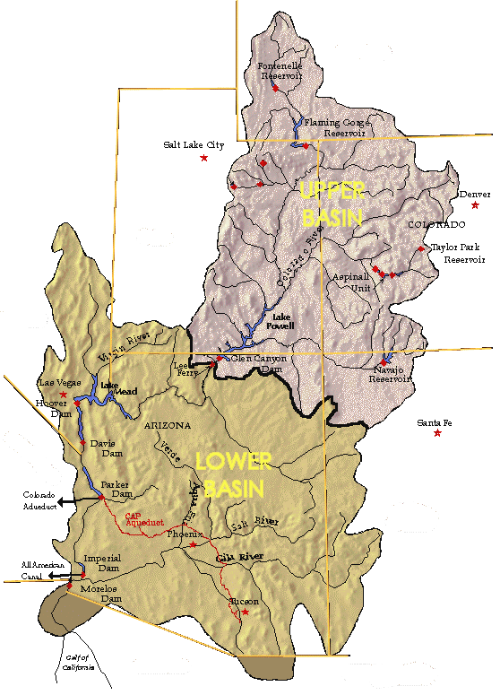
Colorado River Allocations
Upper Basin (7.5 maf)
UPPER
BASIN
Lower Basin (7.5 maf)
CA – 4.4 maf
AZ – 2.8 maf
NV – 0.3 maf
LOWER
BASIN
Arizona Upper Basin – 50 kaf
Mexico 1.5 maf

Slide 12
Colorado River Management Programs Overview
Entitlement Oversight
Monitors mainstem Colorado River and Central Arizona Project entitlements and recommends allocations and transfers of these water supplies.
Planning & Operations
Collaborates with the federal government, and representatives of the seven basin states to better prepare for Arizona’s long term needs and by taking an active role in water use projections, monitoring of hydrologic conditions and hydroelectric projects.
Environmental Programs
Participates in programs such as the Lower Colorado River Multi-Species Program, the Glen Canyon Dam Adaptive Management Program and the Colorado River Basin Salinity Control Forum.
Bi-National Negotiations
Represents the State in comprehensive binational partnership for management of Colorado River resources.

Slide 13
Groundwater Management Statewide Provisions
New Wells - Must file an “Notice of Intent” before drilling any well
Licensing of Well Drillers
Registration of all wells
Groundwater Transportation Protections
Underground Storage & Recovery
Community Water Systems Reporting & Planning
Notes:
13

Slide 14
Groundwater Management Act
Passed in 1980
Created Arizona Department of Water Resources
Goals of the Groundwater Management Act:
Control severe groundwater depletion
Provide the means for allocating Arizona's limited groundwater resources to most effectively meet the state's changing water needs
Augment Arizona’s groundwater supplies through development of additional water supplies
Preserve groundwater for use in drought

Slide 15
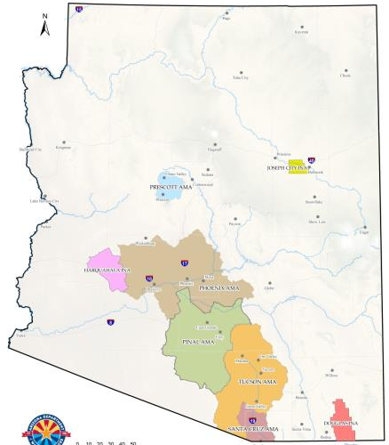
Groundwater Management
Active Management Areas (AMAs)
Phoenix
Pinal
Prescott
Tucson
Santa Cruz
Irrigation Non-Expansion Areas (INAs)
Harquahala
Douglas
Joseph City

Slide 16
Active Management Areas
Five Active Management Areas
Highest degree of regulation in State
Management Goals & Planning - Mandatory conservation requirements for most users (municipal, agricultural and industrial)
Need withdrawal authority to pump >35 gallons per minute
Must measure and report water use >35 gallons per minute
New “Non-Exempt” wells may require hydrologic impact analysis
Well spacing rules

Slide 17
Active Management Area Goals
Phoenix AMA: To achieve safe-yield by the year 2025
Pinal AMA: To preserve agricultural economy for as long as feasible, while considering the need to preserve groundwater for future non-irrigation uses
Prescott AMA: To achieve safe-yield by the year 2025
Tucson AMA: To achieve safe-yield by the year 2025
Santa Cruz AMA: To maintain a safe-yield condition in the active management area and to prevent local water tables from experiencing long term declines

Slide 18
Irrigation Non-Expansion Areas
Three Irrigation Non-Expansion Areas
Harquahala, Douglas and Joseph City
Groundwater depletion is not as severe as AMAs but requires further regulation
No new irrigated lands
Substitution of acres possible

Slide 19
Grandfathered Groundwater Rights
Based on historic pumping (1975-1979)
Irrigation grandfathered rights
Type 1 non-irrigation grandfathered rights
Converted from an Irrigation GFR
Type 2 non-irrigation grandfathered rights
Based on historic pumping for a non-irrigation purpose
Portable within AMA of Origin

Slide 20
Service Area Rights
City/town/private water company/irrigation districts: Pumping and Delivery to Non-Irrigation Customers
Untreated water provider: Pumping and Delivery to Landscapes Via Non-Potable Distribution System
Expandable Rights: Grow to Serve Service Area Population

Slide 21
Assured Water Supply Program
Inside Active Management Areas
Established in 1980
Rules adopted in 1995
Arizona Department of Real Estate cannot issue Subdivision Plats without 100-year AWS Demonstration
Certificates of Assured Supply
Service by water provider with Designation of Assured Supply
Public Notice Process
Certificates
Designations
On-Line Application Status

Slide 22
Adequate Water Supply Program
Outside the Active Management Areas
Established in 1973
Consumer advisory program
Plats can be approved with inadequate determination. Disclosure of inadequate water supply required to first buyer
Water Reports
Service by water provider with Designation of Adequate Supply
Required Public Notice Process
Designations of Adequacy
Water Reports
On-Line Application Status

Slide 23
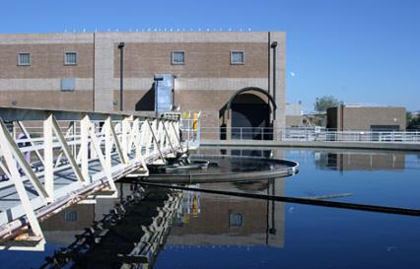
Underground Storage and Recovery Program
Recharge
Storing excess water supplies for future use
Underground Water Storage and Recovery (1986)
Underground Storage and Recovery Act (1994)
Consolidated Programs
Types of Storage
Annual Storage & Recovery
Long Term Storage
Sources of Stored Water
Reclaimed
Central Arizona Project
Surface Water
91st Ave Wastewater Treatment Plant

Slide 24
QUESTIONS?

Slide 25
ARIZONA’S NEXT CENTURY Strategic Vision for Water Supply Sustainability
Groundwater Management Districts Association – Winter Conference
January 7, 2015
Michael J. Lacey, Director
Arizona Department of Water Resources

Slide 26
What We Have Accomplished

Slide 27
What We Have To Address
Source: WRDC, 2011

Slide 28
What We Are Doing Arizona Strategic Vision for Water Supply Sustainability
Purpose:
Identify viable strategies to guide Arizona in addressing future water needs, providing a stable economy for our future – for all water users.
Uses existing information (CRBS, WRDC, Az. Water Atlas, Water Level Monitoring, AMA Assessments)
Identify Local Options First
Identify Priority Strategies

Slide 29
Arizona’s Strategic Vision
Water Supply and Demand Analysis
Arizona (2010) Water Resources Development Commission | Total statewide demands Current - 6.9 MAF 2035 - 8.1 MAF 2110 - 10.6 MAF Projected imbalance between 900,000 and 3.2 MAF over the next 25 to 100 years
Reclamation (2012) Colorado River Basin Water Supply & Demand Study | Colorado River Basin-Wide average imbalance of 3.2 MAF by 2060 Arizona’s projected imbalance between 260,000 to 1.4 MAF by 2060

Slide 30
Arizona’s Strategic Vision Water Supply Opportunities
Non-Indian Agricultural (NIA) Priority CAP water
Reclaimed Water/Water Reuse
Groundwater in storage
potable, poor quality & brackish supplies
Water Supply Development
Revised Watershed Management Practices
Weather modification
Rainwater Harvesting/Stormwater Capture (large-scale or macro)
Importation or Exchange of New Water Supplies Developed Outside of Arizona (e.g., Ocean Desalination)

Slide 31
Arizona’s Strategic Vision Challenges
Complex Physical Water Supply Availability
Land Ownership
69% of Lands in Arizona Federally Owned & Managed
Federal Reserve Rights
Access to Water Supplies and Transmission of Future Water Supplies
NEPA/ESA/CWA Compliance
General Stream Adjudication
Outstanding Tribal Water Rights Claims
Complex Water Rights System

Slide 32
Arizona’s Strategic Vision Strategic Priorities For Moving Arizona Forward
Identify the Role of In-State Water Transfers
Resolution of Federal and Non-Federal Water Rights Claims
General Stream Adjudication
Indian Water Rights Settlements
Continued Commitment to Water Conservation & Reuse of Reclaimed Water – Including Direct Potable Reuse
Comprehensive Statewide Data Collection & Analysis
Modeling Local Conditions
Supply Importation - Desalination
Funding
Rural Infrastructure
Business, Community and State Leader Engagement

Slide 33
Arizona’s Strategic Vision Roll Out Process
Whistlestop Tour (46 So Far)
GUACs Watershed Groups Water Users/Associations
ITCA IBWC SE AZ Community Forum Homebuilder Reps
AHS AZ House & Senate Chambers of Commerce
WRRC Agribusiness & Water Council Arizona Congressional Delegation
Topic Specific Engagement
Desalination
Design Build Finance Reps Mexican Water Officials
Water Transfers
DCDC Dialogue – ADWR / Yuma Reps
Reuse
Adjudication Process
Economic Development/Finance Alternatives
Next Steps Planning - Integration

Slide 34
Arizona’s Strategic Vision Conclusions
Ultimately, the State of Arizona is not facing an immediate water crisis
There are some local areas that require more immediate action
Growing statewide imbalance between existing water supplies and demand projected in the next 25 years
The lack of an immediate problem increases the potential for inaction
Arizona’s History is its Future!
We must continue to invest and develop new water supplies and infrastructure to support economic growth
Arizona needs a continuing Strategic Vision for Water Supply Sustainability to guide its economic stability through the next century

Slide 35
Arizona’s Strategic Vision for Water Supply Sustainability
Questions?
Michael J. Lacey
Director
mjlacey@azwater.gov
Phone: (602) 771-8426

